Slide 1
Innovation types
Ing. Zuzana Repaská, Ph.D.

Slide 2
Innovations
Innovation is the practical application of ideas that result in different new types of new offerings, like
  …,
  …,
  …and
  …
  intending to improve or disrupt existing applications or creating new solutions.
It doesn’t matter if you are getting the ideas from outside the organization, through brainstorming, combining of existing ideas, or radical new thinking within your field.
But it should be at … and it should … to ensure business survival.

Slide 3
Peter Drucker point of view
Innovation is the specific … , whether in an existing business, a public service institution, or a new venture started by alone individual in the family kitchen.
It is the means by which the entrepreneur either creates new wealth-producing resources or endows existing resources with enhanced potential for … .

Slide 4
8 fields of innovations
Innovation can be in different forms and outcomes. When we talk about innovation, most people think of new products while there is a wide array of different innovation outcomes possible. Here we list the most common:
1. Product & Product Performance Innovation
Either a … is developed or the … is improved.
This kind of innovation is very common in the business world.

Slide 5
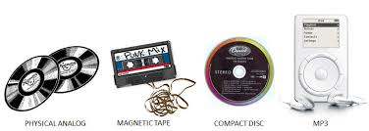
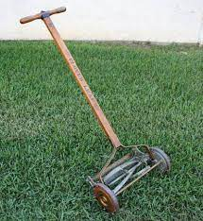
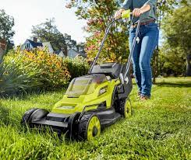

Slide 6
8 fields of innovations
2. Technology Innovation
New technologies can be also the basis for many other innovations.
The best example was the … , which was itself an innovation but also lead to other innovations in various fields.

Slide 7
8 fields of innovations
3. Business Model Innovation
Many of the most successful companies in the world managed to innovate their business model.
Using … , … and … can lead to new possible business models which can create, deliver and capture customer value.
Digital ecosystems are a well-known example of innovation using several technologies and creating a whole new type of business.

Slide 8
8 fields of innovations
4. Organizational Innovation
Managing and sharing … in a new way can also be an innovation.
It’s possible to use resources and assets in a completely … .
5. Process Innovation
Innovation in the processes can improve the … or … of existing methods.
Possible process innovations involve production, delivery, or customer interaction.

Slide 9
8 fields of innovations
6. Marketing / Sales – New Channel Innovation
New methods to capture and hold attention from customers. Either through the use of innovative marketing/sales concepts or the use of new channels for customer acquisition/sales.
7. Network Innovation
By connecting different … and … it might be possible to create extra value. This type of innovation is very common due to the use of ICT services.

Slide 10
8 fields of innovations
8. Customer Engagement / Retention
Innovative concepts that try to increase the engagement of customers and keep the retention up.
The goal is to have innovative models to keep the customers “locked-in” or engaged.

Slide 11
4 types of innovations
First, we need to understand that there are various ways that innovation can have an impact on products, services, and processes.
Most commonly we differentiate between 4 levels of innovation:
  … ,
  … ,
  … and
  … .

Slide 12
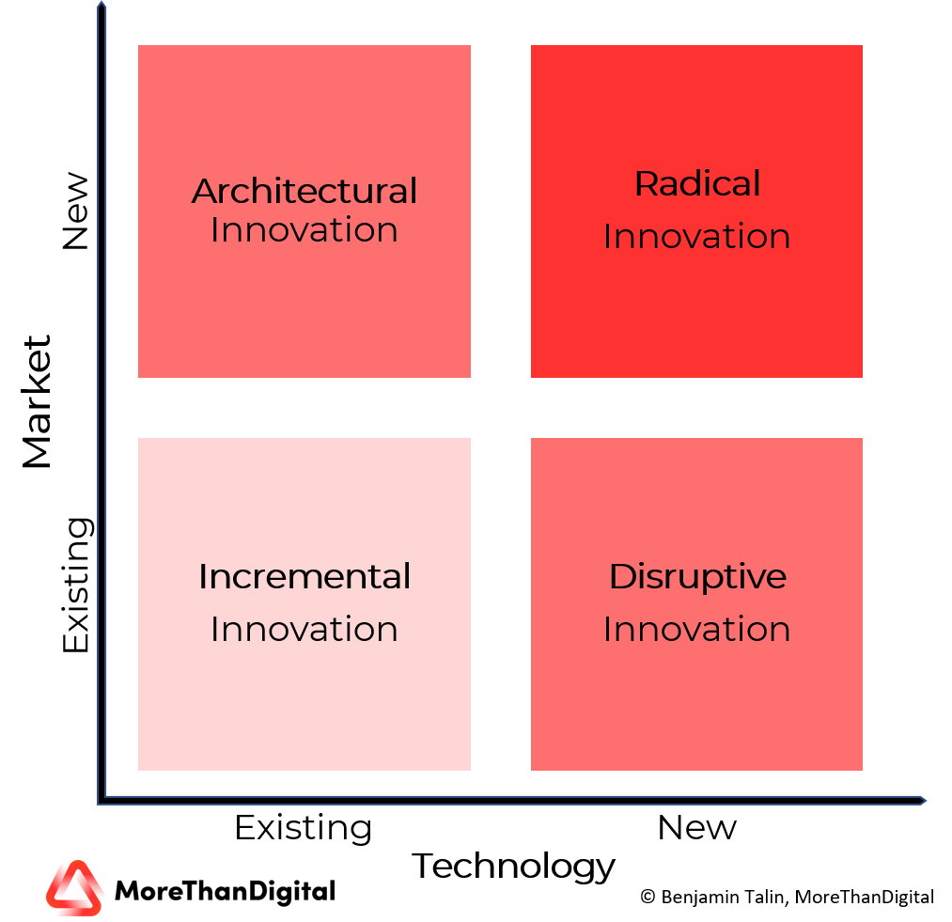

Slide 13
4 types of innovations
1. Incremental Innovation
… , …
One of the most common forms of innovation that we can observe. It uses existing technologies within an existing market. The goal is to improve an existing offering by adding new features, changes in the design, etc.
Example
The best Example for incremental innovation can be seen in the Smartphone market where the most innovation is only … , improving … , or adding some … , etc.

Slide 14
4 types of innovations
2. Disruptive Innovation
… , …
Disruptive innovation is mostly associated with applying new … , … , or … to existing industries. Sometimes new technologies and business models seem, especially in the beginning, inferior to the existing solutions but after some iterations, they surpass the existing models and take over the market due to efficiency and/or efficacy advantages.

Slide 15
4 types of innovations
Examples
Amazon used Internet-Technologies to disrupt the existing industry for … . They had the existing market for … but changed the way it was sold, delivered and experienced due to the use of disruptive technologies. Another example was the … , where existing technologies in the market (Phones with buttons, keypads, etc.) were replaced with touch-interface-centered devices combined with intuitive user interfaces.

Slide 16
4 types of innovations
3. Architectural Innovation
… , …
Architectural innovation is something we see with tech giants like Amazon, Google, and many more at the moment. They take their domain … , …, and … and apply them to a different market. This way they can open up new markets and expand their customer base.
Examples
Especially digital ecosystem orchestrators like … and … use this innovation strategy to enter new markets. They use existing expertise in building … , … , and … to offer new services and products for different markets. A recent example for this: …

Slide 17
4 types of innovations
4. Radical Innovation
… , …
Even it is the stereotypical way most people see innovation; it is the rarest form of them all. Radical innovation involves the creation of technologies, services, and business models that open up entirely new markets.
Example
The best example of radical innovation was the invention of the … . This radical new technology opened up a new form of travel, invented an industry, and a whole new market.

Slide 18
How to encourage innovations in a business
Innovation is sometimes a key critical area for the survival of many businesses and industries.
But encouraging your employees to come up with new ideas can be sometimes stressful.
Task:
What would you do to encourage innovations in your business?

Slide 19
How to encourage innovations in a business
…
…
…
…
…
…
…
…
…
…

Slide 20
Protection of innovations
Innovation is a calculated risk that needs to be addressed.
Not all projects will be successful, and the company’s process needs to be managed to filter out potential fails before they have a too big impact on your innovation budget.
Try to streamline the process and maybe create your own innovation program which covers some of the points mentioned above.
This way you can manage it better and get a better overview.
There are many ways in which you can protect your innovation. We focus here on the 2 major protection methods which are either “legal protection” or being the market leader due to a “first-mover advantage”.

Slide 21
Protection of innovations
1. Legal Protection
Depending on the type of innovation, it might be useful to … your invention to monetize it and protect it from others.
There also needs to be an understanding of the … .
While the initial cost might not be as high, it can be that the legal costs to enforce possible patent infringements can skyrocket and make it harder for smaller companies to get their right.
It is also important to understand that not everything can be protected and patented. While products, processes, and technologies are usually easier to be protected/patented, it’s harder/impossible to protect software or business models.

Slide 22
Protection of innovations
2. First-Mover Advantage
Especially software companies make use of the first-mover advantage. A company that has a new process, new business model, or new product tries to get as much market share as possible while the competition is still developing its offering.
This headstart gives the first-mover the advantage of incrementally improving the product. This way it’s possible to grab a market share and offer a better product/service faster than others.

Slide 23
Digital ecosystem
One of the most promising (and already proven) digital business models of the 21st century now is the … and … . This is why it’s important to understand what digital ecosystems are and what roles you can have in these ecosystems.
The variety of digital ecosystems is already broad and most of the well-known ecosystems span … and involve … of industry, partners, competitors, customers, and businesses. This defies also traditional mindsets in the industry. The “… ” approach is breaking apart and a mindset of “… ” comes forward. That is why it is also one of the most successful disruptive business models.

Slide 24
Digital eCosystem example: Amazon
Since around the year, 2000 Amazon is constantly building on its digital ecosystem. First, the retail giant needed to build a giant server infrastructure around the globe to be able to serve the customers of their e-commerce platform. But soon Amazon began to rent out server capacity to other businesses. This step leads to Amazon Web Services (AWS) and was an important milestone for the company to create this massive ecosystem they have right now.
Amazon used its own AWS infrastructure not only to supply other companies with infrastructure services but also used it as a launchpad for all other services like Amazon Prime Videos, Prime Music, Studio, etc. This led to a fast build-up of services around the Amazon universe and also a kind of lock-in for many users. They had the advantages of being a prime customer and receive packages faster, had access to Amazon Music, and even were able to watch series and movies from the prime library.

Slide 25
Digital eCosystem example: Amazon
Amazon later then involved a lot of outside companies to participate in this ecosystem. So were the e-commerce part the first one to open up and allow even competitors to use this infrastructure of services and tools Amazon offered. This made them a huge success when looking at their whole Amazon ecosystem.
The following overview gives you a quick glimpse into the vast ecosystem Amazon built. There are more than 40 subsidiaries of Amazon today and there will be more in the future.

Slide 26
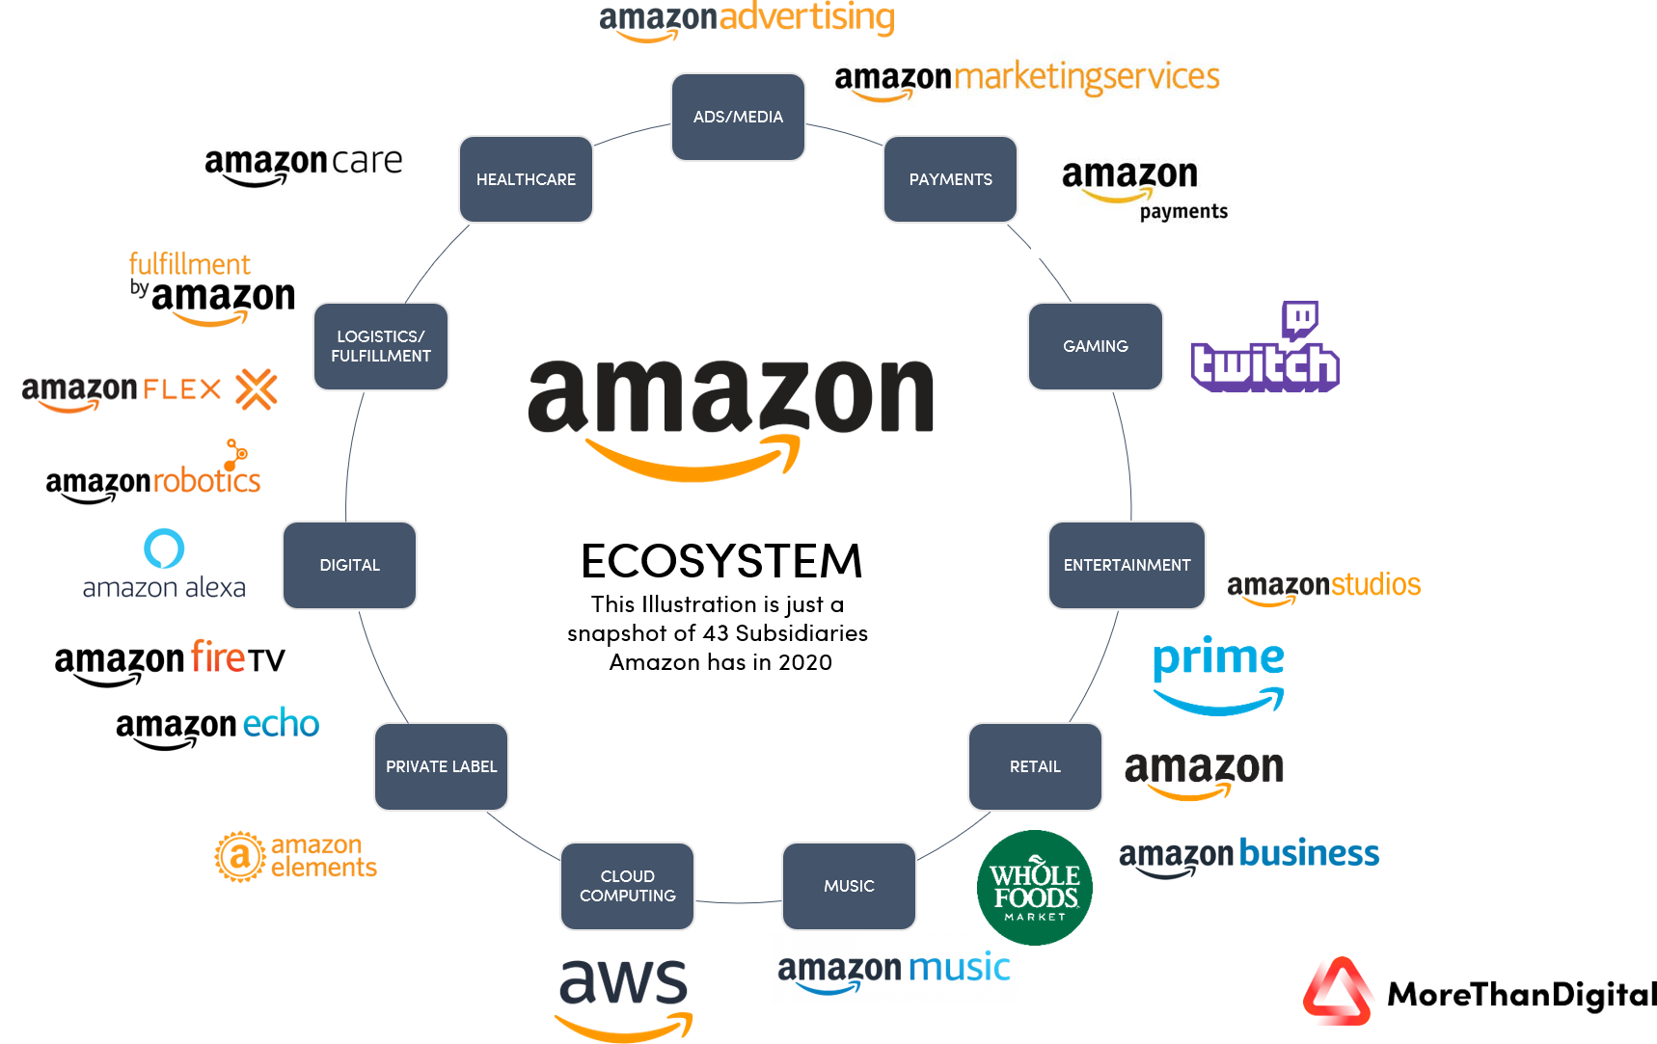

Slide 27
Digital ecosystem
A digital ecosystem is focusing on … to customers by optimizing data and workflows from different internal departments, tools, systems, as well as customers, suppliers, and external partners.
It should remove … from the customer journey and enable every participant in the ecosystem to use state of the art technologies and systems to fulfill their individual needs.
For these ecosystems offer customers a unified and easy to use system that delivers value through a variety of services, products, and insights. This also allows the platforms to grow exponentially and outpace the normal market by using several mechanics involved.

Slide 28
Digital ecosystem
This also means that a … are possible when scaling an ecosystem. From direct sales of products and services to advertisements, subscriptions, and many more. By understanding the customer better and realigning the product offering it is possible to grow the number of services and products offered with the numbers of insights gathered from the customers. This makes the digital ecosystems so … and also so … that the list of the most valuable companies in the world is led by companies harvesting the power of digital ecosystems.
There you find Apple, Google, Facebook, Microsoft, and many more who are using their customer base and an ecosystem approach to grow revenues and offer better products and services to their customers.

Slide 29
5 key characteristics of digital ecosystem
1. …
When looking at the most successful digital ecosystems you see the strict focus on … .
Sometimes these ecosystems didn’t even have a monetization model at the beginning as they focused on the customer and understanding the customer like we will learn in the next chapter about data before they even start to put a price tag on services or offerings.

Slide 30
5 key characteristics of digital ecosystem
1. Customer-Centric
Being customer-centric doesn’t only look at customer service or the personalized advertisements/marketing the company offers, it’s more of a whole spectrum customer centricity which is only possible due to the scale of the business.
This means … and … and … collaboration to integrate the customer journey as well as possible.

Slide 31
5 key characteristics of digital ecosystem
Data-Driven
One of the main advantages of using a digital ecosystem is the possibility to gather further information about … , … , … , and more. This makes data one of the key drivers for every digital ecosystem.
The more you can know about the … the better you can offer services, software, technology, and tools to improve the customer journey throughout.

Slide 32
5 key characteristics of digital ecosystem
2. …
Due to the enormous insights, digital ecosystems gather from customers, suppliers, and third parties, it is also possible to make this insight actionable.
Automation is one of the key elements in lowering … , improving … but also offering new services/products to increase the value stream.

Slide 33
5 key characteristics of digital ecosystem
3. …
Digital ecosystems are there to scale and by limiting them mostly to countries or regions you will never get the benefit of using a platform and an ecosystem.
This means that digital ecosystems also need to be built to make … , geographies, and even … .
Sometimes even cultural barriers need to be addressed.

Slide 34
5 key characteristics of digital ecosystem
4. …
Due to the scale of digital ecosystems, it’s also worth mentioning that the mindset must be very dynamic.
Ecosystems need to adapt … and react to changing market dynamics fast, otherwise, the user base will move onwards and switch the platform.
Business … , fast … , and also the use of new technologies and business models need to be at the heart of every decision.

Slide 35
3 roles in a digital ecosystem
Before you begin imagining yourself as an ecosystem builder you need to deep-dive into your company and your offerings.
This also means that you need to map out which ecosystems are important for you and what role you will have in which ecosystem.
There are in general … your company can have in an ecosystem.

Slide 36
3 roles in a digital ecosystem
1. …
These companies take the risk, complexity, and also the challenges of building a digital ecosystem.
These are companies like Amazon, Alibaba, Ping, etc. who enable others to participate in an ecosystem and sell goods and services through this system.

Slide 37
3 roles in a digital ecosystem
2. …
These are companies that contribute to the ecosystem and monetize value in different ecosystems. One of the best-known modular producers might be ….
With their service, they offer different platforms and ecosystems the service to have a unified payment gateway, so customers can pay easily. A modular producer can add core services to ecosystems that meet consumers, business needs but also buyers and sellers in a way.

Slide 38
3 roles in a digital ecosystem
3. …
The customer can be a … or an … , and it extracts value from the ecosystem. When you book an … then you are a customer of the ecosystem that Airbnb has created and orchestrated.
The boundaries are sometimes fluid. So, for example, someone who is a user of Facebook is a … (content) and … (advertisements) at the same time.
Also, companies can find themselves sometimes using, sometimes orchestrating, or sometimes adding services to multiple digital ecosystems.

Slide 39
3 types of digital ecosystem
Functional Digital Ecosystem
This is one of the simplest ecosystems and gets usually built around an existing product or offering of a company. It has a … … … … (maybe 10-100) and is very focused on the internal aspect. Due to its simplicity and easy integration, it is also the most widely used ecosystem we can find across the globe. But limitations also apply as the data collection and further integration is complicated as this is most of the time a closed ecosystem.

Slide 40
3 types of digital ecosystem
Examples of these functional ecosystems can be found in the … … where the platforms get connected to the digital services of the partners involved to create a very product-centric ecosystem of a smart and connected car, mostly limited to a limited number of products.

Slide 41
3 types of digital ecosystem
Platform Ecosystem
More advanced ecosystems are the digital platform ecosystems. They can involve … … and also can incorporate a multitude of digital offerings. This digital ecosystem is very much based on the “data first” approach to leverage the customer insights to further upsell or design new offerings due to the data generated.
But the biggest differentiator is the common platform under which all the partners participate and create their value with/from. So, the ecosystem orchestrator is offering a common platform under which all the connected parties work together.

Slide 42
3 types of digital ecosystem
Google Home is a good example of this. Google is the provides a common platform under which developers, producers and engineers can work together to create home appliances which use the Google Home platform to become connected and smart.
Google itself is developing tools like their home speaker but also partners can use the platform ecosystem to offer their products and services.

Slide 43
3 types of digital ecosystem
Super Platform Ecosystem
One of the most … and … ecosystem models involves the integration of different platforms and the use of different user journeys including their data. Super Platform Ecosystems involve usually many different industries, different services and are trying to connect the whole user journey to the ecosystem as good as possible. Most Super Platform Ecosystems are now found in the hands of tech giants like … , … , … , … and some others.

Slide 44
3 types of digital ecosystem
WeChat, the … , is a perfect example of creating a Super Platform Ecosystem. The app now covers all important aspects of the user’s life. In a single platform it offers thousands of services and features including everyday … , … , … , … and more.
With every added offering, WeChat can integrate more into daily life thus enabling better data collection which can lead to new offerings and a “lock-in”.

Slide 45
Task 1:
What makes a World's Most Innovative Company?
  Write the answers on the basis of the following video:
    https://www.youtube.com/watch?v=MBO5DCmNUBQ

Slide 46
Task 2:
Make brief notes – 5 secrets of innovative companies – describe each of them.

