Slide 1
Biomimicry innovations inspired by nature
Ing. Zuzana Repaská, Ph.D.

Slide 2
Innovations and new technology inspired by nature
Biomimicry
  ………………………………………. ………………………………………………………………………………………
  means ………………………………………………
  is the process of taking the innovations that exist in nature and applying them to technology
    What is biomimicry?
      https://youtu.be/FBUpnG1G4yQ

Slide 3
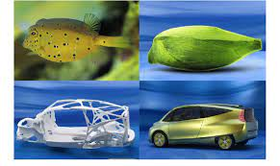
biomimicry
Some of the tools, vehicles, and products that you see on a daily basis, or use, have been ……………………………… ………………………………
Biomimicry represents innovations that have changed the world for the better and have made your life a little bit ……………………………….

Slide 4
Biomimicry examples
Kingfisher & The Shinkansen Train
First on the list the Kingfisher and the story of the Shinkansen.
Japan produces some of the most efficient and fast trains of the world, with speeds in the excess of ……………………………… km/h.
However, when traveling at these speeds after emerging from a tunnel the trains would produce a sonic boom, a huge source of noise pollution that plagued local Japanese residents. So, what did engineers do?

Slide 5
Biomimicry examples
With the help of a little biomimicry, engineers turned to an unlikely source, the Kingfisher. With their elongated beak, Kingfisher birds are able to travel between the air and water with very little splash while hunting.
Engineers redesigned the train in the image of the bird, giving the train a long beak-like shape at the front of the train.
With this simple upgrade, the engineers were able to reduce the noise of the train with the added benefits of having a train that uses ……………………………… less electricity, and that is ……………………………… faster than the original.

Slide 6
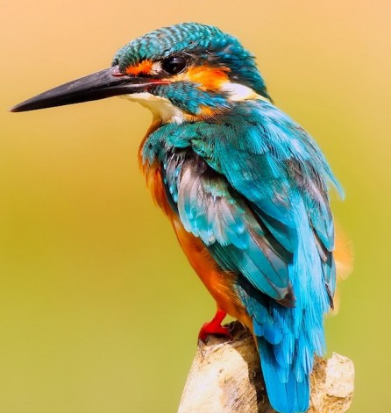
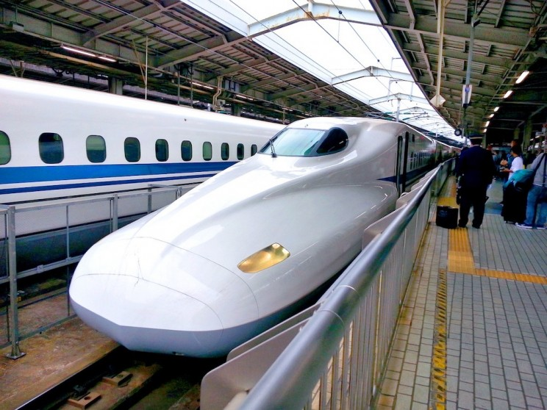
bioMimicry examples

Slide 7
bioMimicry examples
Whales & Wind Turbines
  Whales are some of nature’s largest creatures, yet they are widely aerodynamic, being some the best swimmers, divers and jumpers in the ocean. What contributes to this? Like an airplane, the whale’s fins are its ………………………………, unique because of the bump protrusions on the fins, called tubercles.
  The efficiency at which a whale can swim has inspired serrated-edge wind turbines; turbines that themselves are far quieter and efficient than the smooth blades that are more commonly known.
  https://youtu.be/FMG5Ah1g8rM

Slide 8
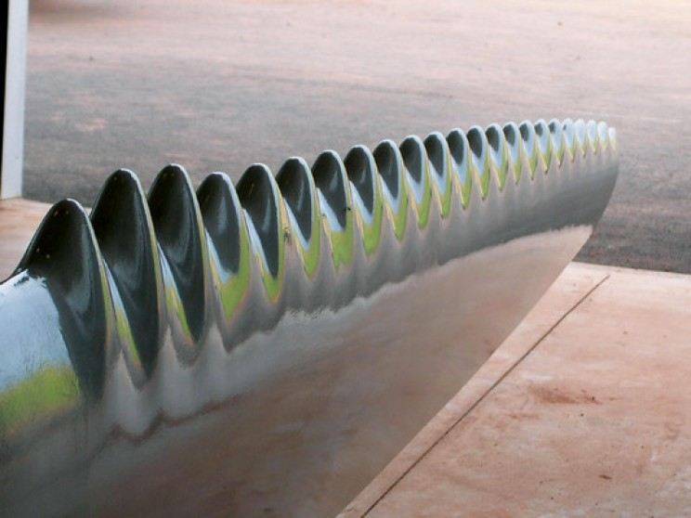
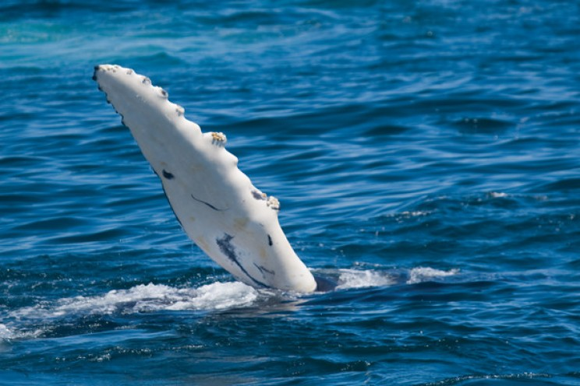
bioMimicry examples

Slide 9
bioMimicry examples
Sharks & Aquatic Vehicles
  After NASA examined the microscopic pattern of shark skin, they created their own laboratory shark skin or riblets film to use on a host of products. Why? Sharks are some of nature's most efficient swimmers.
  The small little grooves or dentricles in sharkskin significantly reduces the drag of a vessel when its attached to the surface. This sharkskin film is used on a host of everyday objects like coatings for ship’s hulls, submarines, aircraft, and even swimwear for humans.
  https://youtu.be/jHGTZmKWEnU

Slide 10
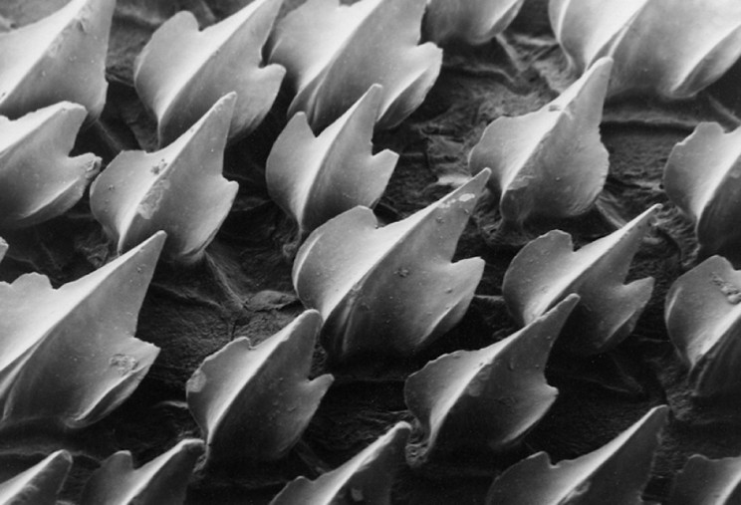
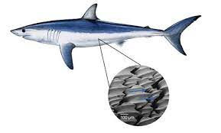
bioMimicry examples

