Slide 1

Papers and Electronic Documents, Electronic Signature, Dynamic Signature
Moravian Business College Olomouc
Lukáš Pavlík, Ph.D.
Department of Informatics and Applied Mathematics
E-mail: lukas.pavlik@mvso.cz

Slide 2
Papers and Electronic Documents – Main Difference
In content, electronic documents are no different than paper documents.
All sorts of documents are subject to discovery electronic or otherwise.
Legally and technically, there are substantial differences between the discoveries of the two media.
“Some 93 percent of documents are now created electronically, according to industry reports.
And 70 percent of documents never migrate to paper.

Slide 3
Papers and Electronic Documents – Main Difference
No matter what the legal status of discovery of electronic documents will be, the prevalence of electronic documents makes them a major discovery issue.
The following is a list of discovery-related differences between electronic documents and paper ones.
We assume that a paper document is a document that was created, maintained, and used on actual paper; it is not a hard copy of an electronic document.

Slide 4
Papers and Electronic Documents – Main Difference
This point is obvious to the majority of observers.
Today’s typical disks are at several dozens gigabytes and these sizes grow constantly.
A typical medium-size company will have PC’s on the desks of most white-collar workers, company-related data, accounting and order information, personnel information, a potential for several databases and company servers, an email server, backup tapes, etc.

Slide 5
Papers and Electronic Documents – Main Difference
Such a company will easily have several terabytes of information.
Accordingly, such a company has over 2 million documents.
Just one personal hard drive can contain 1.5 million pages of data, and one corporate backup tape can contain 4 million pages of data.
Thus the magnitude of electronic data that needs to be handled in discovery is staggering.
In most corporate civil lawsuits, several backup tapes, hard drives, and removable media are involved.

Slide 6
Papers and Electronic Documents – Main Difference
Paper documents can be ledgers, personnel files, notes, memos, letters, articles, papers, pictures, etc.
This variety exists also in electronic form.
But then spreadsheets are way more complex than ledger, for example.
They contain formulas, may contain charts, they can serve as databases, etc.
In addition to the additional information, e.g. charts, the electronic spreadsheet supports experimentation with what-if version the discoverer may want to investigate.

Slide 7
Electronic Documents Contains Attributes Lacking in Paper Form
Computers maintain information about your documents, referred to as “metadata,” such as: author’s name, document creation date, date of it last access, etc.
A hard copy of the document does not reveal metadata, although certain metadata items may be printed.
Depending on what you do with the document after opening it on your computer screen, the actions taken may change the metadata collected about that document.

Slide 8

Electronic Documents Contains Attributes Lacking in Paper Form
Paper documents were never that complex.

Slide 9
Electronic Documents Contains Attributes Lacking in Paper Form
Text documents allow you to pick fonts, use colors, use shade selectively, use watermark and change the background and text.
Spreadsheets allow one to selectively display rows and columns, hide formulae and write complex macros.
Many other document types have similar and additional attributes you may employ.
Attributes such as hiding parts of the document are significant to discovery that may tries to be informed about the hidden parts.

Slide 10
Electronic Documents Contains Attributes Lacking in Paper Form
Electronic documents are more efficient than paper documents
Document efficiency is not a standard term.
Here, Document Efficiency means factors such as:
use of less space,
easier to change,
cost of delivery,
faster to search.

Slide 11
Electronic Documents Contains Attributes Lacking in Paper Form
Factor | Electronic | Paper
Space | personal file systems are physically smaller than a small cell phone | stored locally in filing cabinets
Easy to change | can be edited, copied, modified and merged with almost complete ease | requires in most cases recreating document all over again
Delivery speed and cost | by networks, disks, flash memory and CD/DVD | by mail or manually
Search/access | multiple users may access documents simultaneously | multiple users to access documents simultaneously one needs a set of documents per each accessing person

Slide 12
Electronic Documents are More Persistent
Paper documents are easy to destroy.
They may be throwing away, shredding, burned, lost or stolen.
Once such acts take place the documents disappear.
Deleting an electronic document eliminates only the ubiquitous accessible copy.
The document, i.e. its data, still exists and in systems such as Windows and Mac OS, an accessible reference to deleted documents may be in the trash bin.
Restoring a document in the trash bin, i.e. a deleted document, revives the document to its original glory.

Slide 13
Electronic Documents are More Persistent
Even removing the document from the thrash bin does not erase the documents data off the disk.
Once removed from the thrash bin, documents data areas on the disk go into a “fee list” that makes those areas available for future data creation needs.
The free list contains all areas not currently allocated to active documents as well as to deleted documents still in the trash bin.
How long will an area stay on the free list (thereby still containing the deleted documents data)?
That is difficult to predict due the huge variability of factors such as: future demand for disk space, size of current and future files, the current availability of disk space, etc.

Slide 14
Electronic Documents are More Persistent
Even the complete deletion of a document, its trash bin instance and the allocation of the document’s data area on the disk does not typically extinguishes the document altogether.
Certain habitual practices create copies of documents and are only marginally affected by document deletion:
Backups – most organizations and individuals regularly create back up copies of documents as precautionary actions.
The backups are maintained independently of the document itself.
Documents may be exchanged by email, access through web pages and manually handed electronic copies.
Thus copies continue to exist after the deletion of the original document.

Slide 15

Electronic Documents are More Persistent
Even work on a simple text document is quite frequently preceded by creating a copy of the document being edited.
Once again, such copies persist beyond the deleted document unless specifically deleted.

Slide 16
Electronic Documents Change Faster and Easier than Paper Documents
Changes to an electronic document are fast and easy.
The reason is obvious; all you need to do is make the change and save it.
Changes to paper documents, however, require retyping the whole document.
There are many other reasons to the difference in speed and frequency. We already said that documents may be dynamic.
Web pages are made dynamic in order to ease change.
For discovery, faster and frequent changes imply a need for a more meticulous and length monitoring of document discovery.

Slide 17
The Redundancy in Electronic Documents is Higher
Due to the type of recording used for electronic data, minor errors in a document can be corrected by existing tools.
The tools rely on the redundancy of checksums and other devices.
MS Word tries to recover defective documents.
Due to frequent changes in documents, individuals learn to save previous versions of the documents.
Doing that generates redundancy of document versions.
Emails, flash memories, CDs all proliferate documents and result in high redundancy.
One copies documents to flash memory, attaches a document to an email to a fellow worker or create a CD for distribution or archiving.

Slide 18
The Redundancy in Electronic Documents is Higher
Most companies and many individuals backup documents regularly.
Studies show that “about 70 % of enterprises meet the criteria of verifying the integrity of their backup media at least weekly.
Tools to control versioning of files create built-in redundancy wherever they are applied.
Versioning, i.e. version control, widely used by the software industry has started to infiltrate word processor as well as other applications.
Versioning, by its very definition maintains several versions.

Slide 19
Electronic Signature
In the modern world, everything has digitalized with time.
From online shopping to automation of complex business functions, everything is digital today, and it lays the foundation of our future as well.
One of the things that has become popular is electronic signatures or e-signatures.
However, because it appears to be easy to sign a document online, many are often concerned about the legality of e-signatures.
Does the e-signature on a legal agreement give the document any legal status?

Slide 20
Electronic Signature
The first thing you have to know is what an e-signature is.
Just like your inked signature, signing documents online is a way for you to sign documents, except that e-signatures are multi-dimensional.
There are many ways for you to do it.
You could use an e-signing tool that gives you the ability to sign a document with a mouse click or draw your signature on a digital document using a mouse.
The presence of such a signature on a document may or may not give it a (stronger or weaker) legal status, depending on various factors that you will read later in the guide.

Slide 21
Electronic Signature - Legality
Now that you know what e-signatures are, you must be wondering about their legality.
Yes, you could put an electronic signature on a document but does doing so make the document legal?
Electronic signatures are legally binding in thirty European countries, the United States and the vast majority of countries around the world.
An electronic signature can carry the same weight and legal effect as a traditional paper document with a pen and ink signature.

Slide 22

Electronic Signature - Legality
An electronic signature can carry the same weight and legal effect as a traditional paper document with a pen and ink signature.

Slide 23
Who has Signed?
This is the part where the identity of the signatory must be verifiable.
There are a number of methods that can be used to perform identity verification such as using verification via SMS, email, electronic ID, for example, BankID in Sweden.
The stricter the identity control there is in the method, the higher the security the method offers.
On top of this, a lot of information about every request made to the document or contract are saved and logged.
It is important to remember that none of these identification method is 100 % secure, even though digital is almost always better than the analog alternative!

Slide 24
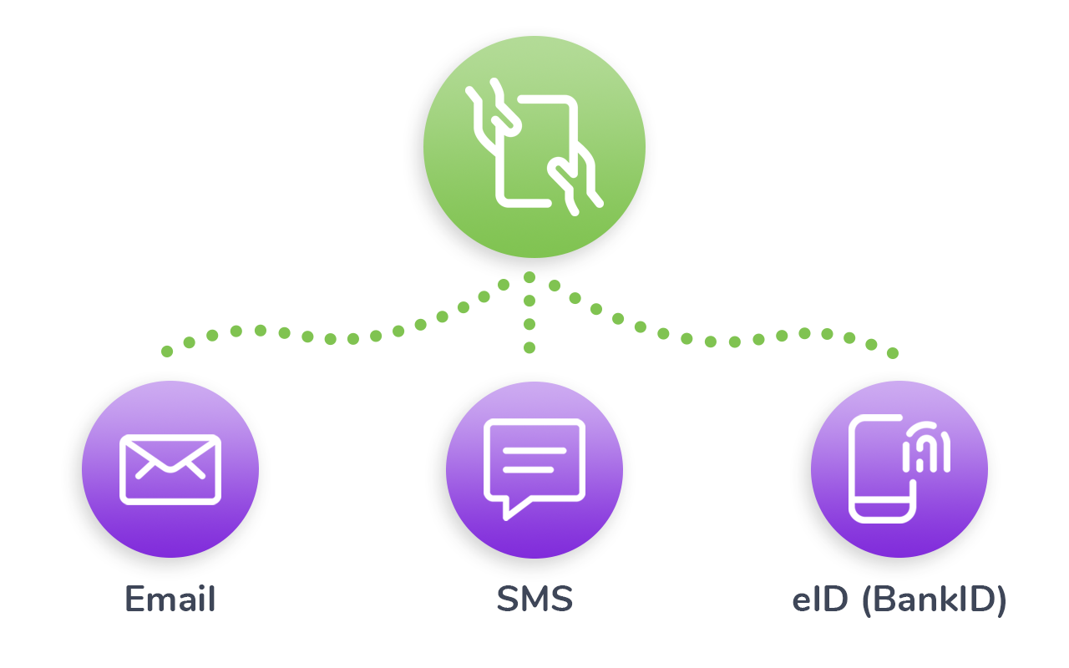
Who has Signed?

Slide 25
What was Signed?
The next part that affects the legal status of a signed document is the content of the document and the intent of the parties.
What was signed?
Did the parties invite to the contract intend to sign and legally commit to the document?
This is where the contract content and what the parties stated in the signed version of the document matter.
If a contract changes before being signed, then the new wording becomes a new contract offer.
If there is more than one party invited to sign the document, then the contract is only signed when all have signed, thus agreeing on the common content.

Slide 26
Has the Document Been Changed or Tampered with After Signing?
The final part that is important to determine the legal status of an electronically signed document is the integrity of the document after signing.
This means that after the parties have signed the document, it must be kept intact and not be modified or tampered with.
By using an electronic signature based on PKI, the document gets hashed and signed using an asymmetric encryption key pair.
The integrity of the document is thereby protected so that even a slight change in the document, e.g. change of a comma, a point or space, would create a different hash value, thereby revealing that a change has occurred.

Slide 27

Has the Document Been Changed or Tampered with After Signing?

Slide 28
Qualifications for an E-signature to be Legally Binding
As you can tell by now, not every electronic signature will be found to be legally binding.
Obviously, you cannot just take a picture of your signature on a piece of paper, crop it, and paste in your documents to use it for making the documents “legal”; this method will not provide any decent level of evidence as someone else can easily copy-paste it from your document to another document.
The legal value of an electronic signature will depend on its ability to prove who applied it, the identity of that person and that the signed data has not changed after signing.

Slide 29
Regulation of Electronic Signatures
The types of signatures described above are described in more detail in the eIDAS (electronic IDentification, Authentication and trust Services) Regulation of the European Union.
eIDAS is a comprehensive regulation dealing with electronic identification and trust services for electronic transactions in the European Single Market.
In the US the ESIGN Act is regulating e-signatures on the federal level.
Oneflow follows the standards and best practices set out in or following from the eIDAS regulation.
eIDAS: Electronic Identification and Trust Services Regulation
ESIGN Act: It stands for US Electronic Signatures in Global and National Commerce Act
UETA: Uniform Electronic Transactions Act

Slide 30
eIDAS
eIDAS’ is shorthand for ‘electronic identification and trust services’.
It refers to a range of services that help verify the identity of individuals and businesses online or the authenticity of electronic documents.
Read the key definitions section of this guide for more detail on specific types of trust services.
The eIDAS Regulation is Regulation (EU) 910/2014 on electronic identification and trust services for electronic transactions in the internal market.
It came into effect on 1 July 2016.
As a European Regulation, it has direct effect in UK law and automatically applies in the UK.

Slide 31
eIDAS
There are also some specific provisions on its effect, supervision and enforcement in the UK set out in the Electronic Identification and Trust Services for Electronic Transactions Regulations 2016 (the UK eIDAS Regulations).
The UK eIDAS Regulations were amended by the Data Protection Act 2018 to reflect changes in the Commissioner's investigative powers.
The Regulation aims to enhance trust in electronic transactions between businesses, citizens and public authorities by providing a common legal framework for the cross-border recognition of electronic ID and consistent rules on trust services across the EU.

Slide 32
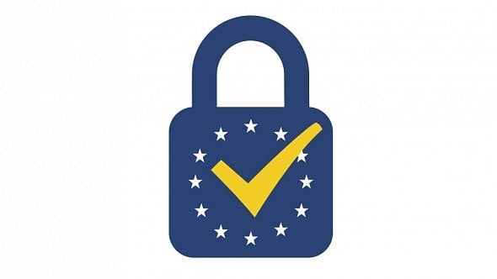
eIDAS
For more information on the eIDAS Regulation and relevant binding implementing decisions adopted by the European Commission, visit the Commission webpages on trust services and eID.
The European Union Agency for Network and Information Security (ENISA) also provides expert advice and recommendations on the implementation of the eIDAS Regulation.

Slide 33
eIDAS
Chapter II of the Regulation provides a framework which will allow European citizens to use electronic ID to access online public services in other EU member states by September 2018.
The UK’s national electronic identification scheme is Verify, and responsibility for this part of eIDAS lies with the Government Digital Service (GDS).
Chapter III of the Regulation sets out requirements for trust services.
It also sets out what trust service providers need to do in order to gain qualified status, which entitles them to be listed on a trusted list and to use an EU trust mark.
This guide focuses on the trust service provisions in Chapter III of the eIDAS Regulation.

Slide 34
eIDAS
The ICO is the UK supervisory body for the trust service provisions of the eIDAS Regulation.
We can grant and revoke qualified status for trust service providers established in the UK, report on security breaches, carry out audits and take enforcement action.
We also cooperate with supervisory bodies in other EU member states, and submit annual reports to the European Commission and to ENISA.

Slide 35
Dynamic Signature
Dynamic signature is a biometric modality that uses, for recognition purposes, the anatomic and behavioral characteristics that an individual exhibits when signing his or her name (or other phrase).
Dynamic signature devices should not be confused with electronic signature capture systems that are used to capture a graphic image of the signature and are common in locations where merchants are capturing signatures for transaction authorizations.

Slide 36
Dynamic Signature
Data such as the dynamically captured direction, stroke, pressure, and shape of an individual’s signature can enable handwriting to be a reliable indicator of an individual’s identity (i.e., measurements of the captured data, when compared to those of matching samples, are a reliable biometric for writer identification.)
The first signature recognition system was developed in 1965.
Dynamic signature recognition research continued in the 1970s focusing on the use of static or geometric characteristics (what the signature looks like) rather than dynamic characteristics (how the signature was made).
Interest in dynamic characteristics surged with the availability of better acquisition systems accomplished through the use of touch sensitive technologies.

Slide 37
Dynamic Signature
In 1977, a patent was awarded for a “personal identification apparatus” that was able to acquire dynamic pressure information.
Dynamic signature recognition uses multiple characteristics in the analysis of an individual’s handwriting.
These characteristics vary in use and importance from vendor to vendor and are collected using contact sensitive technologies, such as PDAs or digitizing tablets.
Most of the features used are dynamic characteristics rather than static and geometric characteristics, although some vendors also include these characteristics in their analyses.
Common dynamic characteristics include the velocity, acceleration, timing, pressure, and direction of the signature strokes, all analyzed in the X, Y, and Z directions.

Slide 38
Dynamic Signature
The X and Y position are used to show the changes in velocity in the respective directions while the Z direction is used to indicate changes in pressure with respect to time.
Some dynamic signature recognition algorithms incorporate a learning function to account for the natural changes or drifts that occur in an individual’s signature over time.

Slide 39
Dynamic Signature
The characteristics used for dynamic signature recognition are almost impossible to replicate.
Unlike a graphical image of the signature, which can be replicated by a trained human forger, a computer manipulation, or a photocopy, dynamic characteristics are complex and unique to the handwriting style of the individual.
Despite this major strength of dynamic signature recognition, the characteristics historically have a large intra-class variability (meaning that an individual’s own signature may vary from collection to collection), often making dynamic signature recognition difficult.
Recent research has reported that static writing samples can be successfully analyzed to overcome this issue.

Slide 40
Thank you for your attention

