Slide 1
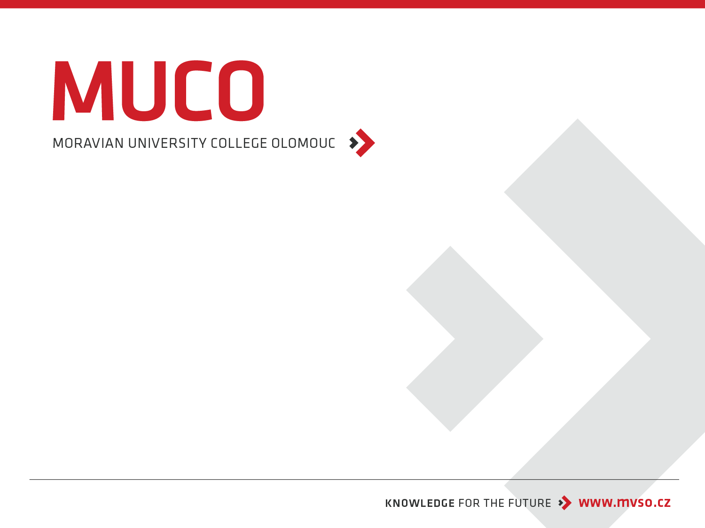
Information Security Management System - ISO / IEC 27000, ITIL, COBIT
Moravian Business College Olomouc
Lukáš Pavlík, Ph.D.
Department of Informatics and Applied Mathematics
E-mail: lukas.pavlik@mvso.cz

Slide 2
Information Security Management System - ISMS
Every technology-driven business process is exposed to security and privacy threats.
Sophisticated technologies are capable of combating cybersecurity attacks, but these aren’t enough: organizations must ensure that business processes, policies, and workforce behavior also minimize or mitigate these risks.
Because this path is neither easy nor clear, companies adopt frameworks that help guide towards information security (InfoSec) best practices.
This is where information security management systems come into play—let’s take a look.

Slide 3
Information Security Management System - ISMS
An information security management system (ISMS) is a framework of policies and controls that manage security and risks systematically and across your entire enterprise—information security.
These security controls can follow common security standards or be more focused on your industry.
For example, ISO 27001 is a set of specifications detailing how to create, manage, and implement ISMS policies and controls.
The ISO doesn’t mandate specific actions; instead, it provides guideline on developing appropriate ISMS strategies.

Slide 4
Information Security Management System - ISMS
The framework for ISMS is usually focused on risk assessment and risk management.
Think of it as a structured approach to the balanced tradeoff between risk mitigation and the cost (risk) incurred.
Organizations operating in tightly regulated industry verticals such as healthcare or national defense may require a broad scope of security activities and risk mitigation stratégy.

Slide 5
Information Security Management System - ISMS
While ISMS is designed to establish holistic information security management capabilities, digital transformation requires organizations to adopt ongoing improvements and evolution of their security policies and controls.
The structure and boundaries defined by an ISMS may apply only for a limited time frame and the workforce may struggle to adopt them in the initial stages.
The challenge for organizations is to evolve these security control mechanisms as their risks, culture, and resources change.

Slide 6
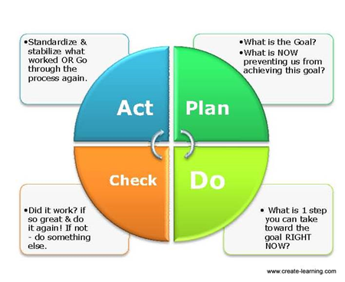
Information Security Management System - ISMS
According to ISO 27001, ISMS implementation follows a Plan-Do-Check-Act (PCDA) model for continuous improvement in ISM processes:

Slide 7
Information Security Management System - ISMS
Plan. Identify the problems and collect useful information to evaluate security risk. Define the policies and processes that can be used to address problem root causes. Develop methods to establish continuous improvement in information security management capabilities.
Do. Implement the devised security policies and procedures. The implementation follows the ISO standards, but actual implementation is based on the resources available to your company.

Slide 8
Information Security Management System - ISMS
Check. Monitor the effectiveness of ISMS policies and controls. Evaluate tangible outcomes as well as behavioral aspects associated with the ISM processes.
Act. Focus on continuous improvement. Document the results, share knowledge, and use a feedback loop to address future iterations of the PCDA model implementation of ISMS policies and controls.

Slide 9
Information Security Management System – ISO 27001, 27002
ISO/IEC 27001 is the international security standard that details the requirements of an ISMS.
ISO 27001, along with the best-practice guidelines contained in ISO 27002, serve as two excellent guides to get you started with implementing an ISMS.
A certified ISMS, independently audited by an approved certification body, can serve as the necessary reassurance to customers and potential clients that the organization has taken the steps required to protect their information assets from a range of identified risks.

Slide 10
Information Security Management System – ISO 27001, 27002
The strength of an ISMS is based on the robustness of the information security risk assessment, which is key to any implementation.
The ability to recognize the full range of risks that the organization and its data may face in the foreseeable future is a precursor to implementing the necessary mitigating measures (known as ‘controls’).
ISO 27001 provides a list of recommended controls that can serve as a checklist to assess whether you have taken into consideration all the controls necessary for legislative, business, contractual, or regulatory purposes.

Slide 11
Information Security Management System – ISO 27001, 27002
The history of the ISO 27001 standard refers to the British Standard 7799, published in 1995.
After undergoing a series of revisions, this standard originated the standard known as ISO/IEC 17799.
With a second part of BS 7799 regarding the implementation of an Information Security Management System and published in 1999, it was established the standard now known as ISO 27001.
This standard was established in 2005 with the publication of a new revision made in 2013 to accommodate the necessary adaptations, since resources like cloud computing has become a reality in the IT universe.

Slide 12
Main Features of ISO 27001, 27002
Risk analysis
The standard requires the company to conduct a security risk analysis periodically, whenever significant changes are proposed or established.
For this analysis to be done correctly, it is necessary to establish risk acceptance criteria as well as the definition of how these risks will be measured.
It should also be assessed the potential consequences of identified risks, as well as their likelihood and levels.

Slide 13
Main Features of ISO 27001, 27002
Top management commitment
The standard also requires senior management to demonstrate commitment to the ISMS, as well as being part of the company responsible for information security. Leaders are also responsible for ensuring that all resources for system deployment are available and allocated correctly, having the obligation to guide employees in order to make the system truly efficient.
Definition of goals and strategies
During planning, the company needs to be very clear about what its security goals are and what strategies will be established to achieve those goals. The objectives, however, cannot be generic; they must be measurable and consider safety requirements.

Slide 14
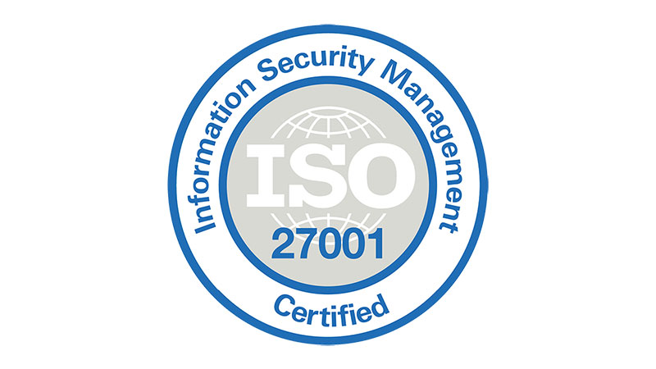
Main Features of ISO 27001, 27002
Resources and competences
The organization must also ensure that all the resources needed not only for implementation but also for system maintenance are available. In addition, it is necessary to establish what the necessary skills are and to make sure that the persons responsible are qualified enough, even with supporting documentation.

Slide 15
Main Features of ISO 27001, 27002
Documenting the information
The standard requires all information to be properly documented, with identification, definition and format. The information needs an update whenever there is a change in the initial definitions of the project, being necessary the changes to be approved, before being formalized and consolidated.
Tracking the performance
At that moment, the objectives defined in previous steps should be measured and monitored, through indicators that allow an analysis of efficiency of the system.

Slide 16
ITIL
ITIL has become the de facto standard in IT service management.
It helps organizations in all kinds of industries offer their services in a quality-driven and economical way.
The most recent version of the ITIL framework, ITIL® 4, was released in February 2019.
It’s a significant update from ITIL V3 which was in widespread use for over a decade.
Whether you’re already on your certification journey or you’re just researching the field of IT service, before you start preparing for the ITIL exams, it's helpful to learn the basic ITIL concepts and terms, as well as ITIL processes, to become familiar with the core components of the exam.
So if you’re wondering what is ITIL exactly, and what are the specific ITIL concepts and processes, you’re in the right place.

Slide 17
ITIL
ITIL stands for Information Technology Infrastructure Library.
It is a set of best practices for delivering IT services—it standardizes the selection, planning, delivery, and support of IT services to maximize efficiency and maintain predictable levels of service.
It has roots going back to the 1980s in the United Kingdom as a government initiative, and the framework is now covered in five books that are updated periodically. (There were originally 30 books!).

Slide 18
Concept of ITIL
ITIL has several key principles that are realized through five core components.
Some key ITIL concepts and principles are:
delivering maximum value to customers,
optimizing resources and capabilities,
offering services that are useful and reliable,
planning processes with specific goals in mind,
defining roles clearly for each task,
before we get to the five core components of ITIL concepts, let’s define some important ITIL terms.

Slide 19
Key ITIL Terms
Capabilities
The specialized skills or abilities an organization applies to resources in order to create value.
Functions
Self-contained subsets of an organization intended to accomplish specific tasks. They usually take the form of a group of people and the tools they use.
Processes
Structured sets of activities designed to achieve a specific objective. The four basic characteristics of processes are:
they transform inputs into outputs,
they deliver results to a specific customer or stakeholder,
they are measurable,
they are triggered by specific events.

Slide 20
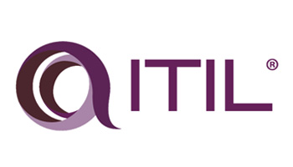
Key ITIL Terms
Resources
The raw materials that contribute to a service, such as money, equipment, time, and staff.
Roles
Defined collections of responsibilities and privileges. Roles may be held by individuals or teams.

Slide 21
Key ITIL Terms
Service Assets
Also known just as assets, these refer to the resources and capabilities that a service provider must allocate to offer a service.
Service Management
Specialized capabilities for delivering value to customers in the form of services.
Services
A means of delivering value to customers without requiring them to own specific costs and risks.

Slide 22
Key ITIL Terms
Value, Utility, and Warranty
The value of the service consists of two components: utility and warranty.
Services must offer both utility and warranty to have value.
Utility, also called fitness for purpose, refers to the ability of the service to remove constraints or increase the performance of the customer.
Warranty, also called fitness for use, is the ability of the service to operate reliably.
As discussed above, let's dive into the five core components of ITIL concepts.

Slide 23
ITIL Framework
The framework of ITIL is divided into five broad stages or categories:
Service Strategy,
Service Design,
Service Transition,
Service Operation,
Continual Service Improvement.

Slide 24
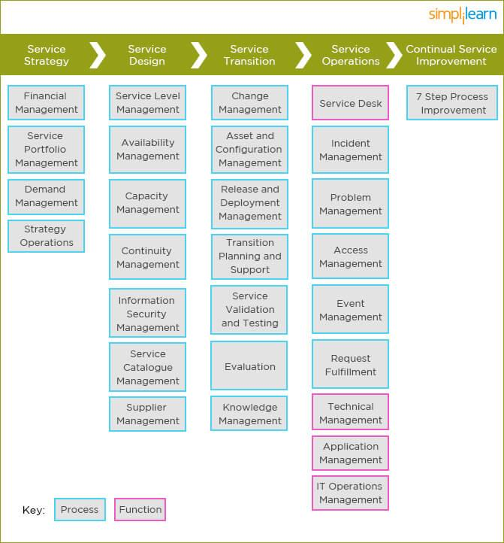
ITIL Framework

Slide 25
ITIL Framework – Service Strategy
The purpose of Service Strategy is to provide a strategy for the service lifecycle.
The strategy should be in sync with business objectives.
The utility and warranty of this component are designed to ensure that the service is fit for purpose and fit for use, respectively.
Ensuring this is important, as these two components are what add value to the delivery of services to customers.
As mentioned above, each major category has subcategories.

Slide 26
ITIL Framework – Service Strategy
As mentioned above, each major category has subcategories.
Within the category of Service Strategy, there are four subcategories.
a) Service Portfolio Management
b) Demand Management
c) Financial Management
d) Strategy Operations

Slide 27
ITIL Framework – Service Design
The Service Design lifecycle phase is about the design of services and all supporting elements for introduction into the live environment.
The “Four Ps of Service Design” represent areas that should be taken into consideration when designing a service.
They are:
People
Human resources and organizational structures required to support the service
Processes
Service Management processes required to support the service
Products
Technology and other infrastructure required to support the service
Partners
Third parties that offer additional support required to support the service
There are seven processes included in Service Design.

Slide 28
ITIL Framework – Service Transition
The objective of the Service Transition process is to build and deploy IT services, making sure that changes to services and Service Management processes are carried out in a coordinated way.
In this phase of the lifecycle, the design is built, tested, and moved into production to enable the business customer to achieve the desired value.
This phase addresses managing changes: controlling the assets and configuration items (the underlying components, such as hardware and software) associated with the new and changed systems, service validation, testing and transition planning to ensure that users, support personnel, and the production environment have been prepared for the release to production.
There are seven processes within the category of Service Transition.

Slide 29
ITIL Framework – Service Operations
This stage focuses on meeting end-users’ expectations while balancing costs and discovering any potential problems.
The Service Operations process includes fulfilling user requests, resolving service failures, fixing problems, and carrying out routine operational tasks.
This is the only category of the five that has functions as well as processes.

Slide 30
ITIL Framework – Continual Service Improvement (CSI)
The objective of this stage is to use methods from quality management to learn from past successes and failures.
It aims to continually improve the effectiveness and efficiency of IT processes and services in line with the concept of continual improvement adopted in ISO 2000.
There is only one process in this area, and it has seven steps:
Identifying improvement strategies
Defining what will be measured
Gathering data
Processing data
Analyzing data
Presenting and using the information drawn from the data
Using the information to improve

Slide 31
COBIT
COBIT is an IT management framework developed by the ISACA to help businesses develop, organize and implement strategies around information management and governance.
First released in 1996, COBIT (Control Objectives for Information and Related Technologies) was initially designed as a set of IT control objectives to help the financial audit community better navigate the growth of IT environments.

Slide 32
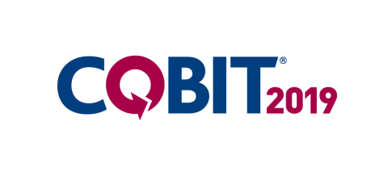
COBIT
In 1998, the ISACA released version 2, which expanded the framework to apply outside the auditing community.
Later, in the 2000s, the ISACA developed version 3, which brought in the IT management and information governance techniques found in the framework today.

Slide 33
COBIT
COBIT 4 was released in 2005, followed by COBIT 4.1 in 2007.
These updates included more information regarding governance surrounding information and communication technology.
In 2012, COBIT 5 was released and in 2013, the ISACA released an add-on to COBIT 5, which included more information for businesses regarding risk management and information governance.

Slide 34
COBIT
The ISACA announced an updated version of COBIT in 2018, ditching the version number and naming it COBIT 2019.
This updated version of COBIT is designed to constantly evolve with “more frequent and fluid updates,” according to the ISACA.
COBIT 2019 was introduced to build governance strategies that are more flexible, collaborative and address new and changing technology.

Slide 35
COBIT
COBIT 2019 updates the framework for modern enterprises by addressing new trends, technologies and security needs.
The framework still plays nicely with other IT management frameworks such as ITIL, CMMI and TOGAF, which makes it a great option as an umbrella framework to unify processes across an entire organization.
New concepts and terminology have been introduced in the COBIT Core Model, which includes 40 governance and management objectives for establishing a governance program.
The performance management system now allows more flexibility when using maturity and capability measurements.
Overall, the framework is designed to give businesses more flexibility when customizing an IT governance strategy.

Slide 36
COBIT
Like other IT management frameworks, COBIT helps align business goals with IT goals by establishing links between the two and creating a process that can help bridge a gap between IT — or IT silos — and outside departments.
One major difference between COBIT and other frameworks is that it focuses specifically on security, risk management and information governance.
This is emphasized in COBIT 2019, with better definitions of what COBIT is and what it isn’t.

Slide 37
COBIT
For example, ISACA says COBIT 2019 isn’t a framework for organizing business processes, managing technology, making IT-related decisions, or determining IT strategies or architecture.
Rather, it’s designed strictly as a framework for governance and management of enterprise IT across the organization.
That’s better clarified for businesses in the updated version, so there’s less confusion about how COBIT should be used and implemented.

Slide 38
COBIT - Main Goals
According to the ISACA, COBIT 2019 was updated to include:
Focus areas and design factors that give more clarity on creating a governance system for business needs.
Better alignment with global standards, frameworks and best practices to bolster the framework’s relevance.
An open-source model that allows for feedback from the global governance community to encourage faster updates and enhancements.
Regular updates released on a rolling basis.

Slide 39
COBIT - Main Goals
COBIT 2019 also introduces “focus area” concepts that describe specific governance topics and issues, which can be addressed by management or governance objectives.
Some examples of these focus areas include small and medium enterprises, cybersecurity, digital transformation and cloud computing.
Focus areas will be added and changed as needed based on trends, research and feedback – there’s no limit for the number of focus areas that can be included in COBIT 2019.

Slide 40
COBIT - Components
COBIT 2019 Framework: Introduction and methodology: The main guide that introduces the basic COBIT principles alongside the structure of the overall framework.
COBIT 2019 Framework: Governance and management objectives: A companion guide that dives into the COBIT Core Model and 40 governance and management objectives. Each objective is described including its purpose, how it connects with the enterprise and how it aligns goals.

Slide 41
COBIT - Components
COBIT 2019 Design Guide: A companion guide that offers in-depth guidance for developing a uniquely tailored governance system for your organization.
COBIT 2019 Implementation Guide: The fourth companion guide in the framework, which guides businesses through implementing the governance strategy once it’s developed. This includes best practices, ways to avoid pitfalls and how to integrate your COBIT 2019 strategy with your COBIT 5 strategy.

Slide 42
COBIT – Principles and Benefits
One major change to COBIT 2019 is that it now encourages feedback from the practitioner community.
You will be able to purchase the COBIT 2019 Design Guide, but in early 2019 the ISACA will also release a crowdsourced version of COBIT where practitioners can leave comments, suggest improvements or propose new concepts and ideas.
COBIT 2019 is designed to be more prescriptive to guide companies in developing a governance strategy, while also allowing organizations to more comfortably tailor a unique best-fits governance strategy.

Slide 43
COBIT – Principles and Benefits
It defines the “components to build and sustain a governance system: processes, policies and procedures, organizational structures, information flows, skills, infrastructure, and culture and behaviors,” according to the ISACA.
Formerly referred to as “enablers” in COBIT 5, these components better define what businesses need for a strong governance system.

Slide 44
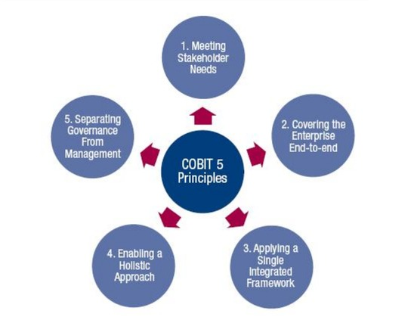
COBIT – Principles and Benefits

Slide 45
COBIT – Principles and Benefits
According to the ISACA, COBIT 2019 best suits clients that use multiple frameworks — such as ITIL, ISO/IEC 2000 and CMMI — with certain silos within IT using their own framework or standard.
It’s also well suited to organizations that are required to follow specific regulatory guidelines from the government and local authorities.
The COBIT 2019 framework helps businesses align existing frameworks in the organization and understand how each framework will fit into the overall strategy.
It can also help businesses monitor the performance of these other frameworks, especially in terms of security compliance, information security and risk management.

Slide 46
COBIT – Principles and Benefits
It’s also designed to give senior management more insight into how technology can align with organizational goals.
You can directly map pain points in the business to certain aspects of the framework, emphasizing the need for “control-driven IT,” according to the ISACA.
The framework gives CIOs and other IT executives a way to demonstrate the ROI on an IT project and how it will help reach key business objectives.

Slide 47
Thank you for your attention

