Slide 1

Internet Security, Protocols, Wireless Networks
Moravian Business College Olomouc
Lukáš Pavlík, Ph.D.
Department of Informatics and Applied Mathematics
E-mail: lukas.pavlik@mvso.cz

Slide 2
Internet Security
The Internet contains a huge amount of information, most of which is useful and suitable for all users.
On the other hand, the Internet has proven to be an effective means of spreading inappropriate content (e.g. pornography) as well as various types of malicious software - from simple viruses to sophisticated "Trojan horses", or extortion programs such as ransomware.
Content filtering tools can filter this information to ensure that users can't easily access it.

Slide 3
Internet Security
The two main categories of tools include web (email) and email address filtering.
Internet filtering can be used to block certain Web pages that contain inappropriate content.
Internet filters refer to databases of known web addresses or URLs with inappropriate content.
Web filters need to update database URLs regularly, because companies that manage inappropriate sites often change URLs or site name to eliminate blocking their web addresses.
Web filters also use keywords that are considered inappropriate to block access to those pages and messages.

Slide 4

Internet Security
Spam is a huge problem today and can generate up to half of e-mail traffic in a standard business.
Email filtering is similar to website filtering and can block inappropriate and unsolicited commercial email.

Slide 5
Internet Security
Unfortunately, these tools today are reactive and rely on databases of well-known websites or email addresses to filter content.
There are also more sophisticated tools that also rely on heuristics to identify these messages and remove them.
As with other heuristic methods, they are not yet reliable enough.

Slide 6
Internet Security
Both legal aspects and user requirements need to be considered before implementing content filtering tools.
Categories such as pornography, hate, and gambling are easily filtered, but other categories, such as online shopping, may require much more analysis of the filtering settings.
If the filtering program becomes too demanding, for example, users - employees of the company may feel a significant limitation, which also affects their work process (searching for business opportunities, etc.).

Slide 7
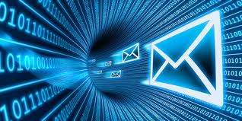
Internet Security
Content filtering is an important component of information security due to the significant impacts of spam productivity and the use (and misuse) of employees' websites at work.
Careful consideration of legal and personnel issues is required when developing a content filtering strategy.

Slide 8
Secure Email Communication
Authentication systems use authentication protocols to evaluate transmitted messages to determine if they are legitimate or, on the other hand, malicious or intended to gain unauthorized intrusion into the enterprise information system.
The protocols are based on specified rules, where it is defined whether the message complies with the specified parameters and can be considered authentic.

Slide 9
Secure Email Communication
The three basic protocols used for authentication include Kerberos, RADIUS, and 802.1x:
Kerberos-A security system developed at MIT that authenticates only users. It does not authorize services or databases; detects identity when logging on for use throughout the session. This system is used in environments such as Novell NetWare and Microsoft Windows.
RADIUS (remote user service authentication option) - an authentication protocol that uses an authentication method to authenticate remote users. It is used for employees who require remote access and it is necessary to identify the workstations they use, it is not enough just a username and password, because this type of authentication can be easily misused and the possibility of unauthorized access is significant.

Slide 10
Secure Email Communication
It is used for employees who require remote access and it is necessary to identify the workstations they use, it is not enough just a username and password, because this type of authentication can be easily misused and the possibility of unauthorized access is significant.
802.1x-IEEE security protocol for wired and wireless local area networks that comply with the 802.11 standard.
It relies on the Extensible Authentication Protocol (EAP) to forward messages to one of various authentication servers, such as RADIUS or Kerberos.

Slide 11
Secure Email Communication
Because email is so critical in today’s business world, organizations have established polices around how to handle this information flow.
One of the first policies most organizations establish is around viewing the contents of emails flowing through their email servers.
It’s important to understand what is in the entire email in order to act appropriately.
After these baseline policies are put into effect, an organization can enact various security policies on those emails.

Slide 12
Secure Email Communication
These email security policies can be as simple as removing all executable content from emails to more in-depth actions, like sending suspicious content to a sandboxing tool for detailed analysis.
If security incidents are detected by these policies, the organization needs to have actionable intelligence about the scope of the attack.
This will help determine what damage the attack may have caused.
Once an organization has visibility into all the emails being sent, they can enforce email encryption policies to prevent sensitive email information from falling into the wrong hands.

Slide 13
Email Security Best Practices
One of the first best practices that organizations should put into effect is implementing a secure email gateway.
An email gateway scans and processes all incoming and outgoing email and makes sure that threats are not allowed in.
Because attacks are increasingly sophisticated, standard security measures, such as blocking known bad file attachments, are no longer effective.
A better solution is to deploy a secure email gateway that uses a multi-layered approach.

Slide 14
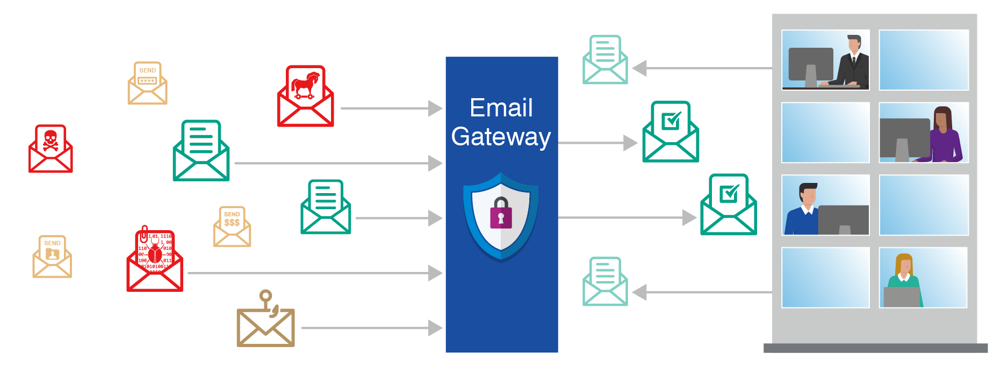
Email Security Best Practices

Slide 15
Email Security Best Practices
It’s also important to deploy an automated email encryption solution as a best practice.
This solution should be able to analyze all outbound email traffic to determine whether the material is sensitive.
If the content is sensitive, it needs to be encrypted before it is emailed to the intended recipient.
This will prevent attackers from viewing emails, even if they were to intercept them.

Slide 16
Email Security Best Practices
Training employees on appropriate email usage and knowing what is a good and bad email is also an important best practice for email security.
Users may receive a malicious email that slips through the secure email gateway, so it’s critical that they understand what to look for.
Most often they are exposed to phishing attacks, which have telltale signs.
Training helps employees spot and report on these types of emails.

Slide 17
Email Security Tools
A secure email gateway, deployed either on-premises or in the cloud, should offer multi-layered protection from unwanted, malicious and BEC email; granular visibility; and business continuity for organizations of all sizes.
These controls enable security teams to have confidence that they can secure users from email threats and maintain email communications in the event of an outage.

Slide 18
Email Security Tools
An email encryption solution reduces the risks associated with regulatory violations, data loss and corporate policy violations while enabling essential business communications.
The email security solution should work for any organization that needs to protect sensitive data, while still making it readily available to affiliates, business partners and users—on both desktops and mobile devices.
An email encryption solution is especially important for organizations required to follow compliance regulations, like GDPR, HIPAA or SOX, or abide by security standards like PCI-DSS.

Slide 19
Wireless Networks
Wireless networks present new tasks in information security.
Wireless technology allowed users to connect directly to their networks instead, without the need for network cables; this trend will continue to grow in the future.
Because this technology was first developed for individual users for personal use, rather than corporate communications, higher priorities were placed on ease of use instead of securing the data being communicated.
Thus, wireless devices were not designed to use encryption when transmitting data, and additionally proposed communication technologies often had weaknesses.

Slide 20
Wireless Networks
Authentication, or the ability to identify who is trying to access systems, is also limited by wireless technology and does not have an input-level scale.
It's also easy for someone to connect an unauthorized wireless device to a corporate network, giving unauthorized access to the corporate information environment that an unauthorized user can use to gain access to corporate resources.
Wireless access (Wifi) and the use of mobile devices (smartphones) as well as BYOD present new tasks for the information security program.

Slide 21
Virtual Private Network VPN
VPN tools allow you to establish a secure connection between two sites using a public network, such as the Internet.
VPN uses encryption to protect data, creating a secure "tunnel" for transmitted data, protecting it from unauthorized access by unauthorized persons.
A VPN connection creates a secure connection that allows you to connect authorized people who want to remotely access a corporate information environment, such as a corporate e-mail system or corporate servers.

Slide 22
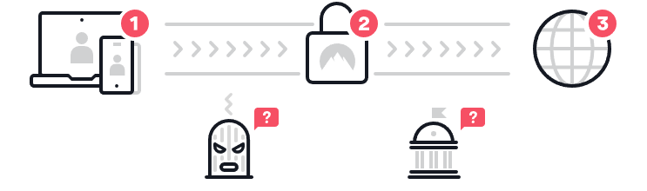
Virtual Private Network VPN
A combination of hardware and software is used to create this VPN connection.
This is a cost-effective way to securely extend the enterprise information system compared to the traditional method using leased lines.

Slide 23
Cybersecurity Threats - Examples
Phishing Gets More Sophisticated — Phishing attacks, in which carefully targeted digital messages are transmitted to fool people into clicking on a link that can then install malware or expose sensitive data, are becoming more sophisticated.
Now that employees at most organizations are more aware of the dangers of email phishing or of clicking on suspicious-looking links, hackers are upping the ante — for example, using machine learning to much more quickly craft and distribute convincing fake messages in the hopes that recipients will unwittingly compromise their organization’s networks and systems.
Such attacks enable hackers to steal user logins, credit card credentials and other types of personal financial information, as well as gain access to private databases.

Slide 24
Cybersecurity Threats - Examples
Ransomware Strategies Evolve — Ransomware attacks are believed to cost victims billions of dollars every year, as hackers deploy technologies that enable them to literally kidnap an individual or organization’s databases and hold all of the information for ransom.
The rise of cryptocurrencies like Bitcoin is credited with helping to fuel ransomware attacks by allowing ransom demands to be paid anonymously.
As companies continue to focus on building stronger defenses to guard against ransomware breaches, some experts believe hackers will increasingly target other potentially profitable ransomware victims such as high-net-worth individuals.

Slide 25
Cybersecurity Threats - Examples
Ping-of-Death - The use of packets longer than 65,535 bytes allowed by the IP specification, with a dedicated memory overflow when received.
Teardrop - use of IP fragments. If an attacker's computer generates fragments that did not match the header data, the operating systems cannot process the incorrect fragment.
Smurf attack - the attacker sends a flood of pings, which are then announced by the router in the target network. If the attacker still states the address of the foreign sender in the IP header of the ping, another network will be flooded with the answers.
Currently, Distributed Denial of Service (DDoS) attacks are carried out that exploit attacks from many extra sources, which does not allow the attacker to be located.

Slide 26
Cybersecurity Threats - Examples
Malware - attackers like and often use malware to penetrate a user's device and subsequently the device in his work, because malware is very effective in this. The term malware itself includes several other types of malicious software, such as spyware, adware, or ransomware.
SQL Injection and Cross-site scripting (XSS) - SQL is a query language used to manage databases. SQL injection exploits vulnerabilities in the queries themselves, which arise through the fault of the developer due to his poor database development. Attackers are primarily attracted to databases that store personal data and sensitive user data, including bank card numbers. As the name suggests, SQL Injection is essentially an injection that attacks a database through untreated input and executes its own modifying SQL statement.

Slide 27
Cybersecurity Threats - Examples
Man-in-the-Middle (MIMT) and Hijacking - If you want to spy on someone's Internet communication, then you will definitely use MIMT. As part of the use of the "man in the middle", the encryption itself is disrupted, when an attacker gets between you and the recipient of your messages, but neither side knows anything. An attacker could then modify the sent communication and send something completely different to the recipient. When hijacking, the attacker obtains your unique ID and when communicating with other websites, he impersonates you. This allows them to log in to your accounts on various websites and their operator will not recognize anything.

Slide 28
Cybersecurity Threats - Examples
Cryptojacking — The cryptocurrency movement also affects cybersecurity in other ways.
For example, cryptojacking is a trend that involves cyber criminals hijacking third-party home or work computers to “mine” for cryptocurrency.

Slide 29
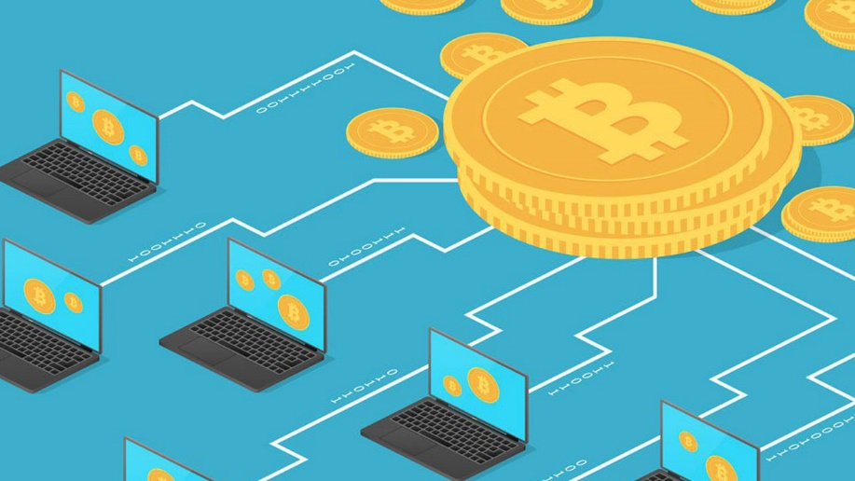
Cybersecurity Threats - Examples
Because mining for cryptocurrency (like Bitcoin, for example) requires immense amounts of computer processing power, hackers can make money by secretly piggybacking on someone else’s systems.
For businesses, cryptojacked systems can cause serious performance issues and costly down time as IT works to track down and resolve the issue.

Slide 30
Cybersecurity Threats - Examples
Cyber-Physical Attacks — The same technology that has enabled us to modernize and computerize critical infrastructure also brings risk.
The ongoing threat of hacks targeting electrical grids, transportation systems, water treatment facilities, etc., represent a major vulnerability going forward.
According to a recent report in The New York Times, even America’s multibillion-dollar military systems are at risk of high-tech foul play.

Slide 31
Cybersecurity Threats - Examples
State-Sponsored Attacks — Beyond hackers looking to make a profit through stealing individual and corporate data, entire nation states are now using their cyber skills to infiltrate other governments and perform attacks on critical infrastructure.
Cybercrime today is a major threat not just for the private sector and for individuals but for the government and the nation as a whole.
As we move into 2020, state-sponsored attacks are expected to increase, with attacks on critical infrastructure of particular concern.

Slide 32
Cybersecurity Threats - Examples
Many such attacks target government-run systems and infrastructure, but private sector organizations are also at risk.
According to a report from Thomson Reuters Labs: “State-sponsored cyberattacks are an emerging and significant risk to private enterprise that will increasingly challenge those sectors of the business world that provide convenient targets for settling geopolitical grievances.”

Slide 33

Cybersecurity Threats - Examples
IoT Attacks — The Internet of Things is becoming more ubiquitous by the day (according to Statista.com, the number of devices connected to the IoT is expected to reach 75 billion by 2025).
It includes laptops and tablets, of course, but also routers, webcams, household appliances, smart watches, medical devices, manufacturing equipment, automobiles and even home security systems.

Slide 34
Cybersecurity Threats - Examples
Connected devices are handy for consumers and many companies now use them to save money by gathering immense amounts of insightful data and streamlining businesses processes.
However, more connected devices means greater risk, making IoT networks more vulnerable to cyber invasions and infections.
Once controlled by hackers, IoT devices can be used to create havoc, overload networks or lock down essential equipment for financial gain.

Slide 35
Cybersecurity Threats - Examples
Smart Medical Devices and Electronic Medical Records (EMRs) — The health care industry is still going through a major evolution as most patient medical records have now moved online, and medical professionals realize the benefits of advancements in smart medical devices.
However, as the health care industry adapts to the digital age, there are a number of concerns around privacy, safety and cybersecurity threats.

Slide 36
Cybersecurity Threats - Examples
According to the Software Engineering Institute of Carnegie Mellon University, “As more devices are connected to hospital and clinic networks, patient data and information will be increasingly vulnerable.
Even more concerning is the risk of remote compromise of a device directly connected to a patient.
An attacker could theoretically increase or decrease dosages, send electrical signals to a patient or disable vital sign monitoring.”

Slide 37
Cybersecurity Threats - Examples
With hospitals and medical facilities still adapting to the digitalization of patient medical records, hackers are exploiting the many vulnerabilities in their security defenses.
And now that patient medical records are almost entirely online, they are a prime target for hackers due to the sensitive information they contain.

Slide 38
Cybersecurity Threats - Examples
Third Parties (Vendors, Contractors, Partners) — Third parties such as vendors and contractors pose a huge risk to corporations, the majority of which have no secure system or dedicated team in place to manage these third-party employees.
As cyber criminals become increasingly sophisticated and cybersecurity threats continue to rise, organizations are becoming more and more aware of the potential threat posed by third parties.
However, the risk is still high; U.S. Customs and Border Protection joined the list of high-profile victims in 2019.

Slide 39
Cybersecurity Threats - Examples
Connected Cars and Semi-Autonomous Vehicles — While the driverless car is close, but not yet here, the connected car is.
A connected car utilizes onboard sensors to optimize its own operation and the comfort of passengers.
This is typically done through embedded, tethered or smartphone integration.
As technology evolves, the connected car is becoming more and more prevalent; by 2020, an estimated 90 percent of new cars will be connected to the internet, according to a report titled “7 Connected Car Trends Fueling the Future.”

Slide 40
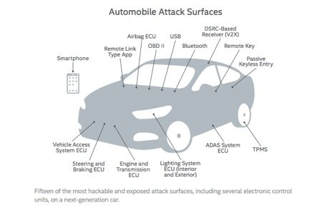
Cybersecurity Threats - Examples
For hackers, this evolution in automobile manufacturing and design means yet another opportunity to exploit vulnerabilities in insecure systems and steal sensitive data and/or harm drivers.
In addition to safety concerns, connected cars pose serious privacy concerns.

Slide 41
Cybersecurity Threats - Examples
Social Engineering — Hackers are continually becoming more and more sophisticated not only in their use of technology, but also psychology.
Tripwire describes social engineers as “hackers who exploit the one weakness that is found in each and every organization: human psychology.
Using a variety of media, including phone calls and social media, these attackers trick people into offering them access to sensitive information.”
The article includes a video demonstrating an example of social engineering.

Slide 42
Thank you for your attention

