Slide 1

Security in Operating Systems, Access Management, Identification, Authentication, Authorization
Moravian Business College Olomouc
Lukáš Pavlík, Ph.D.
Department of Informatics and Applied Mathematics
E-mail: lukas.pavlik@mvso.cz

Slide 2
Specifics of Ensuring Security
The main categories of security technologies include firewalls, anti-virus systems, intrusion detection, vulnerability management and content management increasingly focused on SIEM (Security Information and Event Management), i.e. security information and event management.
Because threats such as viruses, Trojans, malware, ransomware, etc. can exploit IS vulnerabilities in gateways, servers, or client networks, all of these solutions must be implemented in each of the three layers of the network.

Slide 3
Specifics of Ensuring Security
If protection is not provided in all three layers of the system, i.e. data (database), application and presentation, a hole arises in the information environment through which hackers, malicious SW, but active or passive activity of users, can compromise.
This is especially true for the presentation layer, on which personal computers are used, here it is necessary to ensure in the presentation layer has been consistently addressed access rights, continuous protection of processed data and backup.

Slide 4
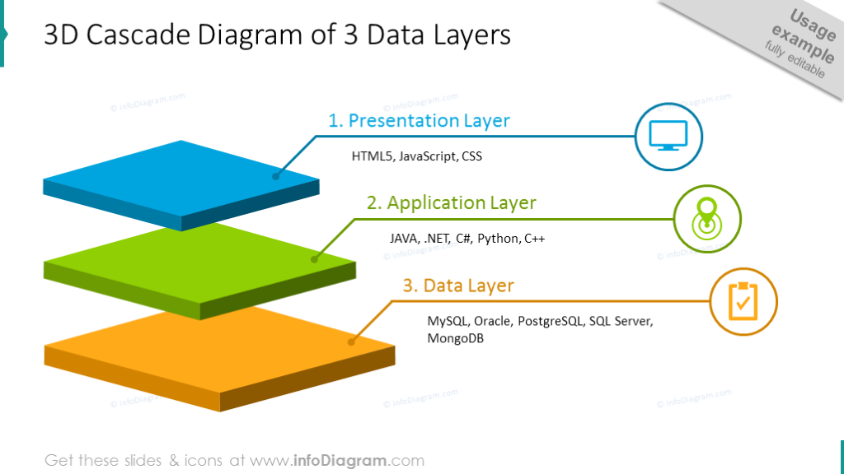
Specifics of Ensuring Security

Slide 5
Provision and Management of Security Tools - Authentication
Information technology includes three main tools for controlling access to computer and communication systems and for restricting users from accessing only functions and activities corresponding to their needs within a set level of authorization, authorization and account management.
Authentication is a process that determines who you are, what authorization you have to access applications, the information system, etc.

Slide 6
Provision and Management of Security Tools - Authentication
Authorized access control systems (e.g. Active Directory in the MS Windows environment) are implemented in information systems to control and audit authentication processes.
More advanced authentication technologies provide additional security during the authentication process.
These technologies involve the use of physical devices or tokens, such as smart cards, that store additional information to identify the user.

Slide 7
Provision and Management of Security Tools - Authentication
Biometric systems can also take advantage of unique biological features, including fingerprints or retinal images, and the increasingly used dynamic biometric signature (DBP) to achieve a higher level of authentication, so-called multi-layer authentication.
Security experts refer to the need for a minimum use of two forms of authentication, i.e. two-factor authentication.
Two-factor authentication is recommended for controlling access to standard information systems or for remote access to these systems, as this eliminates the vulnerability of information systems in cases of using "name, password" authentication.

Slide 8
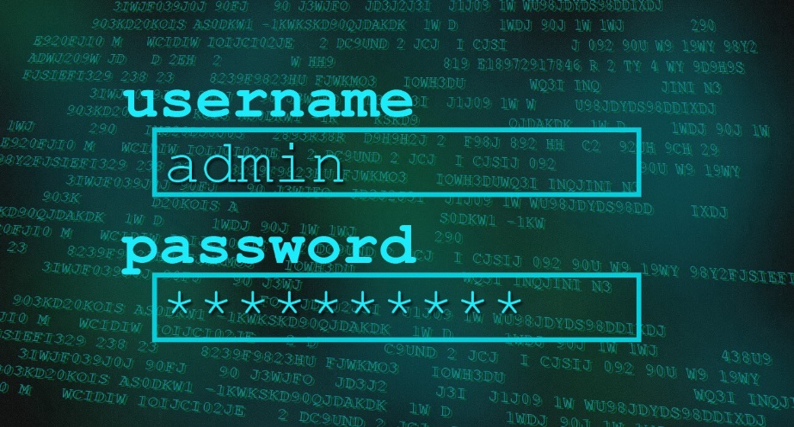
Provision and Management of Security Tools - Authentication
Traditional verification factors can be divided as follows:
something you know, such as a password;
something you have, such as a symbol;
something you are, such as biometric characteristics;
where you are, for example using global positioning satellites.

Slide 9
Provision and Management of Security Tools - Authentication
Client software solutions may also utilize other tools, such as "tokens" or "certificates," that uniquely identify both the owner of the workstation (e.g., a personal computer) and the physical device itself.
This SW solution makes it possible to solve the pitfalls of remote access, when it is verified that the authorized user accesses the system from the physical device that is declared, and it is possible to control the authorization for remote access to the system in large networks.
In any case, organizations and businesses should use two-factor authentication to access the system, as simple user IDs and passwords do not provide sufficient assurance that unauthorized access has not occurred, especially with insufficient password management.

Slide 10
Provision and Management of Security Tools - Authentication
Users must comply with the following most important responsibilities when working with passwords:
Passwords must not be communicated to another person in any way.
Passwords must not be marked anywhere and must be kept secret.
It must not be in any way allowed for another person to become familiar with the password.
Names of close persons, animals and other words that may be guessed from the knowledge of the password holder or did not contain consecutive identical ones may not be used as passwords.

Slide 11
Provision and Management of Security Tools - Authentication
The password must be strong enough so that it cannot be easily broken by machine or by hand (combination of upper and lower case letters and numbers, length at least 10 characters) and should be changed regularly depending on the risks associated with breaking.
Passwords must not be recorded on paper or in a similar form (with the exception of the safe storage of administrator passwords in the event of an accident).

Slide 12
Provision and Management of Security Tools - Authentication
Passwords must be changed in the event of any indication that the system or password may be compromised.
Fulfillment of these requirements cannot be left to the users themselves, it is necessary to implement into information systems solutions that enforce proper password management.

Slide 13
Provision and Management of Security Tools - Authorization
The authorization feature allows system administrators to restrict certain special permissions to certain roles or functions that employees perform within the organization.
With the use of authorization, the structuring of the rights of individual users of the information system is solved.
For example, all users in a company may have a general-purpose e-mail account, but only a limited number of employees would have privileged access to defined applications.
In this case, the system allows the system administrator to control certain limited functions.

Slide 14
Provision and Management of Security Tools - Authorization
Another example is systems with individual applications, in which the types of duties and powers are separated according to the given role of individual users. e.g. staff who have access to sensitive information (e.g. payroll).
Authorization management must find out who is accessing the defined systems and what activities they perform there.
A system of regular internal audits must be designed to check that no one is accessing the systems without proper authorization or with the intention of misuse.

Slide 15
Provision and Management of Security Tools - Authorization
For example, all employees in a given financial area may be entitled to access the company's enterprise resource planning (ERP) system.
However, if the auditor finds that employees are using the system during non-business hours without the presence of supervisors, further investigation may be necessary to ensure that these activities are appropriate.
Managing user accounts across multiple systems is a difficult task, and single sign-on software is part of the solution to this problem (Single Sign on - SSO).
These solutions provide a single user ID and password to access multiple systems that may exist in a company.

Slide 16
Provision and Management of Security Tools - Authorization
However, software for single access login brings significant security vulnerabilities in cases where the company operates systems with a different architecture.
In these cases, SSOs, which create a more secure environment for users, can pose risks when deployed to a wide range of enterprise applications.
Account management, as the third tool in addressing access, is used to audit and control resource utilization.
From an audit perspective, it is important to have a good knowledge of who is accessing the various resources within the business and to have an overview of user activity.
This approach is part of the "good practice" required when revising critical system protocols (not only) to ensure that only authorized users have access to them.

Slide 17
Provision and Management of Security Tools - Authorization
Account management is closely connected with authorization, where the basis is regular control of users who have access to reserved areas, such as the company's data center, etc.
In addition, it is a necessary condition for creating an environment where activities can be traced with relevant information (data, electronic documents) throughout their life cycle.

Slide 18
Provision and Management of Security Tools - Encryption
Encryption is the process of converting data into a format that an unauthorized person (as well as an authorized person without knowing the key used) cannot easily read.
There are two main forms of modern encryption: symmetric and asymmetric.
With symmetric encryption, both parties use the same secret key to encrypt and decrypt messages. This is a more secure and faster way to encrypt data.
The big disadvantage of this method is the difficult distribution of secret keys, especially in large systems or networks.

Slide 19
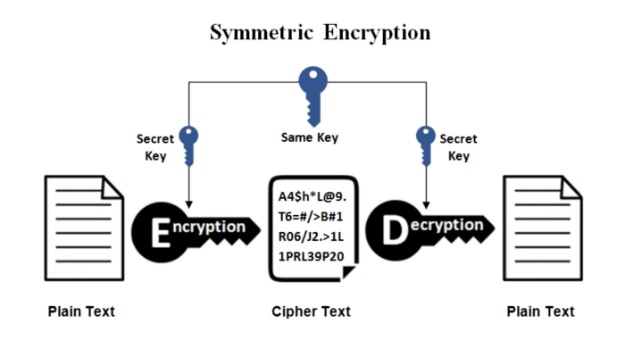
Provision and Management of Security Tools - Encryption

Slide 20
Provision and Management of Security Tools - Encryption
Asymmetric encryption effectively eliminates the disadvantage of distributing secret keys in large systems or networks.
In this case, each party has a public key for encryption and a private key for decrypting data.
In asymmetric encryption, the sender of the message uses the recipient's public key to encrypt the message for him.
The recipient of this message will use his private key to decrypt this message.
The public key cannot be used to decrypt the message or to reconstruct the private key of the recipient.
Asymmetric encryption also raises problems with the "key economy".

Slide 21
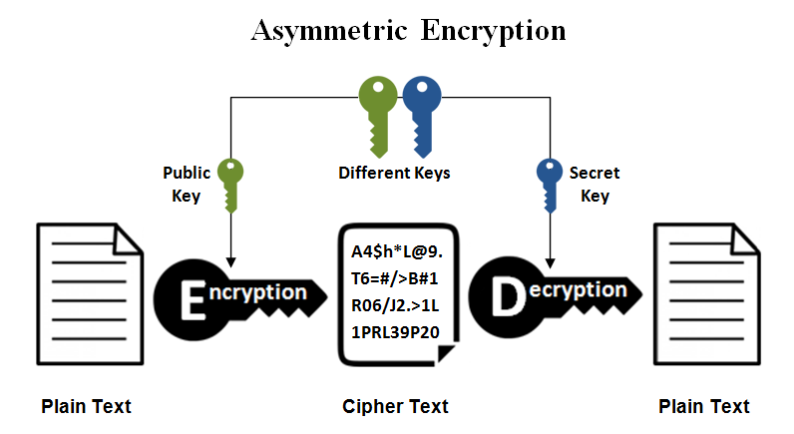
Provision and Management of Security Tools - Encryption

Slide 22
Provision and Management of Security Tools - Encryption
It must be ensured that:
the relevant public key belongs to the declared user,
the private key is stored securely so that it is not misused.
If the unambiguous link between the user and his public key is not verified, the confidentiality of the data may be violated or the authenticity of the data cannot be relied on.
Therefore, the participants in the communication do not distribute the public keys themselves, but use so-called certificates issued by independent third parties - certification authorities.
The participants in the communication thus use certificates when transmitting data – i.e. confirmation that the given public key belongs to the relevant subject.

Slide 23
Provision and Management of Security Tools - Encryption
PKI (Public Key Infrastructure) is related to this issue, i.e. the public key infrastructure, which creates technical resources, organizational measures and administrators, in order to ensure the management of public key certificates.
Using the PKI system, the credibility of electronic identities can then be ensured.
The basis of the PKI is a certification authority issuing certificates and a certificate revocation list (CRL) that complies with the X.509 standard.
The certification authority, as the issuer of the certificate, is responsible for ensuring that the certificate for asymmetric keys is issued to the authenticated holder of these keys, and thus the validity of individual users is guaranteed.

Slide 24
Provision and Management of Security Tools - Encryption
The first PKI systems used the services of one so-called root certification authority, which created proprietary certificates.
Currently, issued documents must comply with standards, which in practice means that it is possible to create various PKI models from corporate to PKI built around certified certification authorities.
The S / MIME protocol (which uses both asymmetric and symmetric encryption) and the Secure Sockets Layer (SSL) protocol, which is part of the HTTPS protocol, are used to protect transmitted e-mail messages.

Slide 25
Thank you for your attention

