Slide 1

Data Backup and Recovery of System
Moravian Business College Olomouc
Lukáš Pavlík, Ph.D.
Department of Informatics and Applied Mathematics
E-mail: lukas.pavlik@mvso.cz

Slide 2
Data Backup and Recovery - Introduction
Businesses and organizations realize three things quickly during their daily operations: any computer system can crash; anyone can make errors; and disasters seem to happen when you least expect it or are least prepared for it.
Hence, data backup and recovery are essential parts of running a successful business.
It’s important for businesses to plan ahead and put data backup systems into place in case the worst happens, well before it happens.
Successful data backup systems are accomplished by using an offsite server or separate drives to store your massive amounts of information.
Without putting these systems in place, data recovery becomes difficult resulting in loss of information when the worst happens.

Slide 3
What is Data Backup and Recovery?
Data backup and recovery is the process of backing up your data in the event of a loss and setting up secure systems that allow you to recover your data as a result.
Data backup requires the copying and archiving of computer data to make it accessible in case of data corruption or deletion.
You can only recover data from an earlier time if you have backed it up.
Data backup is one form of disaster recovery making it is an essential part of any sensible disaster recovery plan.

Slide 4
What is Data Backup and Recovery?
Backing up data cannot always restore all of your system’s data and settings.
For instance, computer clusters, database servers, or active directory servers may need additional types of disaster recovery since a backup and recovery may not entirely reconstitute them fully.
Today, you can back up a significant deal of data using cloud storage; therefore, archiving your data on a local system’s hard drive or external storage is not necessary.
What’s more, you can set up your mobile devices using cloud technologies to allow automatic data recovery.

Slide 5
Offsite Servers vs. Independent Drives
Offsite servers are suitable for data recovery since they provide massive amounts of data storage at nominal prices especially when you compare this expenditure to the hassle it saves in case of an information disaster.
Having a safe and secure place to store information off of your main business server is important in the long run.
Data recovery is usually painless.
Moreover, in the rare case where offsite servers crash, they (offsite servers) have backed up the data further onto their own drives.
This makes using an offsite server for your backup and recovery an effective method of keeping your information safe.

Slide 6
Offsite Servers vs. Independent Drives
Another effective method of backing up your business data is to invest in independent drives.
Today, terabyte drives are relatively inexpensive if you purchase them from discount stores or high-volumestores.
Since these drives are basically plug and play, data storage and recovery becomes easy.
Also, there are multiple storage volumes available in the market.

Slide 7
Offsite Servers vs. Independent Drives
Depending on the kinds of data you need to keep your business running, you may choose to back up your data on a daily, weekly, or even monthly basis, though most business opt for either of the first two.
However, for financial data, a daily backup is almost a certainty.
External drives become invaluable in the process of protecting your business data.

Slide 8
Offsite Servers vs. Independent Drives
As you can see, both external drive storage and offsite storage options are potential necessities.
Which one is better for you is entirely dependent on your type of business.
Since data backup and recovery works basically the same way, the real consideration you must make is whether you need a short term or long-term solution and whether the short-term option costs more than the long term one.
Offsite storage provides more storage but at a recurring cost (payments) while external drive storage is often a one-time charge (purchase cost) unless the drive crashes.

Slide 9

Cloud Backup and Recovery
Cloud backup, or online backup, refers to a data backup strategy that involves sending a copy of your primary data over a public or proprietary network to an off-site server.
The server is typically hosted by a third-party service provider (CSP) that charges you a fee based on bandwidth, capacity, or number of users.

Slide 10
Cloud Backup and Recovery
Implementing cloud data backup may help you bolster your organization’s data protection strategy without adding more workload on your IT staff.
The cloud backup process copies data and then stores it on different media or a separate storage system that allows easy access in case of a recovery situation.
Some options include:
Backing up your data directly to the public cloud.
This entails writing the data directly to a cloud infrastructure provider.
Backing up your data to a service provider.
Here, you write data to a CSP offering backup services in its managed data center.
Cloud-to-cloud backup option is for data that lives in the cloud in SaaS (software as a service) applications.
This method copies your data to another cloud.

Slide 11
Cloud Backup and Recovery
When you begin using cloud backup services, the initial backup can take days to finish uploading over the network because of the volume of data.
Thus, a technique called cloud seeding is used, which allows a cloud backup vendor to send you a storage device, such as a tape cartridge or disk drive, on which to back up your data locally before sending the device back to the CSP.
Once the initial seeding is completed, the provider only backs up your data over the network.

Slide 12
Cloud Backup and Recovery
Online data backup systems are often built around client software applications that run on a schedule determined by the level of service purchased.
If, for instance, you have contracted a CSP for daily backups, the application will collect, compress, encrypt, and transfer your data to the CSP’s server every 24 hours.
To reduce the time taken to complete transfers as well as the bandwidth used, the CSP may only provide you with incremental backups after your first full backup.

Slide 13
Cloud Backup and Recovery
Cloud services mostly include the hardware and software you will need to protect your data.
Many cloud subscriptions run on a yearly or monthly basis.
Also, cloud backup services are now popularly used by SMBs (small and medium-sized businesses) as well as large enterprises.
For large companies and organizations, cloud data backup services are used as a supplementary option.

Slide 14
Backup vs. Recovery
In a nutshell, the primary difference between backup and recovery is that the former is a copy of original data that can be used in case of a database failure while recovery refers to the process of restoring your database to its correct (original) state when a failure occurs.
As stated earlier, backup refers to a representative copy of data and includes essential elements of a database such as data files and control files.
Since unexpected database failures are inevitable, a backup of the entire database is required.
There are two major backup types:
Physical Backup: This is a copy of physical database files such as data, control files, log files, and archived redo logs. It is a copy of the files that store database information in another location and forms the foundation of the database recovery mechanism.
Logical Backup: It contains the logical data that is extracted from a database, and it consists of tables, procedures, views, functions, etc. However, keeping a logical backup alone is not recommended or useful since it only provides structural information.

Slide 15
Backup vs. Recovery
Recovery, on the other hand, helps you to restore your database to its correct state in the event a failure occurs.
It improves the reliability of your database since it allows the database to recover to a consistent state after sudden failure.
It is entirely possible to recover your database using log-based recovery.
A log is a record sequence containing transaction records.
The log of all your transactions when stored in a stable storage helps you to recover your database after failure.
It contains information about transactions to execute, transaction states, and modified values.
These pieces of information are all stored in their order of execution.

Slide 16
Types of Data Backup
While the idea of data backup may be simple, implementing an effective and efficient strategy can be difficult.
Backup software applications are developed to reduce the complexity associated with performing backup and recovery operations.

Slide 17
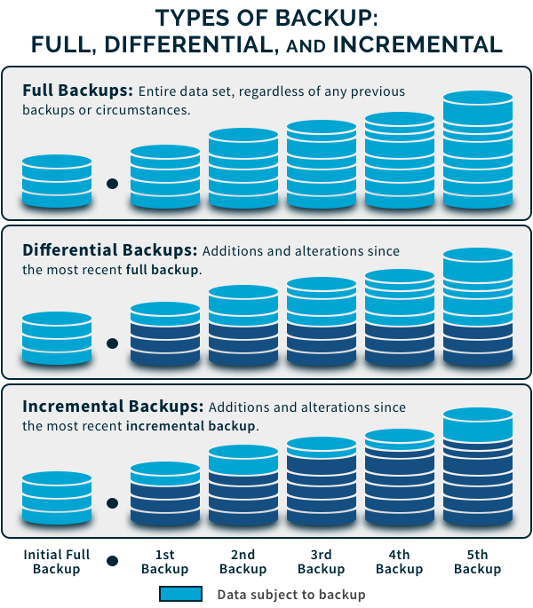
Types of Data Backup

Slide 18
Types of Data Backup
Remember that backup is not the goal.
It is merely a means to accomplish your goal, which is protecting your data.
The most common backup types used are as follows:
Full Backup: It is a basic and complete backup operation that makes a copy of all your data to another media set such as a disk, tape, or CD. Therefore, a complete copy of all your data is made available in a single media set. It takes longer to perform and requires a lot of storage space hence it is typically used in combination with either a differential or incremental backup.
Incremental Backup: This operation results in the copying of only that data that has changed since your last backup operation. A backup application will record and keep track of the time and date that all backup operations occur. This operation is faster and requires less storage media.
Differential Backup: Similar to an incremental type, this backup will copy all changed data from a previous episode but every time it runs, it continues to copy all the data changed since the stated previous full backup.

Slide 19
Importance of Data Backup and Recovery
A backup’s purpose is to create copies of data that you can recover when your primary data fails.
Primary data failures can result from several issues including software or hardware failure, a human-caused event, data corruption, malicious attacks, and accidental deletion of data.
Ergo, backup copies allow you to restore your data from an earlier point in time to aid your business recover quickly from an unplanned event.

Slide 20
Importance of Data Backup and Recovery
Storing a copy of your data on a separate medium is necessary to prevent corruption or loss.
The additional medium could be as simple as a USB stick or external drive, or more substantial, like a tape drive, disk storage medium, or cloud storage container.
You could either put the alternate medium in the same location as your primary data or store it remotely.
If you are situated in an area with a high possibility of weather-related events using a remote location is justified.

Slide 21
Importance of Data Backup and Recovery
For best results, make your backup copies on a regular and consistent basis to minimize the amount of data lost between backups.
This means that the more time that passes between your backup copies, the more potential for data loss you face when recovering from a failure.
So do not wait months to make your backup copies.
Also, retaining multiple copies of your data provides you with the flexibility and insurance to restore your systems to a point in time that was not affected by malicious attacks or data corruption.

Slide 22
What is Disaster Recovery Backup?
In IT, disaster recovery (DR) is part of security planning, and it is developed together with a business continuity plan.
It refers to policies and procedures that focus on protecting an organization or business from any significant effects in the event of a negative event, which may include device or building failures, cyberattacks, or natural disasters.

Slide 23
What is Disaster Recovery Backup?
Disaster recovery is essential in designing strategies that can help your business to quickly restore its hardware, application, and data for business continuity.
It is sometimes considered a subset of business continuity.
Designing a proper disaster recovery plan requires the preparation of an in-depth business impact and risk assessment analysis.
These steps aid in the identification of the specific IT services that can support the crucial business activities of your organization.
They also help to set out the recovery time objectives and recovery point objectives.

Slide 24
What is Disaster Recovery Backup?
Disaster recovery measures can fall into three classifications as follows:
Preventive Measures: Aim at preventing the occurrence of an event.
Corrective Measures: Are put in place to correct a system in the event of a disaster or negative event.
Detective Measures: These focus on discovering and detecting negative events.

Slide 25
What is Disaster Recovery Backup?
Any sensible disaster recovery plan helps you to achieve business continuity even in the worst-casescenarios.
It is also prudent to put in place regular checks and exercises to ensure you have effective disaster recovery measures that are followed by all your individual departments as well as the entire organization as a whole.

Slide 26
The Importance of Disaster Recovery (DR)
Disaster recovery allows your organization to quickly maintain or resume mission-critical functions following the occurrence of a disaster.
Today’s businesses have become more reliant and accustomed to high availability while the tolerance for downtime has significantly decreased.
Ergo, a disaster can have devastating effects on your business especially in today’s highly competitive markets.
Since it is a high possibility for businesses to fail after experiencing significant data loss, disaster recovery has become an essential part of operations.

Slide 27
The Importance of Disaster Recovery (DR)
Recovery time objective (RTO) and recovery point objective (RPO) are two measurements used in DR and downtime.
RTO: Refers to the maximum amount of time after a disaster for your organization to recover its files from backup storage and return to normal operations. In other words, RTO is the maximum downtime amount that your organization can handle. If your organization’s RTO is two hours, it cannot afford to be down for longer than that.
RPO: Refers to the maximum file age that your organization must recover from its backup storage to resume normal operations after a disaster. RPO will determine your minimum backup frequency. For instance, if your organization’s RPO is five hours, your system must back up data at least every five hours.

Slide 28
The Importance of Disaster Recovery (DR)
Therefore, RTO and RPO are instrumental in helping you to choose the optimal disaster recovery procedures, strategies, and technologies for your organization.
Meeting tighter RTO windows will require you to position your secondary data in a manner that makes it easily accessible when needed.
Recovery-in-place is one effective method of restoring data quickly.
It involves using technology that can allow you to move your backup data files to a live state on your backup appliance, which eliminates the need to move the data across a network.
This protects against server and storage system failure.

Slide 29
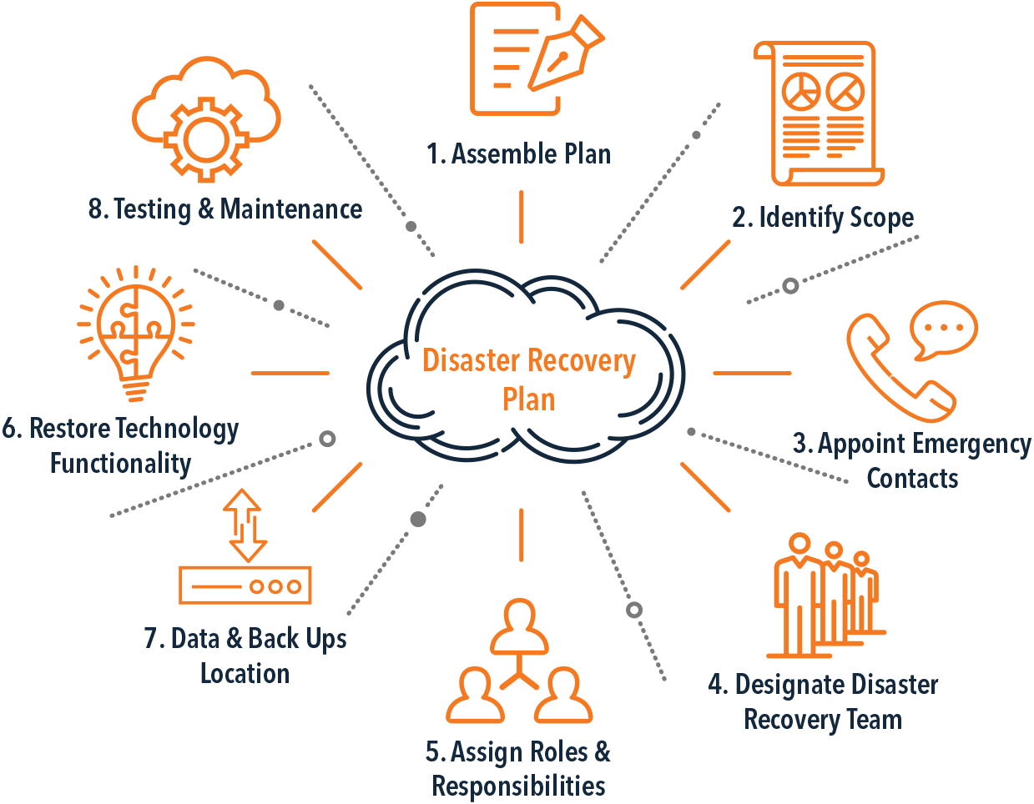
The Importance of Disaster Recovery (DR)
Preparation for a disaster requires you to take a comprehensive approach that encompasses software and hardware, power, networking equipment, connectivity, and testing to ensure DR can be achieved within your RTO and RPO targets.
Though implementing a thorough disaster recovery plan is no small task, its potential benefits are significant.

Slide 30
Why Do You Need a Data Backup and Disaster Recovery Plan?
Without a sound data backup and DR plan, your business risks suffering permanent data loss, unnecessary expenses, and massive downtime.
Here are five convincing reasons for a data backup and DR plan:
All Data is a Target: Whether you are an attorney, a dentist, running a pet shop, or a fortune 500 company, your data always remains vulnerable to threats. Accidents, viruses, malware, and hackers are not picky. They will attack your business for any number of reasons such as fulfilling a vendetta, acquiring sensitive data, or simply because they can.
It is Easy to Lose Data: A lot of data loss occurs as a result of hardware malfunctions or human error as opposed to natural disasters. This means that your data is very easy to lose.

Slide 31
Why Do You Need a Data Backup and Disaster Recovery Plan?
Some Data is Invaluable: Some of your business data cannot be recovered once it is lost.
Downtime is Not Fun: Losing data results in downtime because without it, it becomes incredibly hard for your employees to work. It is difficult to handle clients without their account status and contact information or to work without any of your mission-critical business applications. Without a sound recovery solution in place, your restoration efforts automatically become rebuilding efforts.
Your Reputation is Essential: Downtime and losing your data will definitely affect how other stakeholders view your business as well as their relationship with you. A tarnished reputation can significantly hamper your business especially when stakeholders cannot trust you with their data.

Slide 32
Backup and Recovery Software
Database Management System (DBMS) refers to a software package that helps you manage databases easily and effectively, which allows you to organize your data properly.
DBMS has many advantages, for example, it allows you to store, manipulate, and retrieve data from databases.
It also enables you perform transactions and provides protection to your data.
You may also need a sound backup and recovery software such as Veritas NetBackup.

Slide 33
Thank you for your attention

