Slide 1
Tools for decision making

Slide 2
Tools for decision making
Digging the hole with bare hands is doable, with shovel it is easier …
Common tools for decision making
  Scenarios
  Decision trees
  Flowchart
  Tables – remember shooting competition …

Slide 3
Scenarios I
A scenario depicts a "plausible" or "possible" future state in terms of the critically interdependent issues or variables that define that future, presented in a logical and internally consistent manner.

Slide 4
Scenarios II
A scenario may be a sequence of events, explaining how some future state evolves by describing conditions that precede or "cause" the future states to occur. Or, a scenario may be cross-sectional, describing a "state of affairs" at a given time.

Slide 5
Scenarios III
Multiple scenarios may be generated providing a range of plausible futures under different specified conditions, such as extremes of optimism and pessimism, or according to a major theme, such as energy scarcity, world depression, and so on.

Slide 6
Scenarios IV
Since a scenario is a possible future, it need not be taken as a direct forecast.
Multiple scenarios may be generated providing a range of plausible futures under different specified conditions, such as extremes of optimism and pessimism, or according to a major theme, such as energy scarcity, world depression, and so on.

Slide 7
Scenarios V
A scenario may be presented in either a qualitative or quantitative format and may be of varying length ranging from a few paragraphs to 50 pages.

Slide 8
Scenarios VI
Custom tailored around certain strategic issue
General picture not detailed description – Framework scenarios
Driving forces – will affect outcomes
The Givens – elements taken as facts, unlikely to change
Predetermined – Events already occurred, consequences will yet unfold
Can‘t-go-ons – events existing today, not tomorrow
Impossibles – will not happen
Uncertains – no one knows

Slide 9
Discuss short scenario on current event – your decision making
Do not forget time structure
Mid level of details
Persons involved
Certain and uncertain events
Weather
Etc.

Slide 10
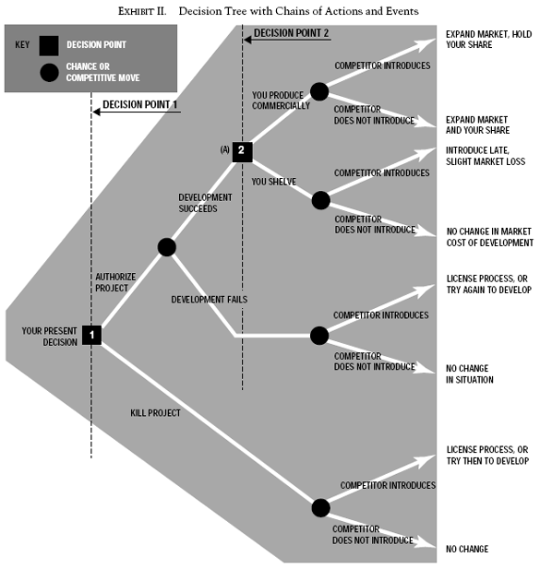
Decision trees I
Visualization of decision
Nodes and branches
Node – test (decision / option)
  Decision node – square
  Chance node – circle
  End node – triangle
Branch - outcome
A decision tree of any size will always combine (a) action choices with (b) different possible events or results of action which are partially affected by chance or other uncontrollable circumstances.

Slide 11
Decision trees II
Can be improved with / enhanced by
  Adding probabilities
  Adding financial outcome (cost and / or revenues)
  Adding physical outcome (causalties, gains, …)
  Adding deadlines / starting times

Slide 12
Prepare short decision tree
If it fits your decision making problem …
What shall I do this evening? (Stay home, go out, cinema, party, pub, alone, with friends, with family …)
Add financial efects

Slide 13
Flow Charts I
A flowchart is a type of diagram that represents a workflow or process
Visual tool for step-by-step approach to solving a task
Suitable for decision making under complete information (no uncertainty) and / or pre-defined set of options

Slide 14
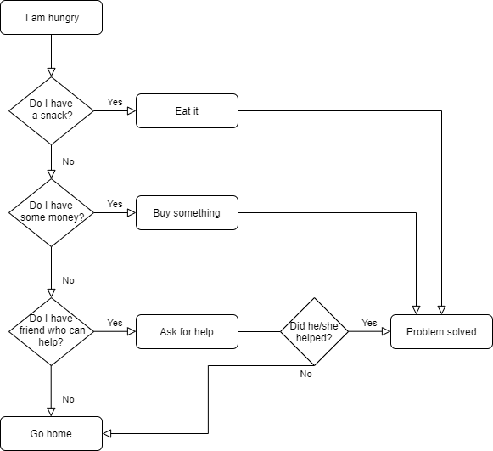
Flow Charts II

Slide 15
Flow Charts III
The more complex the process or decision to make – the wider and larger the flow chart is
Electronic versions

Slide 16
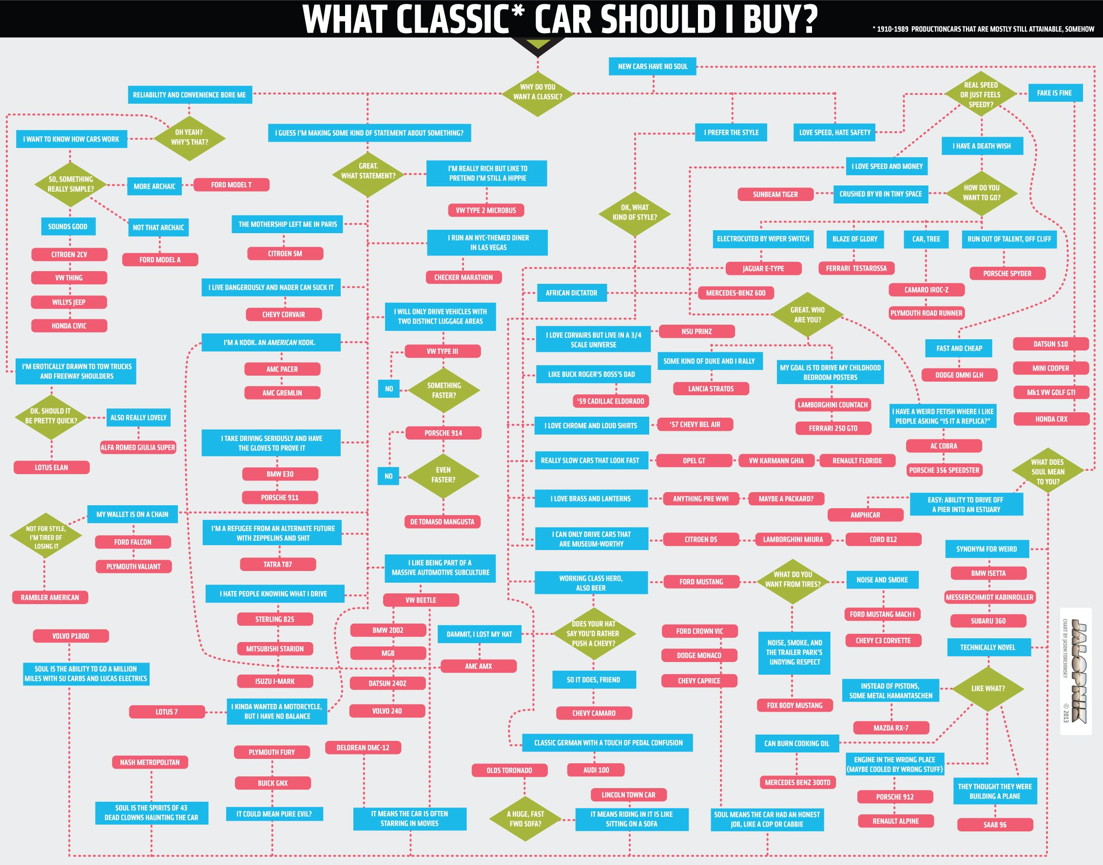

Slide 17
Flow Charts IV
Flow charts often combined with (they are used as a source for)
  Manuals
  Quick Reference Handbooks https://youtu.be/6ZJhCg63tQk and https://youtu.be/fJ5ZLdJDBrg x https://www.youtube.com/watch?v=nGHP4uGImX4
  Alarm regulations (fire alarm, evacuation plans, …)
  Guide lines etc.

