Slide 1

The Biggest Cyber Threats of Recent Years
Moravian Business College Olomouc
Lukáš Pavlík, Ph.D.
Business and Informatics Center
E-mail: lukas.pavlik@mvso.cz

Slide 2
The Biggest Cyber Threats of Recent Years - Introduction
A pandemic-focused years made the events unprecedented in numerous ways, and the cyber attacks were no different.
As the world transitioned to virtual everything - work, school, meetings and family gatherings - attackers took notice.
Attackers embraced new techniques and a hurried switch to remote access increased cyberthreats across the board.
For example, K-12 schools took a brunt of the hit, and new lows were reached like the exfiltration of student data.

Slide 3
The Biggest Cyber Threats of Recent Years - Introduction
The list of top cyber attacks from 2020 include ransomware, phishing, data leaks, breaches and a devastating supply chain attack with a scope like no other.
The virtually-dominated year raised new concerns around security postures and practices, which will continue into 2021.
While there were too many incidents to choose from, here is a list of 10 of the biggest cyber attacks of 2020, in chronological order.

Slide 4

Toll Group
Toll Group tops the list for the year's worst cyber attacks because it was hit by ransomware twice in three months.
However, a spokesperson for Toll Group told SearchSecurity the two incidents were not connected and were "based on different forms of ransomware."
On Feb. 3 the Australia-based logistics company announced on Twitter that it had suffered a cyber attack.

Slide 5
Toll Group
"As a precautionary measure, Toll has made the decision to shut down a number of systems in response to a cyber security incident.
Several Toll customer-facing applications are impacted as a result.
Our immediate priority is to resume services to customers as soon as possible," Toll Group wrote on Twitter.
The most recent attack occurred in May and involved a relatively new ransomware variant: Nefilim.

Slide 6
Marriott International
For the second time in two years, the popular hotel chain suffered a data breach.
On March 31, Marriott released a statement disclosing the information of 5.2 million guests was accessed using the login credentials of two employees at a franchise property.
According to the notice, the breach affected an application used by Marriott to provide guest services. "We believe this activity started in mid-January 2020," the statement said.

Slide 7
Marriott International
"Upon discovery, we confirmed that the login credentials were disabled, immediately began an investigation, implemented heightened monitoring, and arranged resources to inform and assist guests."
While the investigation is ongoing, Marriott said it has no reason to believe that the information included the Marriott Bonvoy account passwords or PINs, payment card information, passport information, national IDs, or driver's license numbers.

Slide 8

Marriott International
However, compromised information may have involved contact details and information relating to customer loyalty accounts, but not passwords.

Slide 9
Magellan
On May 12, the healthcare insurance giant issued a letter to victims stating it had suffered a ransomware attack.
Threat actors had successfully exfiltrated logins, personal information and tax Information.
The scope of the attack included eight Magellan Health entities and approximately 365,000 patients may have been impacted.
"On April 11, 2020, Magellan discovered it was targeted by a ransomware attack.

Slide 10
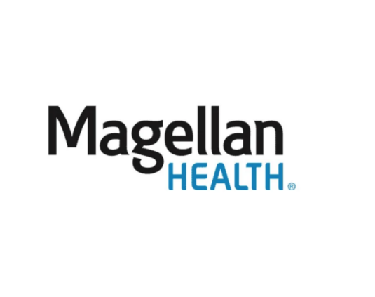
Magellan
The unauthorized actor gained access to Magellan's systems after sending a phishing email on April 6 that impersonated a Magellan client," the letter said.
The company, which has over 10,000 employees, said at the time of the letter they were not aware of any fraud or misuse of any of the personal information.
Phishing, a common attack vector, intensified over the year as threat actors refined their impersonation skills.

Slide 11
Twitter
The popular social media company was breached in July by three individuals in an embarrassing incident that saw several high-profile Twitter accounts hijacked.
Through a social engineering attack, later confirmed by Twitter to be phone phishing, the attackers stole employees' credentials and gained access to the company's internal management systems; dozens of high-profile accounts including those of former President Barack Obama, Amazon CEO Jeff Bezos, and Tesla and SpaceX CEO Elon Musk, were hacked.

Slide 12

Twitter
The threat actors then used the accounts to tweet out bitcoin scams that earned them over $100,000.
Two weeks after the breach, the Department of Justice (DoJ) arraigned the three suspects and charged 17-year-old Graham Ivan Clark as an adult for the attack he allegedly "masterminded," according to authorities.

Slide 13
Garmin
The navigation tech supplier suffered a cyber attack that encrypted some of its systems and forced services offline.
Though Garmin first reported it as an outage, the company revealed on July 27 that it was the victim of a cyber attack which resulted in the disruption of "website functions, customer support, customer-facing applications, and company communications."

Slide 14
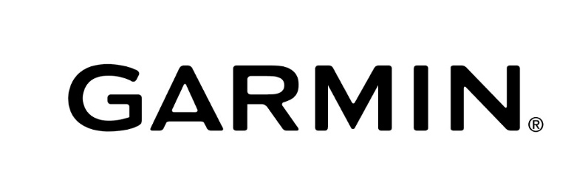
Garmin
The press release also stated there was no indication that any customer data was accessed, lost or stolen.
Speculation rose that the incident was a ransomware attack, although Garmin never confirmed.
In addition, several media outlets reported that they gave in to the attackers' demands, and a ransom had been paid. Some news outlets reported it as high as $10 million.

Slide 15
Clark County School District
The attack on the Clark County School District (CCSD) in Nevada revealed a new security risk: the exposure of student data.
CCSD revealed it was hit by a ransomware attack on Aug. 27 which may have resulted in the theft of student data.
After the district declined to pay the ransom, an update was posted saying it was aware of media reports claiming student data had been exposed on the internet as retribution.

Slide 16
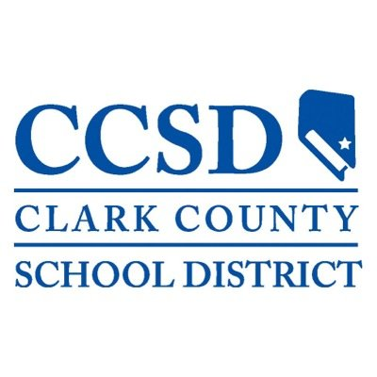
Clark County School District
While it's unclear what information was, the threat of exposing stolen student data was a new low for threat actors and represented a shift to identity theft in attacks on schools.

Slide 17
Software AG
The German software giant was the victim of a double extortion attack that started on Oct. 3, which resulted in a forced shutdown of internal systems and ultimately a major data leak.
Files were encrypted and stolen by operators behind the Clop ransomware.
According to multiple news outlets, a $20 million ransom was demanded, which Software AG declined to pay.
As a result, the ransomware gang followed through with its promise and published confidential data on a data leak site including employees' passport details, internal emails and financial information.

Slide 18
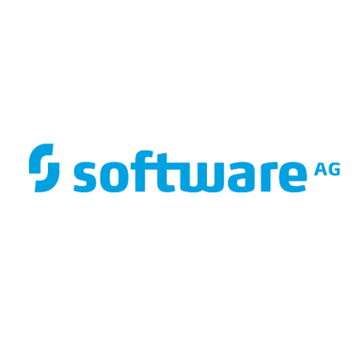
Software AG
Operators behind the Clop ransomware weren't the only group utilizing a double extortion attack.
The name-and-shame tactic became increasingly common throughout 2020 and is now the standard practice for several ransomware gangs.

Slide 19
Vastaamo Psychotherapy Centre
The largest private psychotherapy provider in Finland confirmed it had become the victim of a data breach on October 21, where threat actors stole confidential patient records.
The attack set a new precedent; rather than making demands of the organization, patients were blackmailed directly.
As of last month, 25,000 criminal reports had been submitted to Finland police.

Slide 20
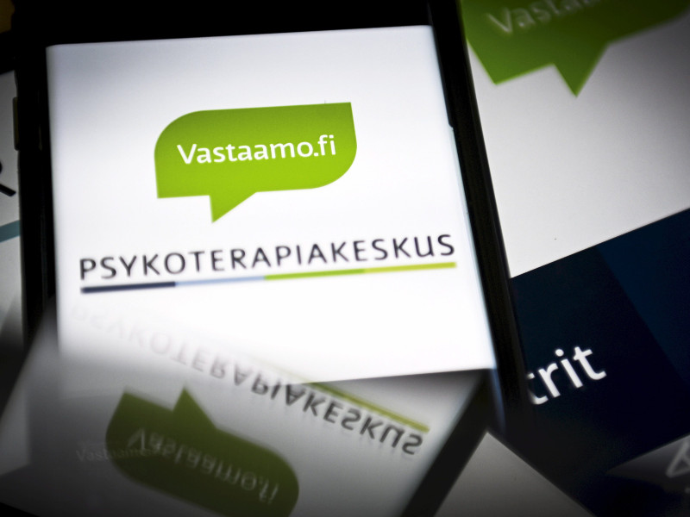
Vastaamo Psychotherapy Centre
In addition, the government's overall response to the incident was significant, both in urgency and sensitivity.
Finland's interior minister called an emergency meeting with key cabinet members and provided emergency counseling services to potential victims of the extortion scheme.

Slide 21
FireEye and SolarWinds supply chain attack victims
FireEye set off a chain of events on Dec. 8th when it disclosed that suspected nation-state hackers had breached the security vendor and obtained FireEye's red team tools.
On Dec. 13, the company disclosed that the nation-state attack was the result of a massive supply chain attack on SolarWinds.
FireEye dubbed the backdoor campaign "UNC2452" and said it allowed threat actors to gain access to numerous government and enterprise networks across the globe.

Slide 22
FireEye and SolarWinds supply chain attack victims
According to a joint statement Dec. 17 by the Federal Bureau of Investigation, the Cybersecurity and Infrastructure Security Agency and the Office of the Director of National Intelligence, the attacks are ongoing.
Additionally, the statement revealed that the supply chain attack affected more than just the Orion platform.
CISA said it has "evidence that the Orion supply chain compromise is not the only initial infection vector leveraged by the APT actor."

Slide 23
FireEye and SolarWinds supply chain attack victims
Since the statement, major tech companies such as Intel, Nvidia and Cisco disclosed they had received the malicious SolarWinds updates, though the companies said they've found no evidence that threat actors exploited the backdoors and breached their networks.
However, Microsoft disclosed on Dec. 31 that threat actors infiltrated its network and viewed - but did not alter or obtain - the company's source code.
Microsoft also said there is no evidence the breach affected customer data or the company's products and services.

Slide 24
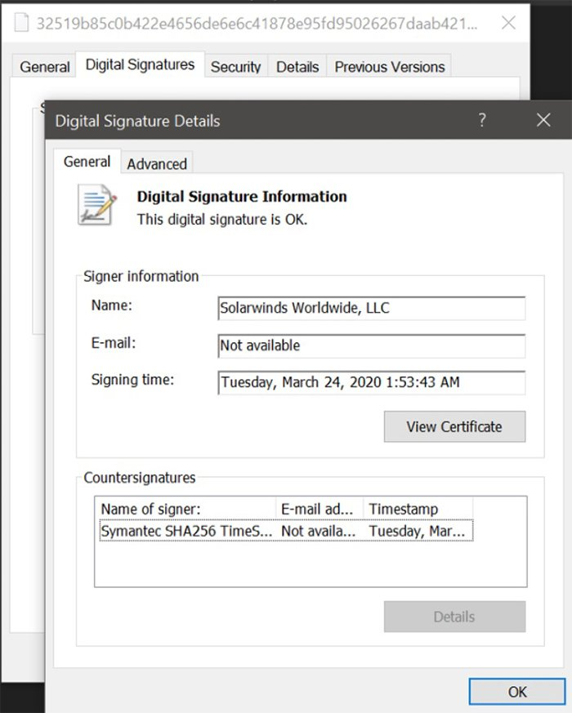
FireEye and SolarWinds supply chain attack victims

Slide 25
FireEye and SolarWinds supply chain attack victims
The scope of the attack, the sophistication of the threat actors and the high-profile victims affected make this not only the biggest attack of 2020, but possibly of the decade.
The incident also highlights the dangers of supply chain attacks and brings into question the security posture of such a large company.
Threat actors, who had performed reconnaissance since March, planted a backdoor in SolarWinds' Orion platform, which was activated when customers updated the software.

Slide 26
FireEye and SolarWinds supply chain attack victims
SolarWinds issued a security advisory about the backdoor which the vendor said affected Orion Platform versions 2019.
4 HF5 through 2020.2.1, which were released between March 2020 and June 2020.
"We have been advised this attack was likely conducted by an outside nation-state and intended to be a narrow, extremely targeted and manually executed attack, as opposed to a broad, system-wide attack," the company said.

Slide 27

FireEye and SolarWinds supply chain attack victims
In the three-week-long investigation since, the full breadth of the attack has grown immensely, but is still not yet fully understood.

Slide 28
Significant Hospital Ransomware Attacks - Ryuk
In 2020, Universal Health Services (UHS) suffered a Ryuk attack that cost the company around $67 million.
With over 90,000 employees serving 3.5 million patients in the United States and the United Kingdom, UHS is a truly massive organization.
Even with a considerable budget and institutional clout, the company failed to prevent the malicious incursion.

Slide 29
Significant Hospital Ransomware Attacks - Ryuk
UHS managed to resume full operations about a month after the incident began.
While restoring IT capabilities, the company’s revenues took a major hit.
Health centers couldn’t keep up with a full load of patients, billing was delayed, and extra labor was needed to get computer systems back up and running.
While the incident was financially devastating, UHS managed to prevent the theft or misuse of sensitive data.

Slide 30

Significant Hospital Ransomware Attacks - Ryuk
The UHS cyberattack represents part of a larger trend.
Ryuk, a specific type of ransom-seeking malware, has been used frequently to infiltrate medical facilities.
Many companies suffer major operating losses while restoring their technological capabilities.

Slide 31
Significant Hospital Ransomware Attacks – Attack via Email
Private companies are not the only institutions vulnerable to nefarious activity. In May of 2021, criminals targeted the Health Service Executive (HSE) in Ireland.
Once the system had been compromised, hackers accessed high-level accounts and used them to extract vast amounts of sensitive data.
With the information already in the hands of criminals, all the Irish government could do was monitor the dark web and try to prevent personal details from being published.

Slide 32
Significant Hospital Ransomware Attacks – Attack via Email
As in the Magellan incident, criminals used a phishing email to launch their assault on the HSE.
When an unsuspecting employee opened a Microsoft Excel file that had been attached to an email, they welcomed the malware into the organization’s digital infrastructure.
From there, the malicious software spread through the system before being detonated a few weeks later.

Slide 33
Significant Hospital Ransomware Attacks – Attack via Email
The HSE incident demonstrated the vulnerability of public health-related institutions.
The HSE is a sprawling organization.
It employs more people than any other state-run entity in Ireland, and those employees access their digital workspaces through more than 70,000 different devices.
Securing such an expansive network is a major challenge, and the Irish government has admitted that various shortcomings left the system overly exposed.
By doubling down on improved security measures, the HSE hopes to prevent future malware assaults.

Slide 34
Significant Hospital Ransomware Attacks – Attack via Email
Timeline of attack:
March 18, 2021 – Initial Compromise. Attackers first gained access to an end user workstation on March 18, 2021. The attackers waited two months before launching additional attacks to actively attempt to compromise the HSE network on May 7th.
May 14, 2021 – Ransomware Attack Begins. The malicious actors then spent one week ‘noisily’ poking around the HSE environment before dropping their ransomware payload on May 14th. Soon thereafter, 80 % of the HSE environment became encrypted with ransomware.

Slide 35

Significant Hospital Ransomware Attacks – Attack via Email
May 21, 2021 – Decryption Keys Obtained. Decryption keys were obtained one week later on May 21. The method for obtaining the decryption keys was not made public.
September 21, 2021 – Full Recovery of HSE Systems - The full recovery of HSE systems was not completed until four months later on September 21.

Slide 36
Significant Hospital Ransomware Attacks – Attack via Email
Analysis of attack
The organization had difficulties on the IT front when organizing their response to the attack.
HHS noted that there was a lack of clearly defined and delineated decision-making authority between the HSE, hospitals and Community Healthcare Organizations (CHO) in the case of a health service-wide crisis.
They also note that the OCIO was not able to provide or source (through third party) the scale of the IT support required by hospitals and CHOs during the extended response to restore applications, systems and services at pace.

Slide 37
Significant Hospital Ransomware Attacks – Attack via Email
The impact of the ransomware attack on communications was severe, as the HSE almost exclusively used on premises email systems (including Microsoft Exchange) that were encrypted, and therefore unavailable, during the attack.
Maintaining and testing a backup communication plan for staff outside of email and traditional communications models is essential to prepare for any large-scale attack or outage.

Slide 38
Thank you for your attention

