Slide 1

Cyber Risk Insurance
Moravian Business College Olomouc
Lukáš Pavlík, Ph.D.
Department of Informatics and Applied Mathematics
E-mail: lukas.pavlik@mvso.cz

Slide 2
Insurance as a Way of Protection and its Essence
The essence of the insurance is to create reserves from the financial contributions of those interested in insurance, which serve to cover the needs or compensation of damages incurred by the insured due to incidents.
The basic purpose of insurance is to compensate for the costs associated with the restoration of the organization's activities and the establishment of a steady state.

Slide 3
Insurance as a Way of Protection and its Essence
As such, the insurance does not affect the risk of the occurrence of the event or any damage, and only applies to previously agreed undesirable events that may occur with a certain probability.
These events are defined in the insurance contract concluded between the insurer and the policyholder.
Common forms of insurance may cover, for example, business risks, natural disasters, illness, death, as well as expenditure on necessary health care in old age, etc.

Slide 4

Insurance as a Way of Protection and its Essence
Breakdown of insurance
The professional literature most often lists the following breakdown of insurance:
compulsory insurance,
non-compulsory insurance (which can be subdivided into life and non-life insurance).

Slide 5
Insurance as a Way of Protection and its Essence
Compulsory insurance
By law, this insurance is imposed on companies and persons obliged to take part in a defined type of insurance.
Mandatory participation in insurance is primarily aimed at ensuring social security of people and securing against damage caused by other persons in the operation of motor vehicles.
This category includes:
statutory health insurance for persons according to the Health Insurance Act,
statutory insurance for accidents at work and occupational diseases,
statutory motor third party liability insurance,
statutory social insurance of persons under the Social Insurance Act.

Slide 6
Insurance as a Way of Protection and its Essence
Optional insurance
This insurance is not compulsory and can be divided into:
life insurance,
non-life insurance.
Life insurance
This type of insurance is always arranged for natural persons in order to protect these persons and family members against the risks of serious injuries, their permanent consequences, serious illnesses or deaths.

Slide 7

Insurance as a Way of Protection and its Essence
Types of life insurance include:
accident insurance,
hospital stay insurance,
major illness insurance,
pension insurance, etc.

Slide 8
Insurance as a Way of Protection and its Essence
These are mainly insurance of movable and immovable property. This category includes, for example:
travel insurance (outpatient medical treatment, etc.),
property insurance (family house, apartment building, garage, etc.),
household insurance (jewelery, valuables, securities, electronics, etc.),
insurance against business interruption,
business risk insurance,
cyber risk insurance,
liability insurance.

Slide 9

Insurance as a Way of Protection and its Essence

Slide 10
Insurance as a Way of Protection and its Essence – Basic Terminology
Current premiums
Premiums that are paid in regularly agreed periods of time. It can be e.g. a month, a year, etc. An agreement that specifies the beginning and length of the period must be part of the insurance contract.
Extraordinary premiums
This is a premium that is paid by the policyholder on a one-off basis in addition to the regular premium or payment. Extraordinary premiums can be deposited at any time during the insurance period.

Slide 11
Insurance as a Way of Protection and its Essence – Basic Terminology
Insured
According to the Civil Code, this term refers to a person whose life, health, property, liability or other value of insurance interest is covered by the Insurance.
Policyholder
It is a natural or legal person who has concluded an insurance contract with the insurance company (i.e. the insurer). The policyholder and the insured are often the same person, but this is not the rule of the insurance contract.

Slide 12
Insurance as a Way of Protection and its Essence – Basic Terminology
Insurer
The Insurer is a natural or legal person who, for a fee, undertakes to assume the agreed risks of Policyholder in the event of possible damage. The insurer is usually an insurance company that is governed by Act No. 699/2004 Coll. 277/2009 Coll., On Insurance. In the case of an insured event, the insurer provides certain financial compensation to the policyholder on the basis of an agreed insurance contract.
Sum insured
Amount of insurance indemnity payable by insurance company under certain conditions and circumstances specified in the insurance contract. In practice, this is the amount to be paid in the event of an insured event.

Slide 13
Insurance as a Way of Protection and its Essence – Basic Terminology
Insurance period
This is the period for which the insurance contract is concluded. If an insured event occurs during this period, the insurance company is obliged to pay the agreed amount of indemnity.
Insured value
This term denotes the highest possible financial damage to property that can occur as a result of an insured event.

Slide 14
Insurance as a Way of Protection and its Essence – Basic Terminology
Insured event
With the exception of life expectancy, this is an incidental event that entails the insurer's obligation to pay the agreed amount of benefits (e.g. illness, injury or death).
Insurance coverage
This is the extent of the agreed risks that are included in the insurance contract. This agreement describes in detail the rules under which an insurance company is obliged to make payments and under which it does not.

Slide 15
Insurance as a Way of Protection and its Essence – Basic Terminology
Insurance indemnity
Amount that can be paid in a lump sum or gradually and which the insurance company provides in case of the occurrence and realization of an insured event.
Insurance Conditions
Conditions which include, in particular, the definition of the origination, duration and termination of insurance, as well as insured events and conditions under which the insurer is not obliged to provide insurance indemnity. Furthermore, the method of determining the scope of insurance benefits and its maturity.

Slide 16
Insurance as a Way of Protection and its Essence – Basic Terminology
Insurance interest
The insurance interest refers to the need for protection against the consequences of insured events. The insurance company is therefore obliged to secure the insurance interest. However, if the insurance interest has passed, the client has the right to cancel the insurance contract.
Insurance
Insurance is used to compensate for the costs incurred in connection with the realization of an undesirable event on the subject of the Insurance.

Slide 17
Insurance as a Way of Protection and its Essence – Basic Terminology
Insurance
The insurance industry can be characterized as a specific economic field dealing with risk minimization in the areas of economic and non-economic human activities.
Lockout
These are cases or situations specified in the insurance conditions in which the insurance company is not obliged to pay the insurance indemnity.

Slide 18
Insurance as a Way of Protection and its Essence – Basic Terminology
Reinsurance insurance
This is a transfer of part of the risk that the insurer transfers from the insured to another subject of insurance, known as a reinsurer (insurance of insurance companies). The reinsurer has no contractual relationship with the insured. It is only the insurer's protection in the case of major insured events, where it usually participates in the payment of insurance indemnity.

Slide 19
Cyber Threats and their Impact on the Information Environment
The effects of cyber threats can disrupt the organisation's function in different areas of management.
These areas in Insurance industry may be both technical and non-technical character.

Slide 20

Cyber Threats and their Impact on the Information Environment
These elements include hardware, reputation, manufacturing equipment, selected segments of a computer network.
If one of the cyber threats is realized, the impact on the organization and its functioning can be long-term.

Slide 21
Cyber Threats and their Impact on the Information Environment
Such impacts include, for example, restoring the reputation of the organization.
If this vulnerable element is compromised, recovery and remediation can take a very long time.
Possible manifestations of damage to the reputation of the organization include, for example, disruption of relationships with customers, customers, suppliers or employees.

Slide 22
Cyber Threats and their Impact on the Information Environment
Other elements that can be disrupted and whose restoration or reconstruction can be very costly and long-term include data.
From a cyber security perspective, it is the most valuable asset and its value is very difficult to determine.
If sensitive data is copied or deleted, the organization can be severely damaged not only at the particular point in time when the data has been misused, but also in future business developments.
To determine the insured value, it is therefore necessary to define possible cyber threats and determine their possible impacts on different areas of the organization in relation to the provision of basic functions.

Slide 23
Insurance of Organizations against Cyber Threats – Characteristics of Insurance
Cyber attacks are no longer targeted solely at Internet companies.
Basically, anyone working with data is at risk.
The importance of cyber security for business success is comparable to physical security.
While companies can insure against theft or damage, the situation is more complicated in the case of their own customer data.

Slide 24
Insurance of Organizations against Cyber Threats – Characteristics of Insurance
In the Czech Republic, the product related to cyber threat insurance was not offered until 2013.
Since 2013 it has been offered by a branch of the American insurance company AIG in Prague in the form of a Cyber Edge product.
With the validity of the GDPR (General Data Protection Regulation) legislation, this type of insurance for small and medium-sized organizations (so-called SMEs) has been increasing in the Czech Republic.
Renomia or Kooperativa are also among the insurance companies that have this type of insurance product on the domestic market in their portfolio.

Slide 25
Insurance of Organizations against Cyber Threats – Characteristics of Insurance
But abroad, the situation is different.
In the US, Germany and the UK, the number of insurance products offered is higher, as are the number of companies that purchase it.
A relatively big problem is the disproportion of the amounts in which insurance coverage is paid.
Altogether, this amount in the US is $ 2.45 billion, or 68.2 billion crowns.
However, even this amount is in fact insufficient.
According to PWC, American companies account for 90% of the premium.
At the same time, only a third of US companies have insurance against damage.

Slide 26
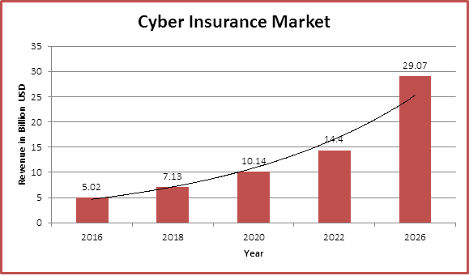
Scope of Coverage and Compensation for Insurance against Cyber Threats
In essence, cyber threat insurance is a combination of property insurance (i.e. the provision of indemnity for damage caused to the insured) and liability insurance, where damages to third parties are paid.

Slide 27
Scope of Coverage and Compensation for Insurance against Cyber Threats
The insurance provides insurance protection against:
leakage of personal data, information and data from the company's information system, whether accidental or negligent;
targeted attack of the information system by third parties or employees in order to gain access to sensitive Information.

Slide 28
Scope of Coverage and Compensation for Insurance against Cyber Threats
Current insurance products are set up to cover the following damages:
damage to the insured caused by the leakage of sensitive corporate data and information,
the insured's costs of notifying the leak of personal data, information and data to supervisory authorities and the public, and communicating with the affected clients to protect the company's reputation;
the insured's costs of identifying the leakage of personal data and information, ensuring the normal operation of the company's information system and implementing measures to remedy the deficiencies that caused the leak,
third party damage in connection with the leak,
costs of the insured for dealing with supervisory authorities and fines imposed by them;
loss of the insured's profits as a result of web or network services and the leakage of personal data and data.

Slide 29
Possibilities to Arrange Insurance against Cyber Threats
Insurance against cyber threats is covered by an insurance contract, as well as other types of insurance, in which conditions and scope of insurance coverage are set.
According to the policyholder's wish, it is possible to negotiate a contractual arrangement that differs from the insurance conditions so that the insurance coverage responds to a specific situation and its needs.
Of course, when it comes to arranging insurance, it is crucial to recognize the threats that those interested in cyber threat insurance may encounter.

Slide 30
Possibilities to Arrange Insurance against Cyber Threats
A very important role is played by the insurer questionnaire, which is filled in by the insurance applicant.
The questionnaire provides information on the policyholder's field of activity, the data and the types of data that the company works with and collects about its clients.
The insurer also works closely with an IT company that contributes to clarifying certain specifics on the part of the insurance applicant.

Slide 31
Possibilities to Arrange Insurance against Cyber Threats
Insuring society against cyber threats is currently very risky.
While, according to insurance companies and their standards, the potential damage incurred is comparable to major natural disasters, the incidence of cyber incidents is much higher in this case.
In the Czech Republic, insurance companies are afraid of this fact, so there is not so much offer of this type of insurance on the market.

Slide 32
Possibilities to Arrange Insurance against Cyber Threats
On the other hand, it can be said that there is a certain interest from companies, but this usually only happens after a media case has been published linked to data leakage or misuse.
Organizations realize that there is a threat in the form of targeted cyber attack, but most of the time, under pressure from other operations, they postpone this fact indefinitely.
They usually deal with the area only when a serious security problem occurs.

Slide 33
Characteristics of Insured Entities
Insurance against cyber threats can be provided to any organization, regardless of its business or operation.
Thus, both the manufacturing company and, for example, the university or the regional authority can insure their data.
It is important to note that insurance against cyber threats covers third-party data insurance.
This means that data relating to, for example, personal data about customers or students can be insured, not the organization's "know-how.

Slide 34
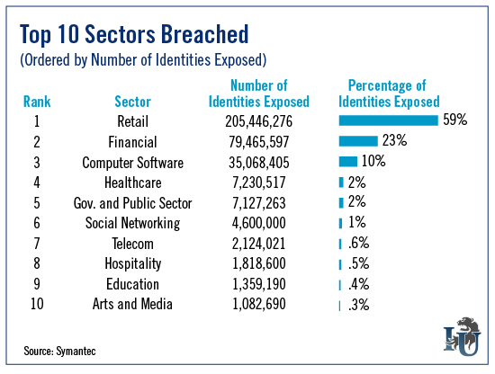
Characteristics of Insured Entities

Slide 35
Thank you for your attention

