Slide 1

Moravian Business College Olomouc
The Strategic Partnership Project - Cyber security 2022
Theresianische Militarakademie Moravian Business College Olomouc
Lecture IV
Lukáš Pavlík Ph.D.

Slide 2

Block II - Contents
Military System Global Security
National and International Cyber Security Strategies
  Fundamentals of Cyber Strategies
Cyber Security Organizations and Standards
  CSERT, ENISA, NIS
International information security standards
  CoBiT
  ITIL
  ISO series of 27000 & NIST & DoD

Slide 3
INFOSYS
The joint definition of an information system (INFOSYS) includes the entire infrastructure, organization, and components that collect, process, store, transmit, display, and disseminate information;
Army definition of INFOSYS includes personnel, machines, manual or automated procedures, and systems that allow collection, processing, dissemination, and display of information;
INFOSYS does not consist only of automated or electronic systems, but can be also manual and "low-tech;
The commander in peace operations should consider his entire staff as part of his INFOSYS

Slide 4
INFOSYS
INFOSYS enable the commander to use information effectively to maintain an accurate view of his battlespace, coordinate the activities of his tactical forces.

Slide 5
Military System Global security
Target of military system information security
Formation of effective and comprehensive information security program consisting of balanced enterprise risks and cost-effective investment in its development.
…hence it requires the right and relative combination of three main aspects:
technology
processes
people (users)

Slide 6
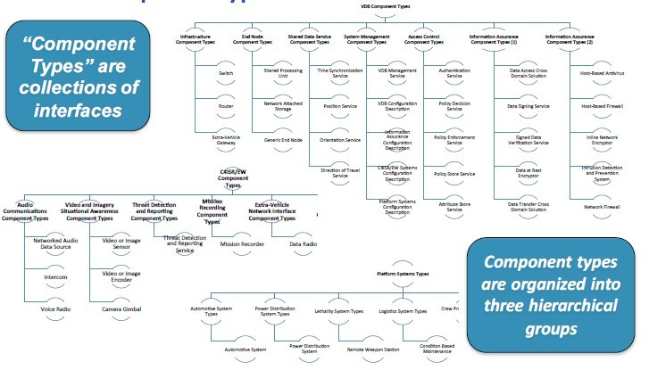
Architecture Contents
Source: Modular Open system Architectures for Military systems (M.S.Moore, K.J.Saylor) Southwest Research Institute; swri.org

Slide 7
People
People are the most important component of comprehensive information security system - and are the most critical part in development of action information security plan and schedule.
Elimination of “human factor” impact is based particularly on:
training of security awareness of staff (including board) – permanent necessity of increasing this awareness;
Explicit security organizational structure chart with defined responsibilities, duties etc.

Slide 8
Processes
The following steps:
Formulate security strategy;
Define information security management system in accordance with enterprise complexity, kind of managed information assets and used technology;
Perform risk evaluation; risk evaluation covers identification of threats that jeopardize enterprise assets, vulnerability management, weaknesses finding and determination of risk level;
Formulate security policy
Formulate of risk acceptance rules in accordance with security policy ;
Choose appropriate security key goals and countermeasures

Slide 9
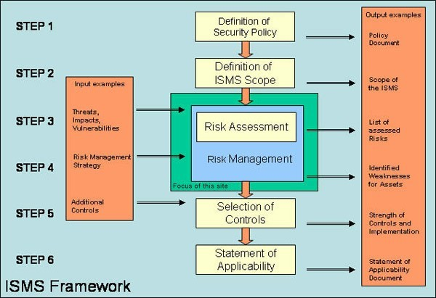
Processes
.

Slide 10
Technology
Technology is the third component of enterprise information security program
Technology is effective if:
Personnel implementation and awareness is on correct and appropriate level
Processes are designed and set up
➢

Slide 11
Security program
Developing and maintaining an information security program is based on determining of perimeters too.
Perimeter = definition of digital borders between enterprise environment and outer electronic word
Effective architecture for any information security program is based on layering security to provide multiple levels of defense.

Slide 12
Security
Security - vulnerabilities
Large number of customized settings
The system includes thousands of parameters and fine settings including segregation of duties for transactions and tables.
the security parameters are set for every single system.
Military system settings are customized according to battlefield requirements.

Slide 13
Security
Military INFOSYS integrate fielded and developmental battlefield automation systems and communications to functionally link strategic, operational, and tactical headquarters.
Following slide depicts the relationships of strategic, operational, and tactical architectures that tie the distributed elements into an integrated, interoperable, network.
➢

Slide 14
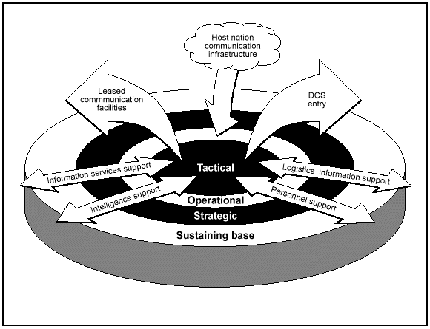
Security
Military IS communication
https:
//www.globalsecurity.org/

Slide 15
Security
Military INFOSYS integrate fielded and developmental battlefield automation systems and communications to functionally link strategic, operational, and tactical headquarters.
Following slide depicts the relationships of strategic, operational, and tactical architectures that tie the distributed elements into an integrated, interoperable, network.
➢

Slide 16
Security vulnerabilities
Military INFOSYS integrate fielded and developmental battlefield automation systems and with it relates
Specificity
➢
Resolvers of SW programs have to check and fix vulnerabilities on the regular basis since hackers monitor weakneses of applications to find and exploit security issues.

Slide 17
Security vulnerabilities
Lack of competent specialists
the „users“ running military systems have "lack“ of awareness and do not be fully aware of actions taken towards global security".
Global security is necessary phenomenom of a new „life“ See example on next slide
➢
➢
➢
➢

Slide 18
National and International Cyber Security Strategies
Securing network and information systems in the European Union are essential to keep the cyber economy running and to guarantee prosperity of the Member States.
The latest cyber security strategy of the European Union is titled Cybersecurity Strategy of the European Union: An Open, Safe and Secure Cyberspace.
It was issued in 2013. (EU Cyber Security Strategy, 2013.)
➢
➢
The main objectives of the strategy are:
Increasing cyber security capabilities and cooperation in the EU; Making the EU a strong player in cyber security;
Mainstreaming cyber security in EU policies.
➢
➢
➢

Slide 19
EU Countries
JOINT COMMUNICATION TO THE EUROPEAN PARLIAMENT, THE COUNCIL, THE EUROPEAN ECONOMIC AND SOCIAL COMMITTEE AND THE COMMITTEE OF THE REGIONS
In Cybersecurity Strategy of the European Union says
Europe will remain vulnerable without a substantial effort to enhance public and private capacities, resources and processes to prevent, detect and handle cyber security incidents.
This is why the Commission has developed a policy on Network and Information Security (NIS)
The European Network and Information Security Agency ENISA was established in a new Regulation to strengthen ENISA and modernise its mandate is being negotiated by Council and Parliament.
➢
➢

Slide 20
NATO countries
NATO and its Member states rely on primary tasks of collective defence, crisis management and cooperative security.
NATO approved its first Policy on Cyber Defence in January 2008 just after massive cyber-attacks happened against Estonia in spring 2007.
In June 2011, NATO defence ministers approved the second NATO Policy on Cyber Defence, titled Defending the Networks – The NATO Policy on Cyber Defence. (NATO, 2016.)
This policy set out a vision for coordinated efforts in cyber defence throughout the Alliance

Slide 21
NATO countries
Cyber defense is part of NATO’s core task of collective defense. NATO is responsible for the protection of its own networks.
NATO reaffirmed its defensive mandate and recognised cyberspace as a domain of operations in which NATO must defend itself as effectively as it does in the air, on land and at sea.
Member states are and remain responsible for the protection of their national networks, which need to be compatible with those of NATO and of each other.
➢
➢
➢
➢

Slide 22
NATO countries
➢
A study commissioned by the NATO Cooperative Cyber Defense Center of Excellence that assesses how international law applies to cyber conflict, a cyber- attack is “a cyber operation, whether offensive or defensive, that is reasonably expected to cause injury or death to persons or damage or destruction to objects.”
This definition, like other ones, leaves significant room for interpretation
As to defining and measuring cyber-attacks, there is no clear standard that is applied across NATO countries. This leads to diverging metrics and makes it challenging to effectively compare data from different national contexts
➢
➢

Slide 23
Cyber Strategy – Czech republic
Strategy of promoting the security interest
The collective dimension of security and defence Strategy of prevention and suppression of security threats
➢
➢
➢
The weakening of the cooperative security mechanism and of political and international legal commitments
The economic framework for safeguarding security interests
➢
➢

Slide 24
Cyber Strategy – Czech republic
Security Threats
Weakening of the cooperative security mechanism and of political and international legal commitments in the area of security
Instability and regional conflicts in and around the Euro-Atlantic area. Terrorism
Proliferation of weapons of mass destruction and their means of delivery Cyber attacks
Negative aspects of international migration
➢
➢
➢
➢
➢
➢
➢

Slide 25
Cyber Strategy - Austria
Österreichische Sicherheitsstrategie Sicherheit in einer neuen Dekade – 2013
zur aktiven Gestaltung einer für Österreich und seine Bevölkerung sowie die Europäische Union (EU) insgesamt vorteilhaften sicherheitsrelevanten Situation,
➢
➢
zur Verhinderung des Entstehens oder Wirksamwerdens von Bedrohungen und zum Schutz gegenüber Bedrohungen bzw. zu deren Bewältigung.
➢
actively shaping a security-relevant situation for Austria and its people as well as the European Union (EU),
➢
➢
to prevent the emergence or the taking effect of threats and for protection against or coping with threats.
➢
The Austrian Cyber Security Strategy / ACSS (Österreichische Strategie für Cyber Sicherheit / ÖSCS) was issued in 2013.
In the framework of its Cyber Security Strategy, Austria set the following strategic goals
➢

Slide 26
Cyber Strategy - Austria
Availability, reliability, confidentiality of data exchange and he integrity of data themselves are guaranteed only in a secure, resilient and reliable cyber space.
  The virtual space must be capable of resisting risks,.
  The design of crucial ICT systems should be as redundant as possible.
➢
Based on the national approach of the competent federal ministries, Austria will ensure that its ICT infrastructures are secure and resilient to threats. The governmental bodies will cooperate closely and as partners with the private sector.
The legal asset “cyber security” is protected by the Austrian authorities – in cooperation with non-governmental partners – by taking effective and proportionate measures in the field of political-strategic control, recognition and response as well as limitation of effects and restoration.
➢

Slide 27
Cyber Strategy - Austria
By taking a number of awareness measures, Austria is building a “culture of cyber security”.
In the framework of a national (and EU) dialogue on cyber security, existing cooperation is strengthened, and new initiatives are supported and interlinked by building knowledge, capabilities and capacities. Thanks to this approach, Austria can be pioneer in implementing measures to secure the digital society.
Austria plays an active role in international cooperation at European and global levels, with participation in e.g. ENISA, by formulating international strategies, etc.
➢
➢

Slide 28
Cyber Strategy - Austria
The Austrian administration’s e-government is secure and continuously further developed; the security measures of the Federal Republic of Austria, the federal provinces, cities and municipalities will be strengthened.
All Austrian enterprises will protect the integrity of their own applications
The Austrian population should be aware of the individual’s personal responsibility in cyber space. All citizens should ensure adequate protection of their online activities and have the necessary capabilities for electronic authentication and signature.
➢
➢

Slide 29
EU - ENISA
ENISA - the European Union Agency for Network and Information Security is a centre of expertise for cyber security in Europe.
The Agency closely cooperates with the Members States and private sector to deliver advice and solutions.
ENISA also supports the development and implementation of the European Union's policy and law on matters relating to network and information security (NIS).

Slide 30
EU - ENISA
The main activities
The draft “EU Cybersecurity Act”, proposed in 2018, intends to establish a European cybersecurity certification framework for ICT products, services and processes
The Cybersecurity Act creates a framework for European Cybersecurity Certificates for products, processes and services that will be valid throughout the EU.
A cybersecurity certification framework incorporates security features in the early stages of their technical design and development (security by design).
It enables their users to ascertain the level of security assurance and ensures that these security features are independently verified.
➢
➢
➢
➢

Slide 31
EU - ENISA
Its activities include
the pan-European Cyber Security Exercises,
the development of National Cyber Security Strategies, CSIRTs cooperation and capacity building, and
studies on secure Cloud adoption, addressing data protection issues,
privacy enhancing technologies and privacy on emerging technologies, eIDs and trust services,
identifying the cyber threat landscape.
➢
➢
➢
➢
➢
➢
➢

Slide 32
ENISA
Inspiration for you:
Visit ENISA web site to get to know EU cyber strategies in greater detail.
https://www.enisa.europa.eu/topics/national-cyber security- strategies/ncss-map/

Slide 33
NIS
The NIS Directive - The Directive on security of network and information systems
- adopted by the European Parliament on 6 July 2016 and the Directive entered into force in August 2016.
The Member States had 21 months to transpose the Directive into their national laws and another 6 months to identify the operators of essential services.
In 2013 the Commission put forward a proposal for a Directive concerning measures to ensure a high common level of network and information security across the Union.

Slide 34
NIS
The NIS Directive provides legal measures to boost the overall level of cyber security in the EU by ensuring:
➢
The Member States’ preparedness by requiring them to be appropriately equipped, e.g. via a Computer Security Incident Response Team (CSIRT) and a competent national NIS authority;
Cooperation among all the Member States by setting up a cooperation group, in order to support and facilitate strategic cooperation and the exchange of information among Member States.
They will also need to set a CSIRT Network, in order to promote swift and effective operational cooperation on specific cyber security incidents and sharing information about risks;
➢
➢

Slide 35
NIS
➢
There are sectors that rely heavily on ICTs, such as energy, transport, water, banking, financial market infrastructures, healthcare and digital infrastructure, that means businesses in these sectors that are identified by the Member States as operators of essential services will have to take appropriate security measures and to report on serious incidents to the relevant national authority.
Also, key digital service providers (search engines, cloud computing services and online marketplaces) will have to comply with the security and notification requirements under this NIS Directive.
➢

Slide 36
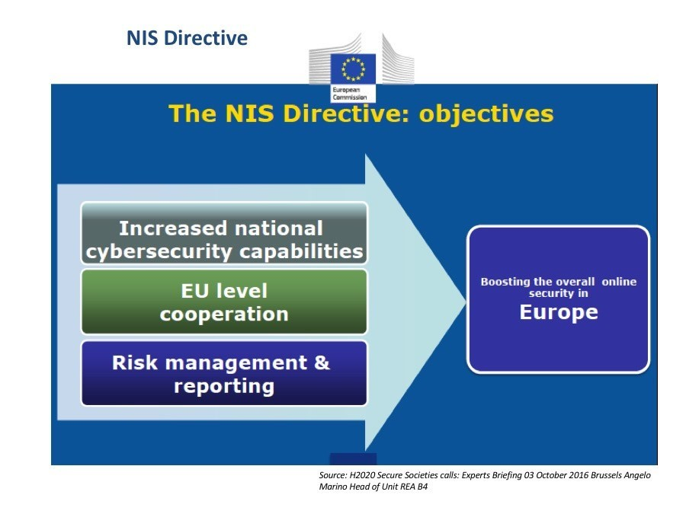
NIS
NIS Directive

Slide 37
CSIRT and CERT
CERT i.e.Computer Emergency Response Team. is usually expert group that handle computer security incidents. Alternative name is known for these groups like Computer Security Incident Response Team (CSIRT).
CERTs usually integrate the following capabilities:
coordination of different cyber security agencies; building cyber security knowledge base;
announcing and notifying of different cyber vulnerabilities; building and developing cyber vulnerability analysis tools; offering cyber security trainings.
➢
➢
➢
➢
➢

Slide 38
CERT
The EU set up a permanent Computer Emergency Response Team - CERT-EU for the EU institutions, agencies and bodies in 2012.
This team is made up of IT security experts from the main EU Institutions.
CERT-EU cooperates closely with other CERTs in the Member States and beyond as well as with specialised IT security companies
➢
➢

Slide 39
International information security standards
Note
In many cases, it is worthwhile to use formula- it is better to copy than to think badly.
Standards and methodologies are an important helper and guide to ensuring our designs, systems and products fulfil security requirements, basic requirements and parameters for cyber security, etc.

Slide 40
COBIT
COBIT
The Control Objectives for Information and Related Technology
elaborated by the Information Systems Audit and Control Association (ISACA) and provide help for the command, control, and governance of information technology.
It assists the leadership with the risk management of a permanently changing information environment and with the assessment of investments necessary for shaping control mechanisms.
This recommendation is a generally accepted set of IT control objectives and directives which can be widely accepted and used in the field of IT security control and regulation by leaders, users, and auditors as well.
➢
➢

Slide 41
ITIL
ITIL - The Information Technology Infrastructure Library (ITIL) - ITIL 4 update (ITIL v.3 is still actual)
a collection of concepts and practices combined in a series of books to be applied in IT Service Management (ITSM), IT development and IT operations.
At first it was created in late of 1980 by Central Computing and Telecommunication Agency (CCTA). The names ITIL and IT Infrastructure Library are registered trademarks of the United Kingdom's Office of Government Commerce (OGC).
ITIL can be classified as a collection of best practices, and its target is large companies, as well small ones.

Slide 42
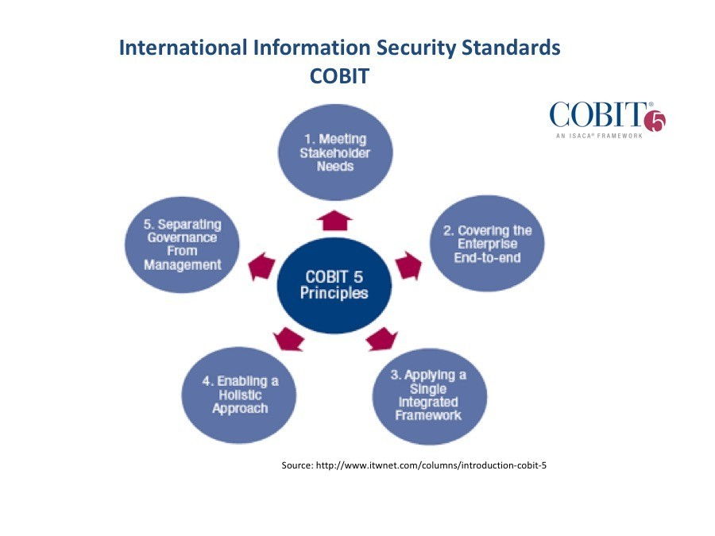
COBIT
.

Slide 43
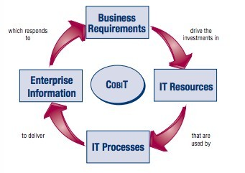
COBIT
.
Unit

Slide 44
Deming cycle
Deming cycle
W. Edwards Deming recommended that processes be placed in a continuous feedback loop so that managers can identify and change the parts of the process that need improvements.
Deming created a (rather oversimplified) diagram to illustrate this continuous process, commonly known as
the PDCA cycle for Plan, Do, Check, Act

Slide 45
Deming cycle
Plan-In the first phase one must identify the problem and the root cause of the problem. Once the problem has been identified then one must plan for corrective action.
Do– In this phase the corrective action will be executed. While the plan is being carried out one must collect data for future reference.
Check– From the data collected in the Do phase, the next step is to Check for results. This phase is also sometimes known as the compare or study phase; that is because expected outcomes are compared with actual results. If the process was successful, then it can move on to the next phase.
Act– If the previous steps have successfully solved the problem then the process can be standardized and fully implemented. This means that this process can be used as a reference to solve similar problems in the future. The cycle should be repeated to promote continuous improvement.

Slide 46
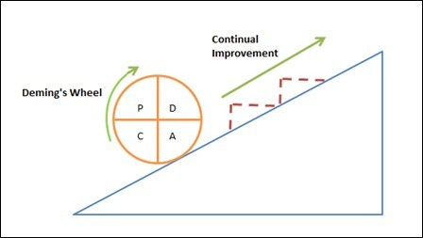
Deming cycle
.

Slide 47
COBIT
The latest, fifth, edition of COBIT (COBIT 5) includes framework systems
COBIT 4.1, Val IT 2.0, Risk IT,
and is significantly influenced by
Business Model for Information Security (BMIS) and Information Technology Assurance Framework (ITAF)
➢
➢
➢
➢
➢
Note
New version is prepared, i.e. COBIT19; Diferencies - more processes

Slide 48
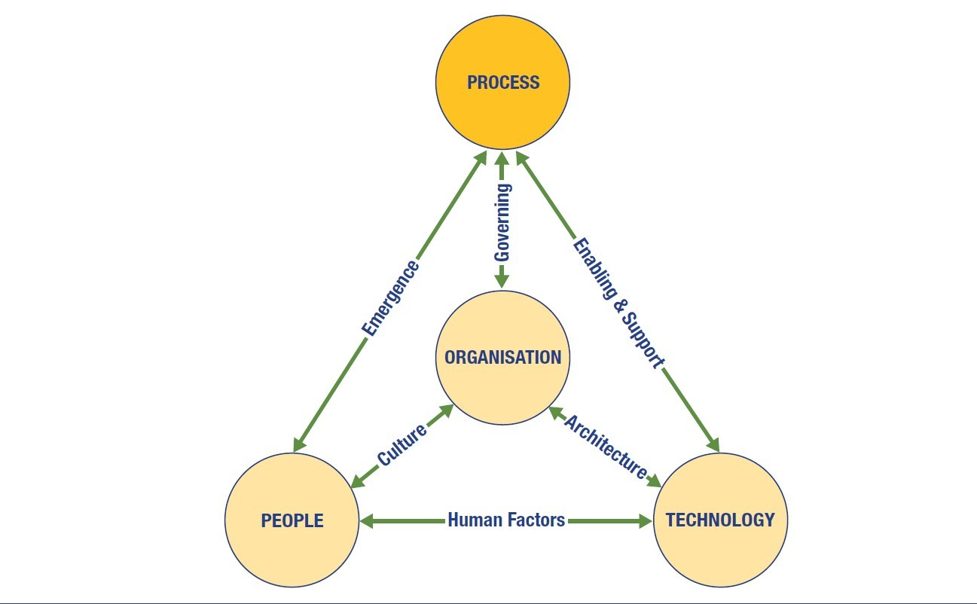
COBIT
.

Slide 49
COBIT
The model addresses the three traditional elements considered in IT (People, Process and Technology) and adds a critical fourth
element (Organisation). In terms of the information security programme, the flexibility and influence of elements and DIs vary.
Some elements are comparatively inactive, but ever-present, such as the overall shape and design of the enterprise. It is there, but it
should be seen as a boundary for the security management initiatives rather than an active and ongoing influence. Likewise, people
are an important element, but not one that changes over time. Human nature will persist, and it is only through cultural change

Slide 50
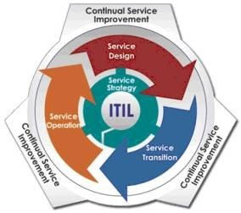
ITIL
ITIL v3 (ITIL 4) in numbers : Five books ITIL Service Strategy, ITIL Service Design, ITIL Service Transition, ITIL Service Operation Continual Service Improvement (CSI) 84 checklists and document templates
23 overall process - two for Strategy, 10 for Design, seven for Transition, seven for Operation and four for CSI

Slide 51
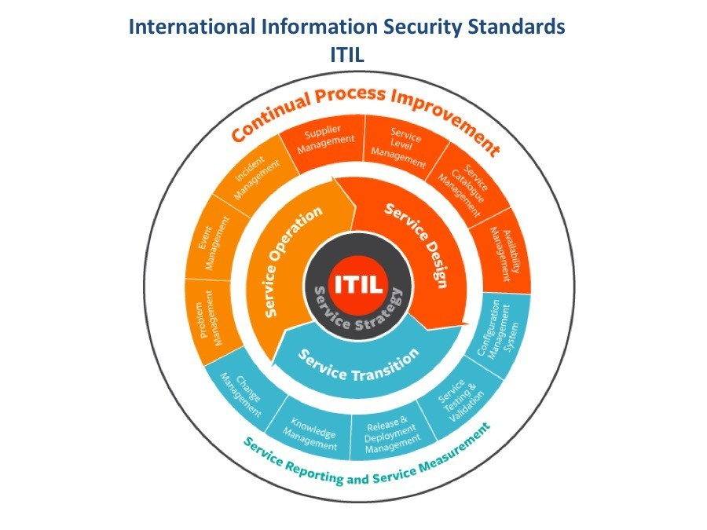
ITIL
.

Slide 52
ISO/IEC 27001
This standard describes the requirements for implementing, operating, monitoring, checking, maintaining, and developing an Information Security Management System (ISMS).
It contains the requirements for the auditing of an organisation. It also outlines demands allowing the control and validation of the ISMS of an organisation by an external expert.
This standard was issued in 2013.
The fundamental notion of ISO/IEC 27001:2013 is the Information Security Management System (ISMS), which is a general management system.

Slide 53
ISO/IEC 27001
The fundamental notion of ISO/IEC 27001:2013 is the Information Security Management System (ISMS),
which is a general management system. It is based on corporate risk management and identifies, realises, operates, controls, maintains, and corrects information security in accordance with the PDCA (Plan, Do, Check, Act) principle.
The parts of the management system are:
organisational structure, regulations, planning activities, responsibilities, practices, procedures, processes, and resources.

Slide 54
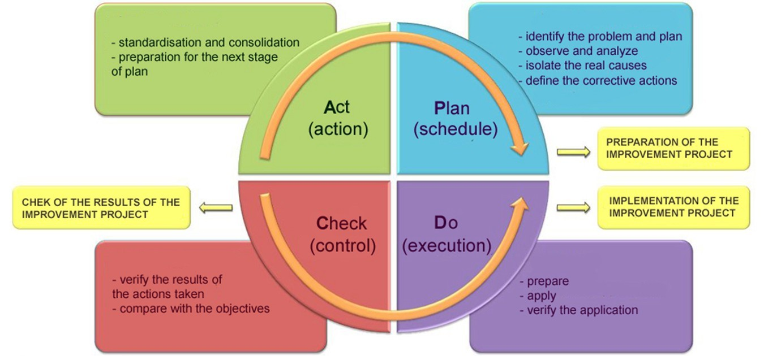
ISO/IEC 27001
Deming

Slide 55
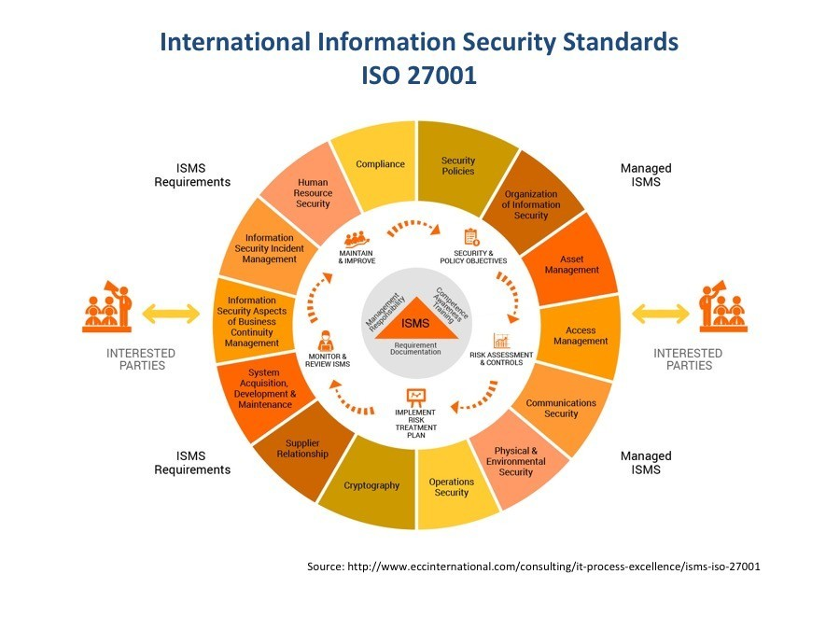
ISO/IEC 27001
Deming cycle

Slide 56
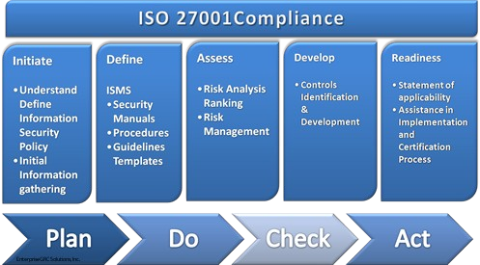
ISO/IEC 27001
proces

Slide 57
ISO/IEC 27002
ISO/IEC 27002:2013 contains code of practice .
It is the Manual of Information Security Management Practice, which contains principal tools, proceses and methods related to security of information systems.
This standard includes 11 security measures chapters which contain a total of 30 security categories. It also has an introduction for risk assessment and correction
➢
➢
➢

Slide 58
ISO/IEC 27002
Information security policies:
Management at the top level should define a set of policies to specify their direction of, and support for, information security.There must be defined an overall “information security policy” as specified in ISO/IEC 27001

Slide 59
ISO/IEC 27002
Objective:
To provide management direction and support for information security in accordance with business requirements and relevant laws and regulations.
The policies for information security should be reviewed at planned intervals or if significant changes occur to ensure their continuing suitability, adequacy and effectiveness.
Each policy must have an owner who has approved management responsibility for the development, review and evaluation of the policies.

Slide 60
ISO/IEC 27002
Organisation of information security:
Proposals for separating tasks and responsibilities in the field of information security, and for defining the relating modes of implementation.

Slide 61
ISO/IEC 27002
Mobile devices and teleworking:
Objective:
To ensure the security of teleworking and use of mobile devices
There should be security policies and controls
  for mobile devices (laptops, tablets, movable ICT devices, smartphones, USB devices) and
  teleworking (such as telecommuting, remote/virtual workplaces etc.

Slide 62
ISO/IEC 27002
It is about the reduction of risks posed by human factors and threats. Such threats may include human error, theft, fraud, sabotage, or incompetence. Information security training and preparation of users is also included.
Human resource security:
➢

Slide 63
ISO/IEC 27002
Access control:
➢
It must be specified protected system of assets associated with information and information processing facilities.

Slide 64
ISO/IEC 27002
Objective:
To limit access to information and information processing facilities
The organization’s requirements to control access to information assets must be specified and documented in an access control policy and procedures. Network access must be structured according to roles.
The allocation of access rights to users should be controlled from initial user registration through to his going off and removal of access rights
Users should be made aware of their responsibilities towards maintaining effective access controls e.g. choosing strong passwords and keeping them confidential.

Slide 65
ISO/IEC 27002
Objective:
To limit access to information and information processing facilities
The organization’s requirements to control access to information assets must be specified and documented in an access control policy and procedures. Network access must be structured according to roles.
The allocation of access rights to users should be controlled from initial user registration through to his going off and removal of access rights
Users should be made aware of their responsibilities towards maintaining effective access controls e.g. choosing strong passwords and keeping them confidential.

Slide 66
ISO/IEC 27002
Cryptography:
It must be specified and implemented a policy on the use of cryptographic controls for protection of information should be developed.
Objective:
To ensure proper and effective use of cryptography to protect the confidentiality, authenticity and/or integrity of information

Slide 67
ISO/IEC 27002
Physical and environmental security:
It defines the establishment of protected areas, and the control of the access to them.

Slide 68
ISO/IEC 27002
Operations security:
➢
This chapter deals with operational procedures and responsibilities, and refers to necessity of logging, monitoring and backup.

Slide 69
ISO/IEC 27002
Communications security:
this chapter is about the storage and processing of information, and the protection of communications, as well as the security rules for hardware, software, and network elements including the proper operation of information-processing assets, and the rules of privacy, integrity, and accessibility of information and other assets, for the minimisation of system errors, for the defence against or detection of network data losses, and data modifications

Slide 70
ISO/IEC 27002
this chapter focuses on the reduction of the impacts of disasters and other unexpected events on the organisation, which influence business processes and the system elements serving them. A disaster is an event which may cause irreparable damage to the business.
Aspects are provided for a disaster management plan and a business continuity plan
Business continuity management:
➢

Slide 71
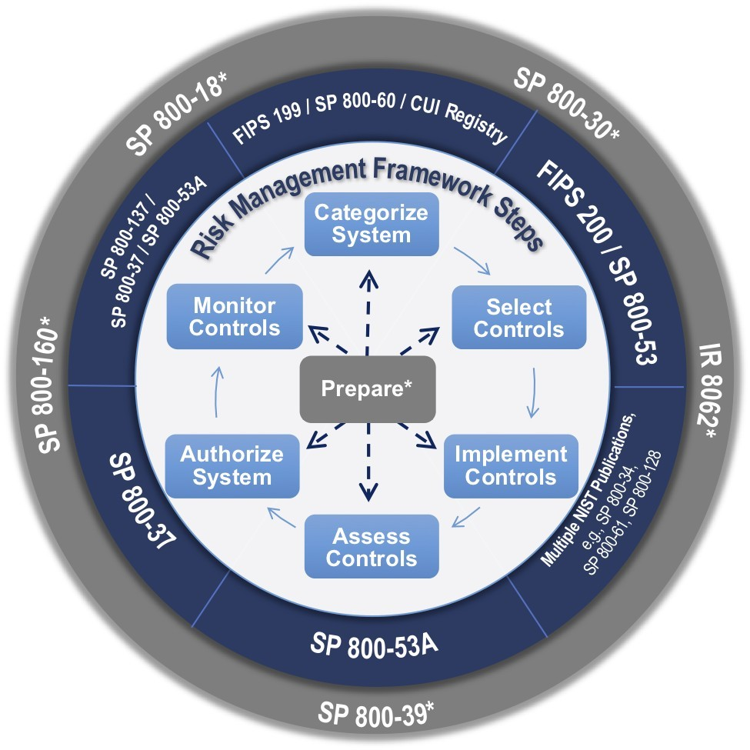
NIST
The National Institute of Standards and Technology (NIST) a non-regulatory agency
of the United States Department of Commerce.
Its mission is to promote innovation and industrial competitiveness.
NIST's activities are organized into laboratory programs that include nanoscale science and technology, engineering, information technology,
neutron research, material measurement, and physical measurement

Slide 72
NIST
NIST issued the FIPS Publication Series
to coordinate the requirements and standards for cryptography modules that include both hardware and software components.
FIPS 140-2; Security Requirements for Cryptographic Modules
specifies the security requirements for cryptographic module,
defines four increasing, qualitative levels
contains awide range of potential applications and environments.

Slide 73
Thank you for your attention

