Slide 1
Moravian Business College Olomouc
The Strategic Partnership Project - Cyber security 2022
Theresianische Militarakademie Moravian Business College Olomouc
Lecture III
Lukáš Pavlík, Ph.D.

Slide 2
Contens
➢
➢
➢
➢
➢
Risk
Risk analysis Risk management Risk evaluation Risk treatment

Slide 3
Risk
The risk management plan
includes these definitions and guidelines:
List of possible risk sources and categories Impact and probability matrix
Risk reduction and action plan Contingency plan
Risk threshold and metrics
➢
➢
➢
➢
➢

Slide 4
Objectives
ISO/IEC 27005 is a standard that propose a way to manage information security risks, particularly in the context of the implementation of an ISMS (ISO/IEC 27001:2019)
ISO/IEC 27005 is not a method, just a guide of risk management
Risk Management is a process that helps you identify and manage potential problems that could undermine key business initiatives or projects

Slide 5
Basic Questions and Answers
Before starting a risk analysis project, it needs to be handled
Q:
What data is valuable to our consumers and/or members?
What would happen if the organization discovered a data breach, and the data was valuable?
What legal liability do we have if something happened to the data?
A:
Answers can be reached by risk analysis, assessment and management, which it is measured in terms of a combination of the probability of a threat activation and its consequence.

Slide 6
Steps to a Cybersecurity Risk Assessment
Risk assessments can be performed on any application, function, or process within your organization.
Organization must do these steps at first
develop an operational framework that fits the size, scope, and complexity of your organization.
register internal and external systems that are either critical to your operations, and / or that process, store, or transmit legally protected or sensitive data
create a risk assessment schedule based on criticality and information sensitivity.

Slide 7
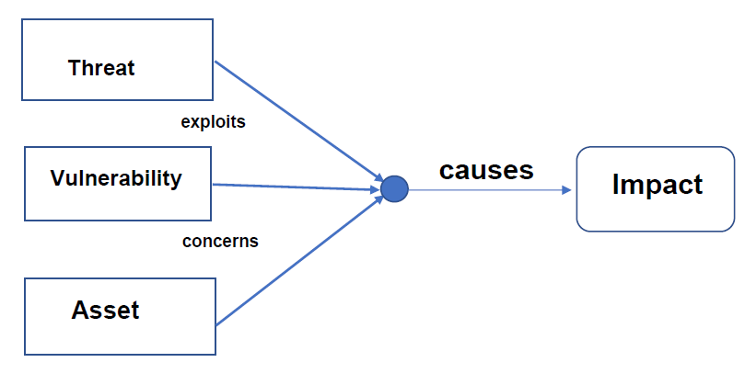
Information Security Risk
The possibility that a given threat will exploit vulnerabilities of an asset and thereby cause (in the most cases negative) impact to the organization.

Slide 8
Definition
Asset - anything that has value to the organization
Vulnerability - a cyber-security term that refers to a flaw in a system that can leave it open to attack. A vulnerability may also refer to any type of weakness in an information system itself, in a set of procedures, or in anything that leaves information security exposed to a threat.
Threat - anything that can negatively alter, disrupt, hide, or erase an object or objects of interest – information system.
Potential cause of an unwanted incident, which may result in harm to a system or organization

Slide 9
Definition
IT Risk
a combination of the consequence of an event and the probability of the event,
a combination of Asset, Threat, Vulnerability and Impact,
Impact to the organization when a threat exploits a vulnerability, effect of uncertainty on objectives,
The possibility that a given threat will exploit vulnerabilities of an asset and thereby cause (in the most cases negative) impact to the organization.
Source of the risk, possible attack
3 kinds
Accidental (unintentional human action)
Deliberate (voluntary human action)
Environmental (non-human action)

Slide 10
Definition
Vulnerability
weakness of an asset (or control) that can be exploited by a threat
Impact
adverse change to the level of business objectives achieved
Consequence of the risk on the system or organization
Generally expressed in terms of:
Confidentiality
Integrity
Availability

Slide 11
Definition
Confidentiality
property that information is not made available or disclosed to unauthorized individuals, entities or processes
internal disclosure, external disclosure...
Integrity
property of protecting the accuracy and completeness of assets
accidental modification, deliberate modification, incorrect results, incomplete results
Availability
property of being accessible and usable upon demand by an authorized entity
performance degradation, short-term/long-term interruption, total loss (destruction)

Slide 12
Definition
Risk = combination of (Threat * Vulnerability * Impact)
Vulnerability: intrinsic to the object or situation
Threat: probability of occurrence of an (external) event exploiting the vulnerability
Impact: consequence Example: damage of servers
Vulnerability: server room is open without authorization of access
Threat: a gangster comes in and …
Impact: loss of business continuity, etc.

Slide 13
Risk Analysis - Identify Assets
All assets should be clearly identified and an inventory of all important assets
information: databases and data files, system documentation, research information, user manuals, training material, operational or support procedures, business continuity plans, fallback arrangements, audit trails, and archived information;
software assets: application software, system software, development tools, and utilities;
physical assets: computer equipment, Communications equipment, removable media, and other equipment, buildings;
services: computing and Communications services, general Utilities, e.g. heating, lighting, power, and air-conditioning;
people, and their qualifications, skills, and experience;
reputation and image of the organization.

Slide 14
Types of assets
Asset: digital document:
threat: disk failure; vulnerability: there is no backup of the document (potential loss of availability)
threat: virus; vulnerability: anti-virus program is not properly updated (potential loss of confidentiality, integrity and availability)
threat: unauthorized access; vulnerability: access control scheme is not properly defined (potential loss of confidentiality, integrity and availability)
threat: unauthorized access; vulnerability: the access was given to too many people (potential loss of confidentiality, integrity and availability)
Asset: system administrator:
threat: unavailability of this person; vulnerability: there is no replacement for this position (potential loss of availability)
threat: frequent errors; vulnerability: lack of training (potential loss of integrity and availability)

Slide 15
Risk Analysis - Identify Threats
Human – loss of a key individual -Illness, death, injury, leave job.
Operational – loss of access to essential assets, or failures in distribution, damage to supplies and operations, any kinds of stealing
Procedural – Failures of accountability, internal systems, or controls, or from fraud.
Project – taking too long on key tasks, lack of product or service quality.
Financial – Business failure, or non-availability of funding.
Technical – Change of technology, or from technical failure.
Natural – Weather, natural disasters, or disease.
Reputational – Loss of customer or employee confidence, or damage to market reputation.
Political – Changes in government policy, or foreign influence.
Structural – Dangerous chemicals, poor lighting, harm of staff, products, or technology can be harmed.

Slide 16
Types of threats
Unauthorized access (malicious or accidental). This could be from a direct hacking attack / compromise, malware infection, or internal threat.
Misuse of information (or privilege) by an authorized user. This could be the result of an unapproved use of data or changes made without approval.
Data leakage or unintentional exposure of information. This includes permitting the use of unencrypted USB and / or CD-ROM without restriction; deficient paper retention and destruction practices; transmitting Non-Public Personal Information (NPPI) over unsecured channels; or accidentally sending sensitive information to the wrong recipient.
Loss of data. This can be the result of poor replication and back-up processes.
Disruption of service or productivity.

Slide 17
Risk Analysis and Risk Management
It can be used a number of different approaches to carry out a thorough analysis:
SWOT Analysis
Failure Mode and Effects Analysis etc.
➢
➢
The useful approach is - FRAP analysis

Slide 18
FACILITATED RISK ANALYSIS PROCESS
The Facilitated Risk Analysis Process (FRAP) was developed as an efficient and disciplined process for ensuring consideration and documentation of information security-related risks to business operations
The process involves analyzing system, application or segment of system operation at a time and is based of communication with a team of individuals who are familiar with business information needs and technical staff who have a detailed understanding of potential system vulnerabilities and related controls.
The sessions, which follow a standard agenda, are managed by a member of the project, external expert or information protection staff and with a target of ensuring that the team members communicate effectively and adhere to the agenda, i.e. to identify potential threats, vulnerabilities, and resultant negative impacts on data integrity, confidentiality, and availability.
Then the team will analyze the effects of such impacts on business operations and broadly categorize the risks according to their priority level.

Slide 19
Risk Management process
Risk Management consists of these steps process:
Step 1 – Identify assets, threats, vulnerabilities
Step 2 – Identify the risks
Step 3 – Analyse the risks
Step 4 – Evaluate the risks
Step 5 – Treat the risks
Risk mitigation and contingency measure definition
Risk monitoring and control
Risk identification efficiency measurement

Slide 20
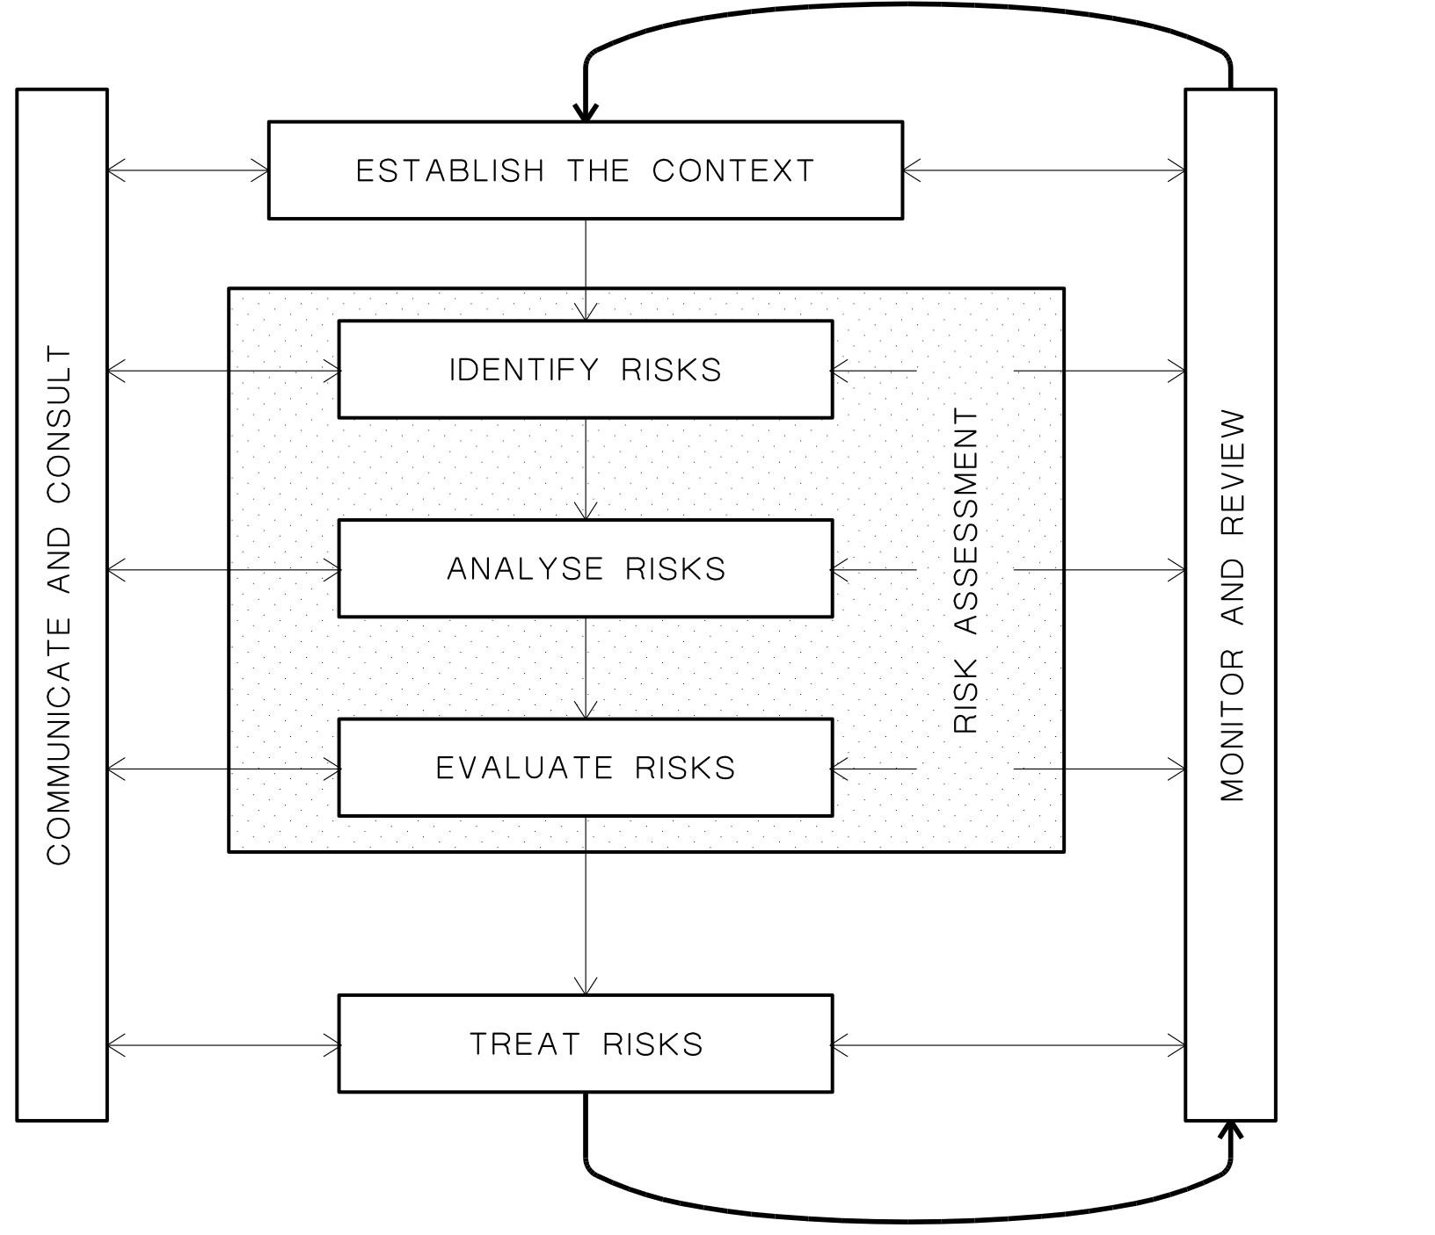
Risk Management process
ISO 27005

Slide 21
Risk Analysis
Risk Analysis
Risk analysis involves examining how project outcomes and objectives might change due to the impact of the risk event.
The risks are identified <= evidence of impacts
They are analyses to identify
the qualitative and
quantitative impact of the risk
Apropriate steps can be taken to mitigate them.

Slide 22
Risk management
The purpose of this step is to identify the likelihood what could go and what is the consequence (loss or damage) of it occurring.
It is necessary to do:
List risks, incidents or accidents that might happen
List the possible causes and scenarios or description of the risk, incident or accident.
It is necessary estimate impact
What is the likelihood of them happening?
What will be the consequences if they do happen?
Risks can be technical, external, internal, organizational, in management proces

Slide 23
Risk Identification
.

Slide 24
Estimate risk - impact
Sources of risks Physical risks
personal injuries,
environmental and weather conditions
and the physical assets of the organisation such as property, buildings, equipment, vehicles, stock and grounds.
Financial risks of the assets of the organisation
theft, fraud, loans, license fees, attendances, membership fees, insurance costs, lease payments, pay-out of damages claims or penalties and fines by the government.
Ethical risks involve actual or potential harm to the reputation or beliefs of your club, while
Legal risks consist of responsibilities imposed on providers, participants and consumers arising from laws made by federal, state and local government authorities.

Slide 25
Definition
Risk identification. In the methodology for identification was prescribed: you needed to identify assets, threats and vulnerabilities
Risk owners. Basically, you should choose a person who is both interested in resolving a risk, and positioned highly enough in the organization to do something about it.
Assessing consequences and likelihood. You should assess separately the consequences and likelihood for each of your risks; you are completely free to use whichever scales you like – e.g., Low-Medium-High, or 1 to 5,.
Method of risk calculation. This is usually done through addition
(e.g., 2 + 5 = 7).

Slide 26
Risk Analysis – level of risk
The purpose of this step is to identify the likelihood what could go and what is the consequence (loss or damage) of it occurring.
It is necessary to do:
List risks, incidents or accidents that might happen
List the possible causes and scenarios or description of the risk, incident or accident.
What is the likelihood of them happening?
What will be the consequences if they do happen?
Risks can be physical, financial, ethical or legal

Slide 27
Likelihood scale
.
Rating | LIKELIHOOD The potential for problems to occur in a year
5 | ALMOST CERTAIN: will probably occur, could occur several times per year
4 | LIKELY: high probability, likely to arise once per year
3 | POSSIBLE: reasonable likelihood that it may arise over a five-year period
2 | UNLIKELY: plausible, could occur over a five to ten year period
1 | RARE: very unlikely but not impossible, unlikely over a ten year period

Slide 28
Loss or damage impact scale
 | Rating | POTENTIAL IMPACT In terms of the objectives of the club
 | 5 | CATASTROPHIC: most objectives may not be achieved, or several severely affected
 | 4 | MAJOR: most objectives threatened, or one severely affected
 | 3 | MODERATE: some objectives affected, considerable effort to rectify i.e. trafic injury – requires medical attention and has some impact on participation in business and/or other activity
 | 2 | MINOR: easily remedied, with some effort the objectives can be achieved i.e. trafic injury requires first aid treatment and prevents immediate participation in business and/or other activity
 | 1 | NEGLIGIBLE: very small impact, rectified by normal processes i.e. trafic injury but does not prevent participation
x

Slide 29
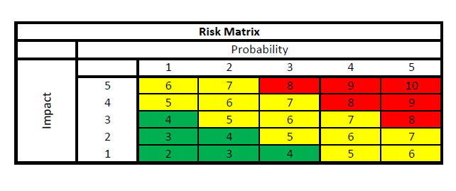
Risk Matrix
Formula:
Risk level = F((impact) + (probability))

Slide 30
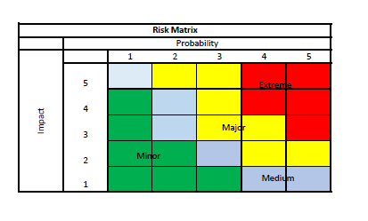
Risk Priority Scale
Example
An extreme risk is:
A very likely risk
level = 4
most objectives threatened
Vulnerability = 4
And whose asset value is 3
Scale of risk = 4 + 4 = 8
Value of risk = 8 + 3 = 11 It is necessary to solve it immediately

Slide 31
Adopted Solutions
What needs to be done
Extreme | Extreme risks that are likely to arise and have potentially serious consequences requiring urgent attention
Major | Major risks that are likely to arise and have potentially serious consequences requiring urgent attention or investigation
Medium | Medium risks that are likely to arise or have serious consequences
Minor | Minor risks and low consequences that may be managed by routine procedures

Slide 32
Example - risk assessment
The assess the overall risks is the final stage of the detailed information security risk assessment
Consequences (impacts) may be assessed in several ways,
➢
➢
qualitative measures (low, moderate or severe), quantitative e.g. monetary,
and or a combination of both.
Likelihood (probability)
To assess the likelihood of threat occurrence, the time frame over which the asset will have value to be protected should be established.
The likelihood of a specific threat occurring is affected by the following:

Slide 33
Example - risk assessment
Namely:
The attractiveness of the asset, - target of threat is being considered
The vulnerability of the asset, applicable to be considered as a threat
The susceptibility of the vulnerability to exploitation, applicable to both technical and non-technical vulnerabilities

Slide 34
Example - risk assessment
The case with predefined values
In risk quantitative assessment methods physical assets are valued in terms of replacement or reconstruction costs (i.e. quantitative measurements).
These costs are then converted onto the same qualitative scale as that used for information.
It is used in case too, when:
software assets are valued in the same way as physical assets and
application software (from the point of view confidentiality or integrity (for example if source code is itself commercially sensitive).

Slide 35
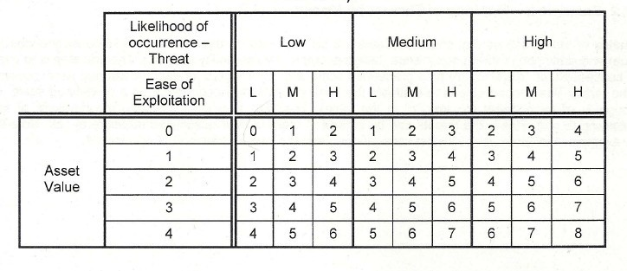
Example - risk assessment
Combination assets, vulnerabilities, probability
Example of risk matrix specified in ISO 27005
Risk = function (Likelihood of event + Asset value)

Slide 36
Example - risk assessment
It is possible to use the other matrix, too.
The results from the consideration of the likelihood of an incident scenario, mapped against the estimated business impact.
The probability of an incident scenario is given by a threat exploiting a vulnerability with a certain likelihood.
The Table maps this probability against the impact related to the incident scenario.
The resulting risk is measured on a scale of 0 to 8 that can be evaluated against risk acceptance criteria. It can be mapped to a simple overall risk rating,
Low risk: 0-2
Medium Risk: 3-5
High Risk: 6-8

Slide 37
Example - risk assessment
the risk matrix - Risk = Function((impact) + (probability))
the same process – like on slide 30.

Slide 38
Definitions
Inherent risk
Inherent Risk – The risk to an entity in the absence of any actions management might take to alter either the risk’s likelihood or impact. (COSO, Appendix E)
From operational risk point of view: intrinsic (inherent) operational risks are risks to which an activity is exposed, without taking into account its control environment. This risk is inherent to the given aktivity.
Residual risk
The risk remaining after management takes action to reduce the impact and likelihood of an adverse event, including control activities in responding to a risk (International standards for professional practice of internal audit)
From operational risk point of view: Residual risk denotes the risk, which is undertaken by the Bank after all control and preventive measures have been implemented

Slide 39
Definition
Criteria for accepting risks.
If your method of risk calculation produces values from 2 to 10, then you can decide that an acceptable level of risk is, e.g. 7, – this would mean that only the risks valued at 8, 9 and 10 need treatment.

Slide 40
Risk evaluation
Evaluation -involves
analysing the likelihood and impacts (consequences) of each identified risk and
deciding which risk factors will potentially have the greatest effect and should,
setting up priority with regard to how they will be managed.
The level of risk is analysed by combining estimates of
likelihood and
consequences,
to determine the priority level of the risk.

Slide 41
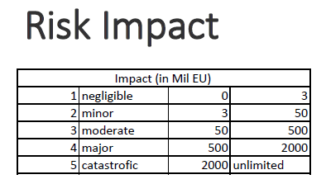
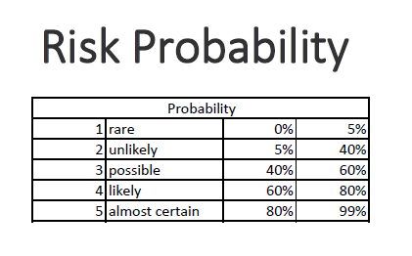
Risk evaluation
Qualitative method

Slide 42
Risk evaluation
Basic Criteria
Risk evaluation criteria
Impact criteria
Risk acceptance criteria
These criteria are specific to a given organization/system, to a given study, etc
The scope and boundaries

Slide 43
Risk evaluation
Depends on
The strategic value of the business information process
The criticality of the information assets involved
Legal and regulatory requirements, and contractual obligations
Operational and business importance of CIA
Stakeholders expectations and perceptions, and negative consequences for goodwill and reputation
Enables to prioritize risks

Slide 44
Importance of evaluation
Usage of outputs Audits can be prioritized according to risk drop The risk drops express dependency on an internal control(s) effectiveness
Example: Blue risk should be audited, Orange is not worth it. Drop is a difference between an Inherent (blue) and a residual (orange) risk and A black (acceptable)
Risk Matrix
 | Probability
Impact |  | 1 | 2 | 3 | 4 | 5
 | 5
 | 4 |  |  |  | inhe | rent
 | 3 |  | re | sidual
 | 2
 | 1 | acceptab | le

Slide 45
Value of risk
It is necessary to identify the threats that organization is facing, then
calculate out both the likelihood of these threats being realized, and their possible impact.
One way of calculate how estimate level of impact is to multiply calculated risk (see appropriate matrix) with the amount a value of asset
This gives you a value for the risk:
Risk Value = Probability of Event x Cost of Event

Slide 46
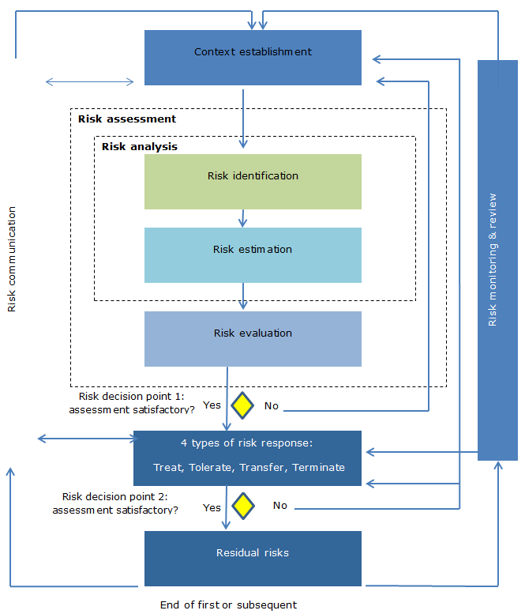
ISO 27005 process
.

Slide 47
Risk treatment
Residual risk management
Once you find out what residual risks are, what do you do with them? Basically, you have these three options:
If the level of risks is below the acceptable level of risk, then you do nothing – the management needs to formally accept those risks.
If the level of risks is above the acceptable level of risk, then you need to find out some new (and better) ways to mitigate those risks – that also means you’ll need to reassess the residual risks.
If the level of risks is above the acceptable level of risk, and the costs of decreasing such risks would be higher than the impact itself, than you need to propose to the management to accept these high risks.
47

Slide 48
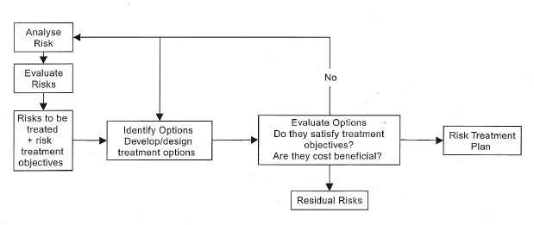
Risk treatment
The risk treatment process and the iterative nature of the development of treatment
action plans

Slide 49
Risk treatment
Risk evaluation provides a list of risks requiring treatment, often with defined ratings or priorities.
Risk treatment involves identifying a range of options for treating these risks, evaluating those options, preparing treatment plans and implementing them.
The design of risk treatment measures should be based on a comprehensive analysis of the risks concerned and from an appropriate level of risks.

Slide 50
Principle
In general terms
A common approach is to divide risks into three bands:
An upper area where adverse risks are intolerable whatever benefits the activity may bring, and risk reduction measures are essential whatever their cost.
A middle area where costs and benefits, are taken into account and opportunities balanced against potential adverse consequences.
A lower area where positive or negative risks are negligible, or so small that no risk treatment measures are needed.

Slide 51
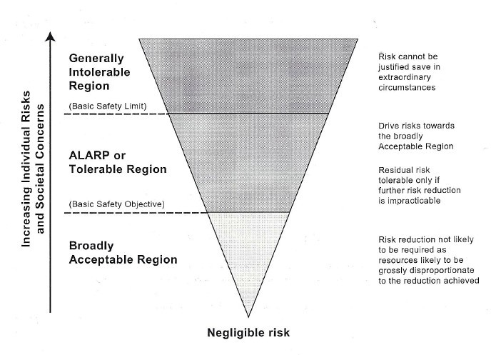
Evaluation principle
.

Slide 52
Definition
Mitigating factors
Actions and controls that are taken to reduce the probability of occurrence and / or the potential impact of the event

Slide 53
Risk treatment
Possible options for risk treatment include:
➢
➢
applying appropriate controls to reduce the risks;
knowingly and objectively accepting risks, providing they clearly satisfy the organization's policy and criteria for risk acceptance;
avoiding risks by not allowing actions that would cause the risks to occur;
➢
➢
transferring the associated risks to other parties,

Slide 54
Risk management process
End of theory

Slide 55
Risk management process
Practice
Basic description of the aktivity
we will continue the solution (started in lecture block 2) in the task of risk managemet for:
Small Company, Ltd. as was founded in 2000 to provide comprehensive services in the field of security technologies
Customers – eGovernment
Employees- 50 employees work in the organization (main branch of the organization + two branches). All employees work with at least one type of information system in the organization. (Three types)
•
•
Information system serves to solve human resources, accounting and wage records. information system is used for production control, capacity planning and maintenance
information system is used for project management, managerial evaluation and customer contact
•
•
•
the company is located in a separate building

